Slide 1
DRS using external cohorts
Martijn Schuemie
&
Yuchen (Mimi) Guo

Slide 2
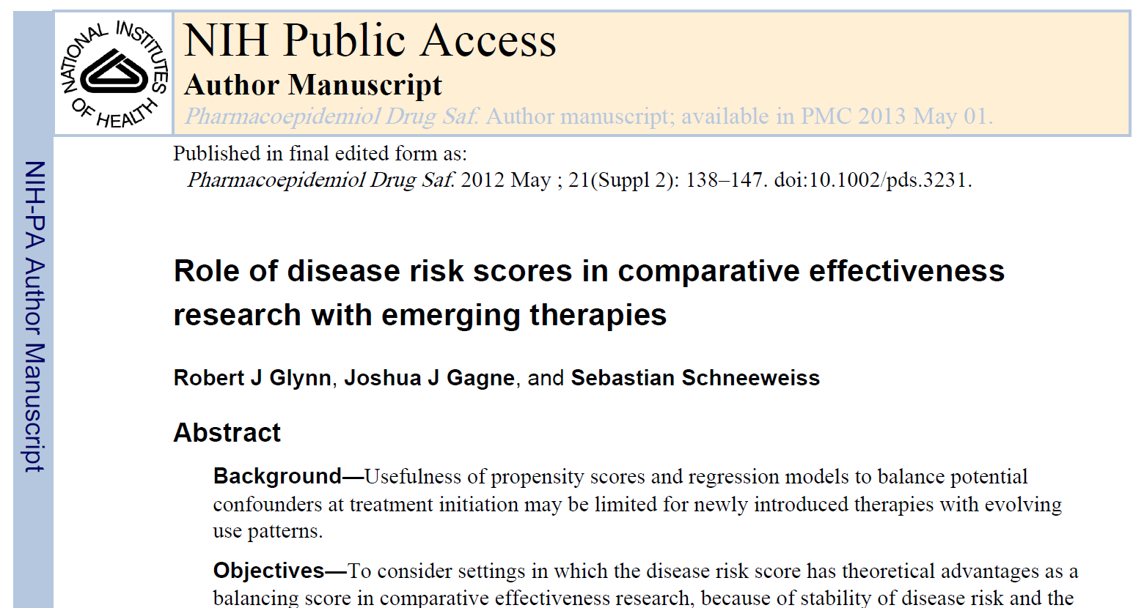
Disease Risk Scores
Alternative to propensity scores
Recommended for emerging therapies, when propensity models cannot be fit or are expected to change rapidly over time due to changing prescriber behavior

Slide 3
Disease Risk Scores
New-user cohort design comparing a target treatment to a comparator treatment for an outcome of interest
Create a model that, using baseline covariates, predicts the outcome (the ‘disease risk model’)
Fit inside comparator cohort
Fit across target and comparator cohort (careful with the exposure!)
Fit in an external population
Use model to generate disease risk score (DRS) for those in the target and comparator cohort
Match / stratify analysis by DRS

Slide 4
COVID-19 Use Case
COVID-19 Hospitalizations
Influenza Hospitalizations
Treatment A
Outcome
Outcome
Treatment B
Disease Risk
Model
Not enough people to fit a reliable propensity model!
Fit disease risk model in external population, apply to COVID-19 exposure cohorts

Slide 5
Simulations

Slide 6
Real-World Evaluation Setup
Exposure: Diclofenac new users with prior diagnosis of arthralgia
Comparator: Celecoxib new users with prior diagnosis of arthralgia
Outcome of interest: GI Bleed
Negative controls
Cohort for training DRS: People with diagnosis of arthralgia

Slide 7
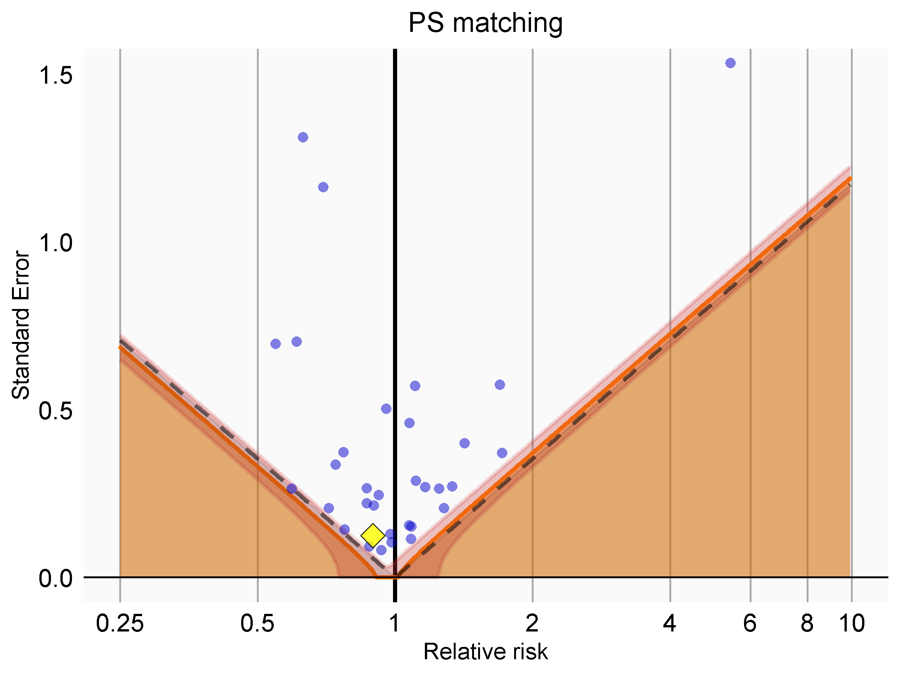
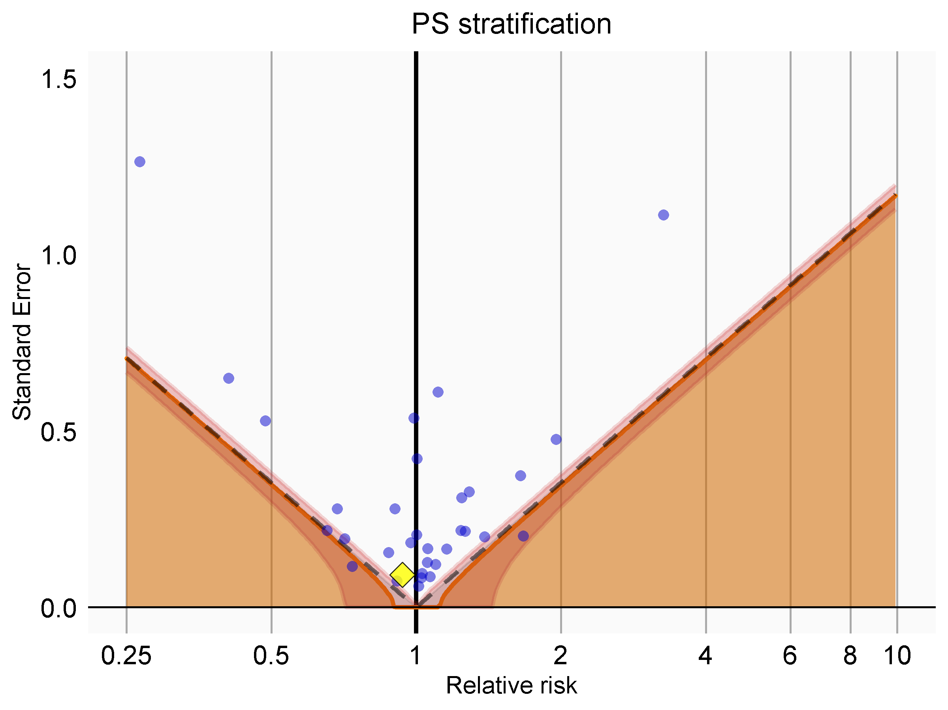
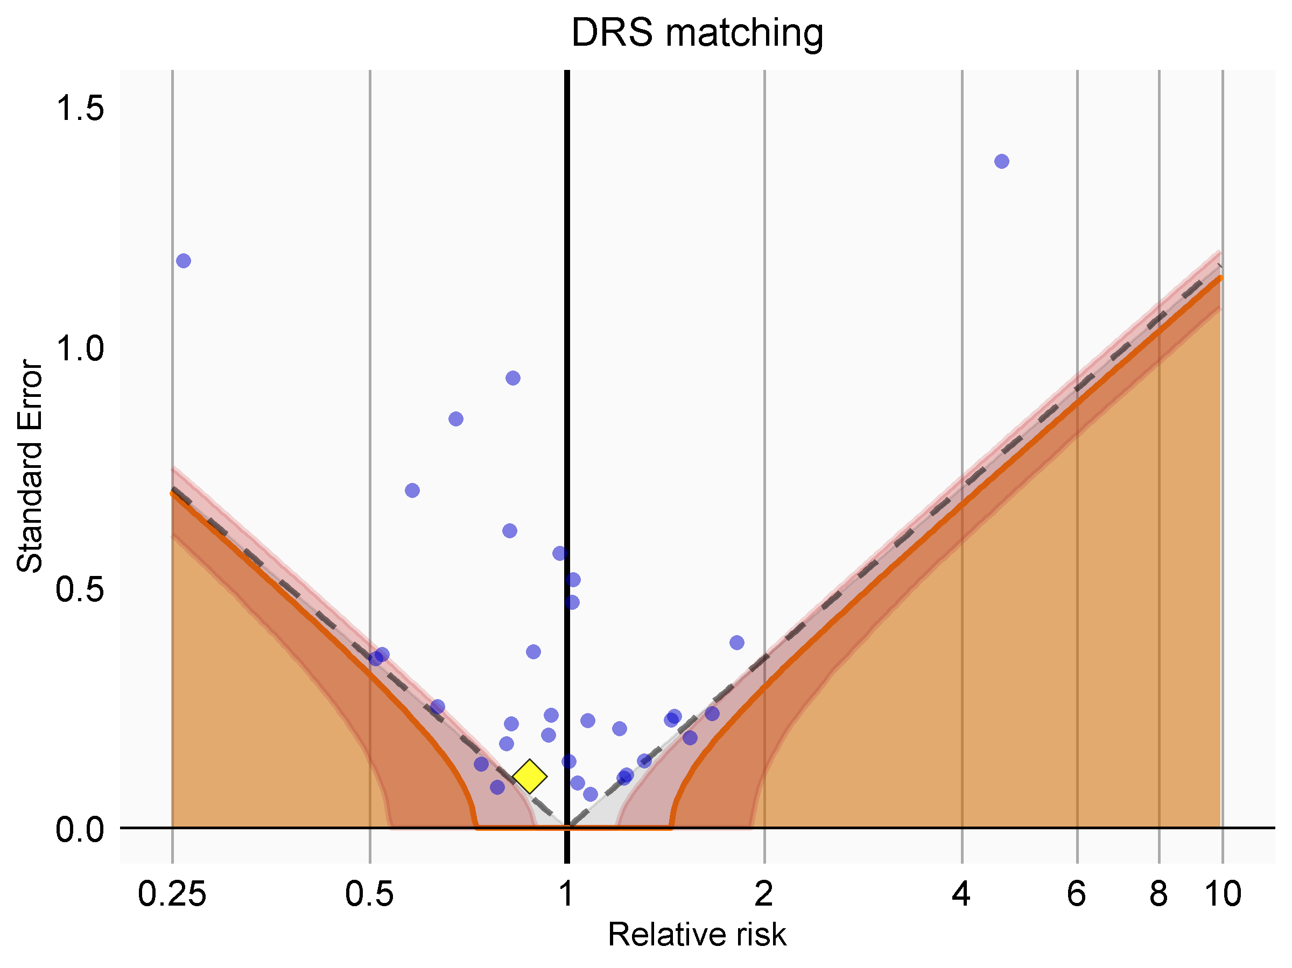
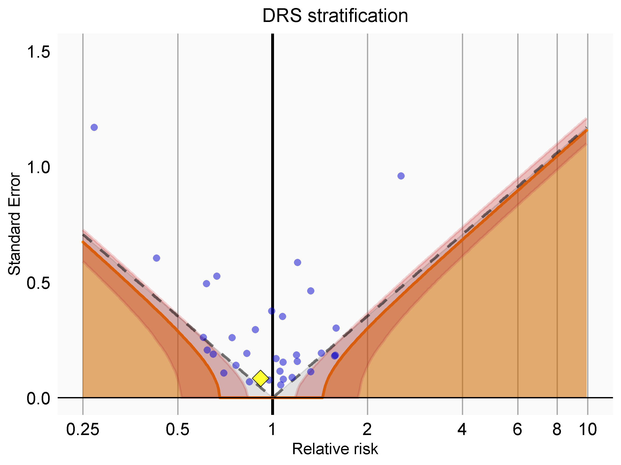
Bias plots

Slide 8
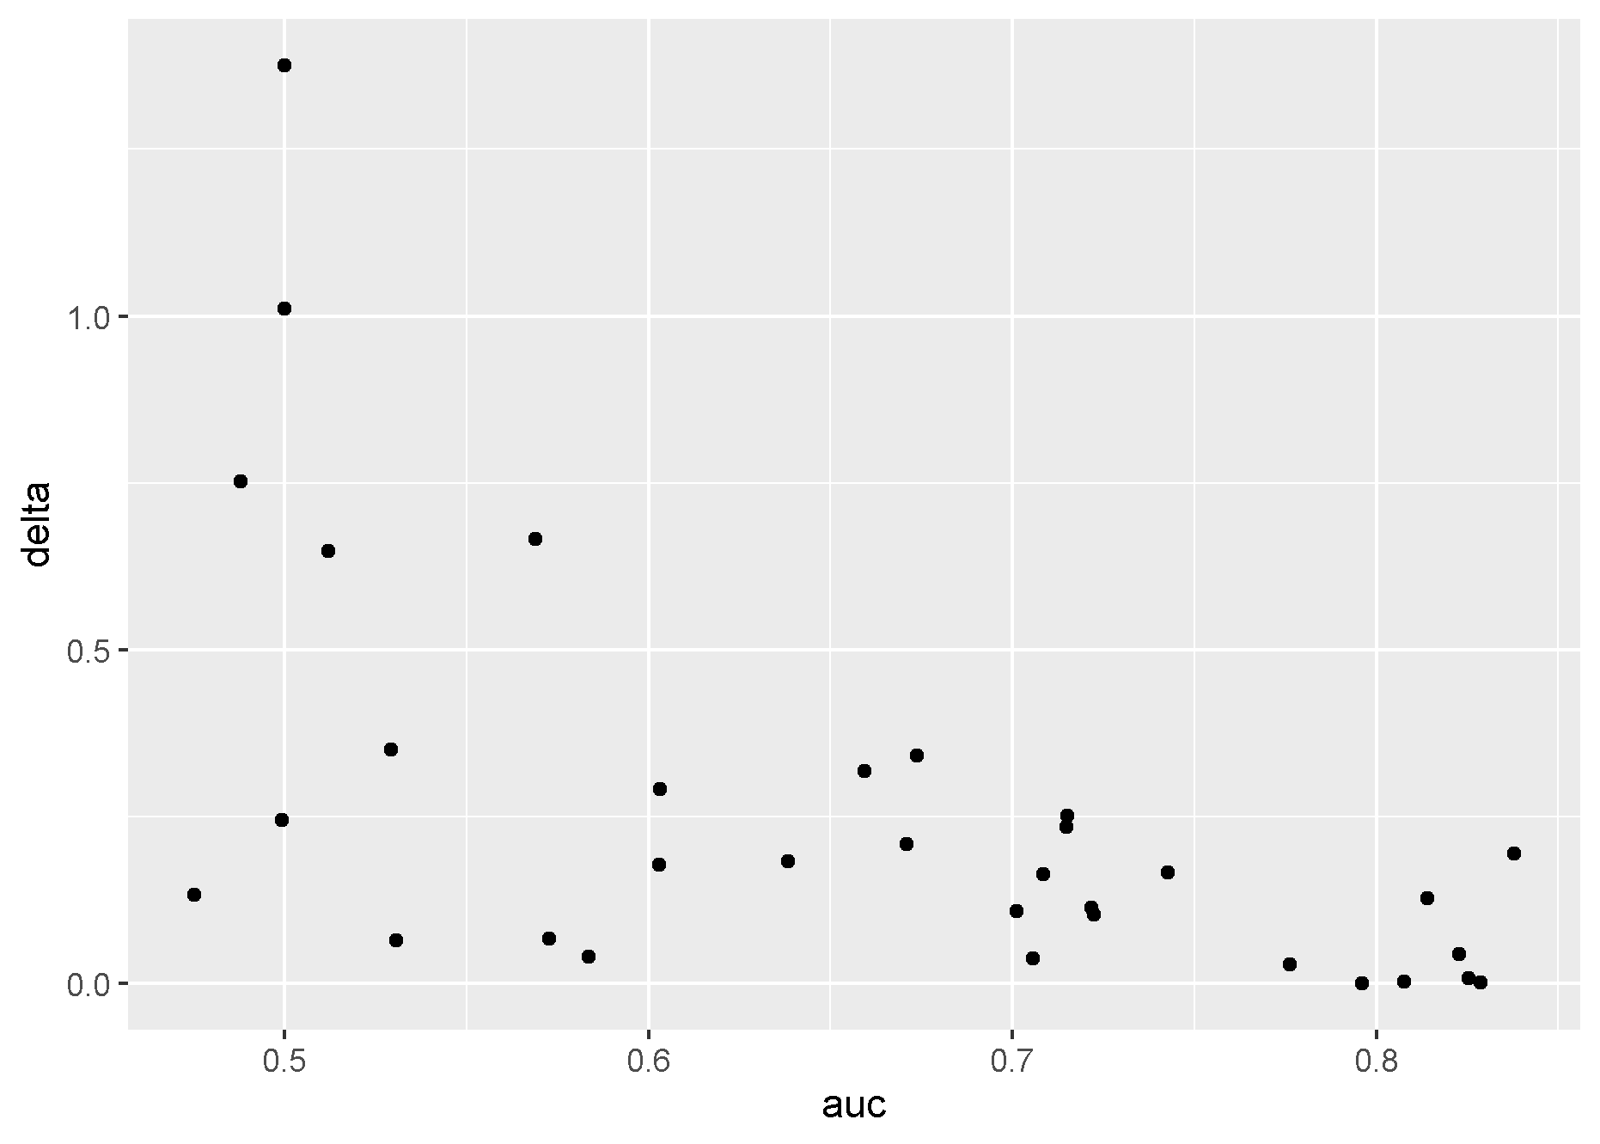
Exploring why
zScore = log(HR) / SE(log(HR))
Delta = abs(log(HR_{PS matching}) – log(HR_{DRS stratification}))

Slide 9
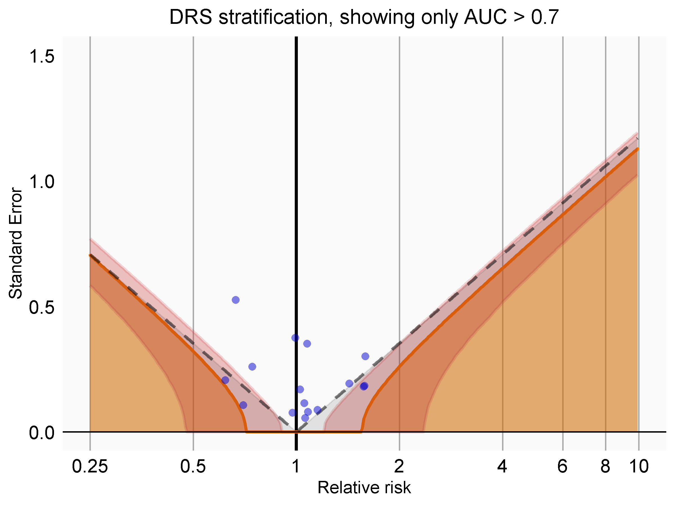
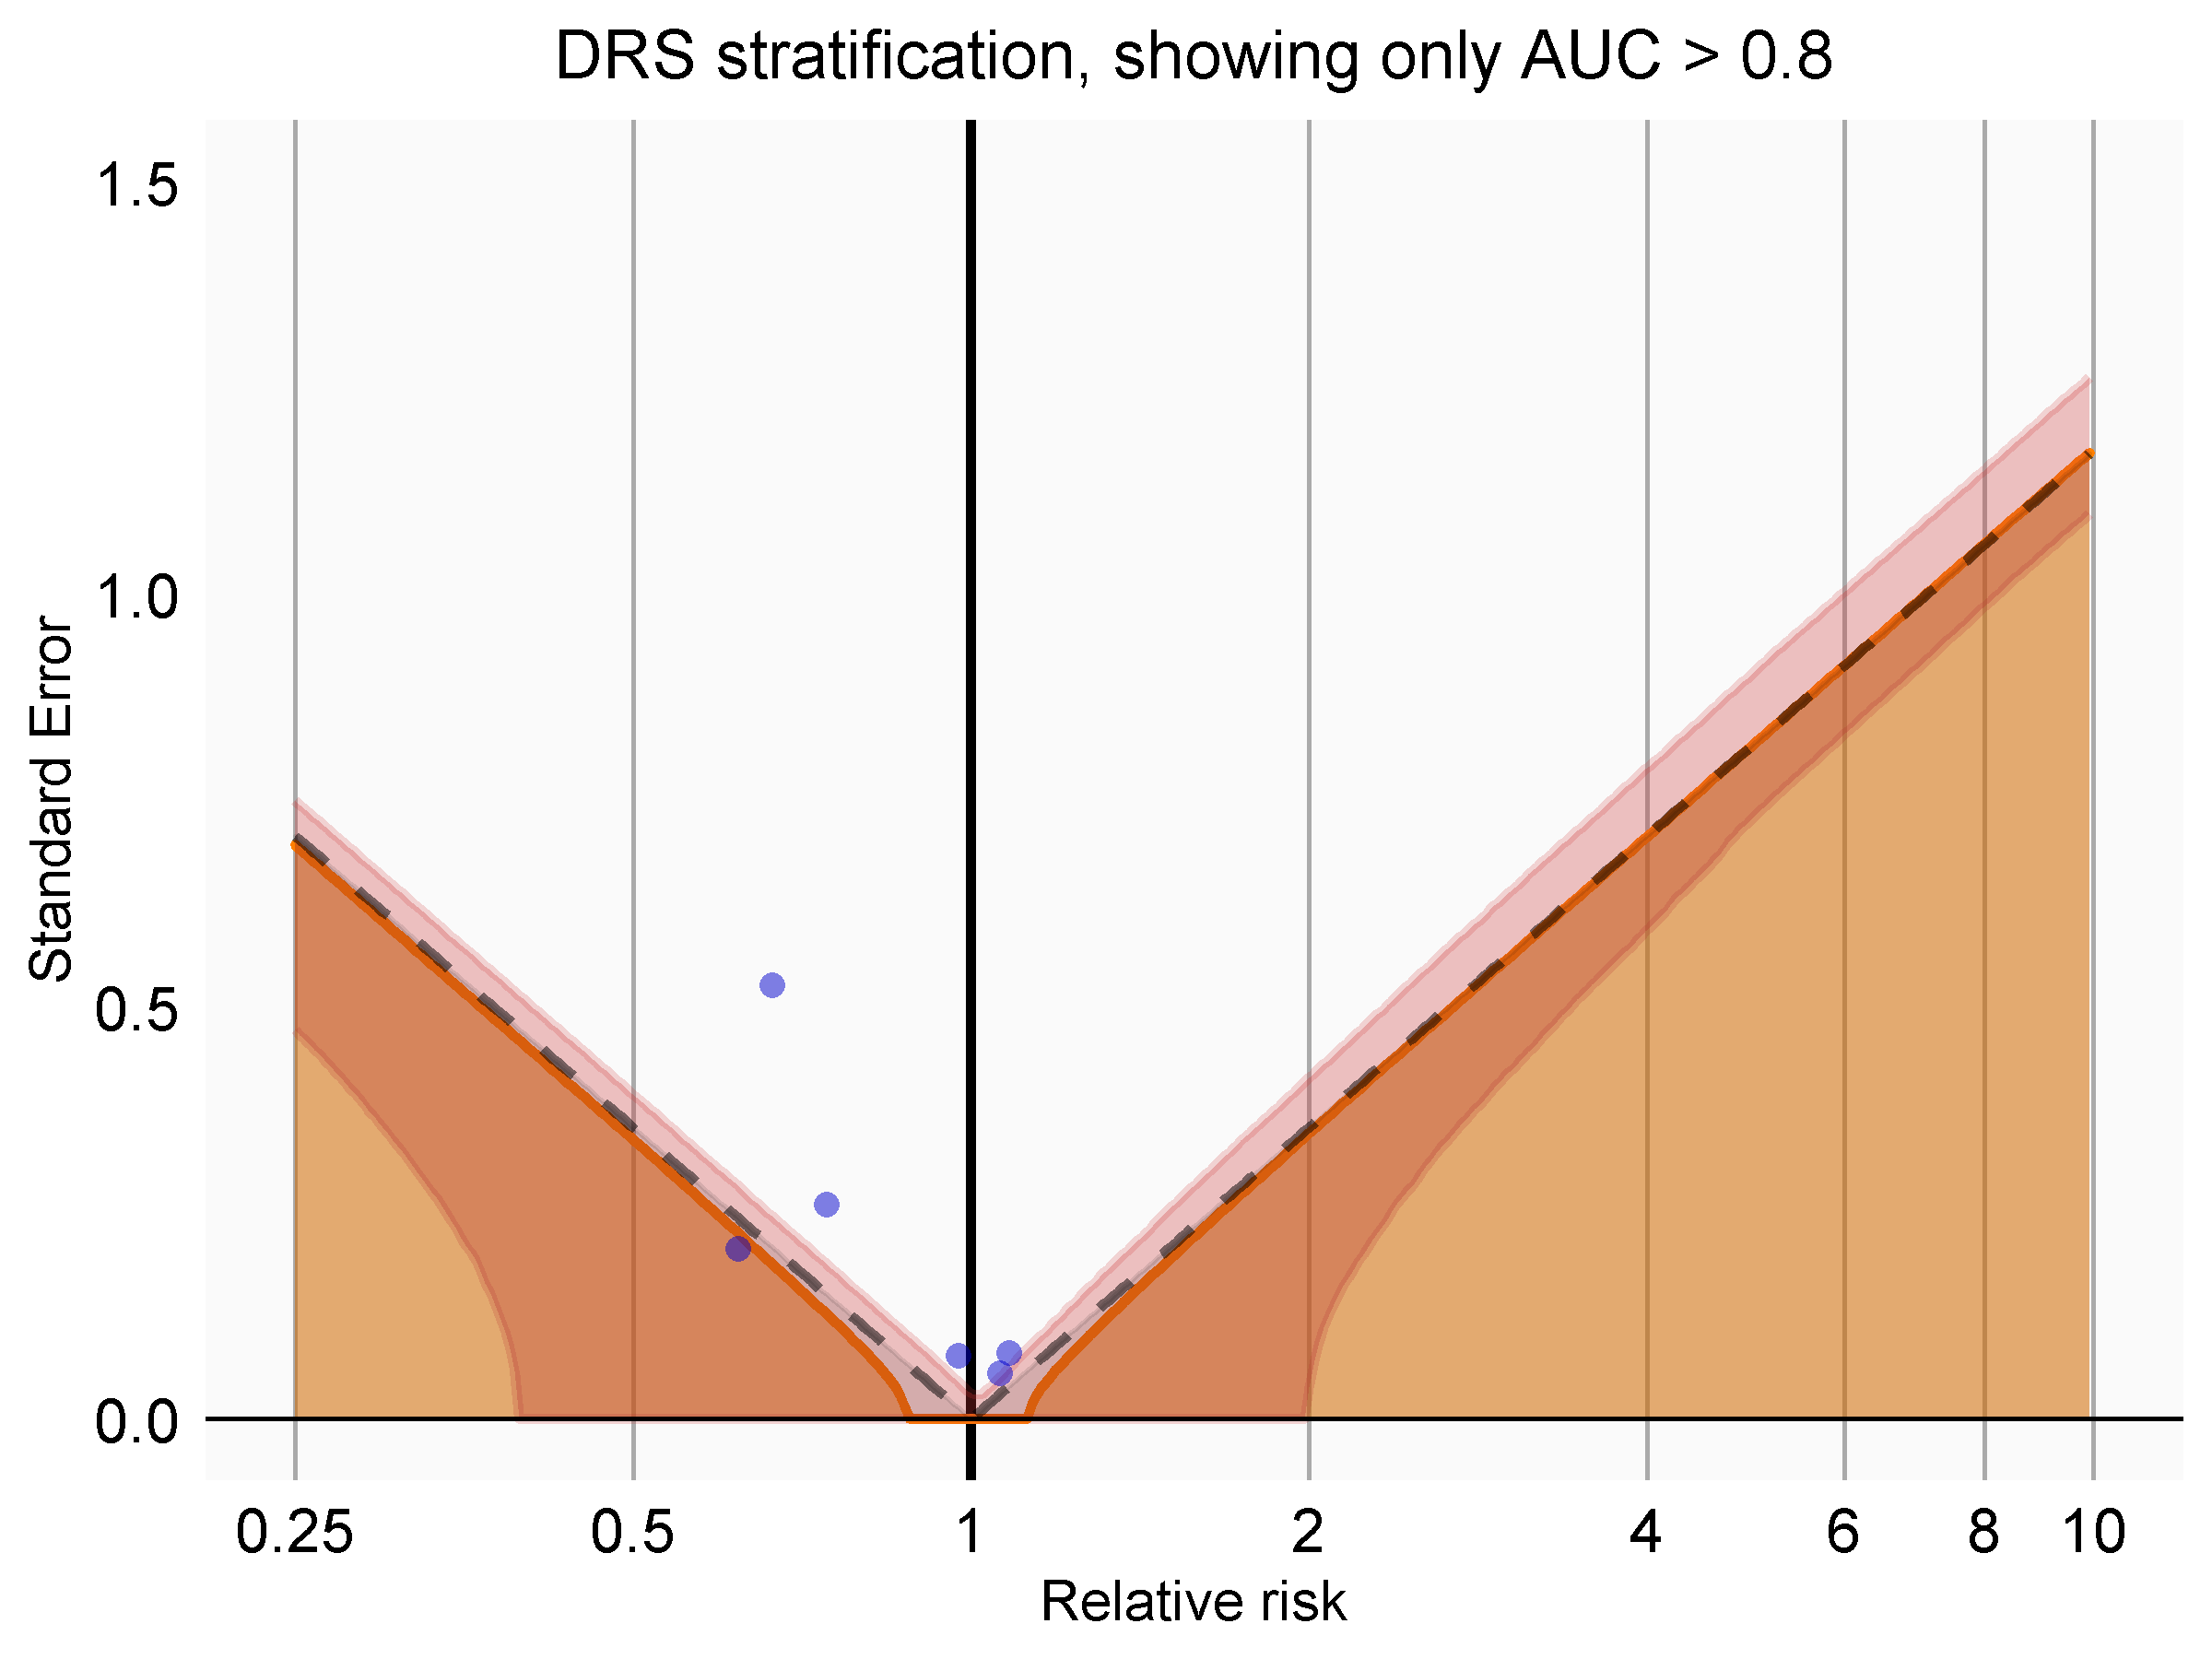
Filtering by AUC

Slide 10
Exploring one negative control

Slide 11
LASSO vs ridge regression
LASSO
Ridge regression

Slide 12
Conclusions
For now, DRS perform worse than PS
May work better than PS when sample size is very low (but still not good)
Simulations agrees DRS not as good as PS, but why?
One reason we don’t see this in reality is poor portability of the disease risk model
We will explore ways to improve portability, and see if this improves DRS performance

