Slide 1
Software validity and meeting (future) regulatory requirements
Martijn Schuemie

Slide 2
Tenacious urban myth
“Studies for the FDA need to be performed using SAS because SAS is validated”

Slide 3
Validity
validation. (1) (FDA) Establishing documented evidence which provides a high degree of assurance that a specific process will consistently produce a product meeting its predetermined specifications and quality attributes.
In other words: does your analysis do what it is supposed to do?
Should journal editors, doctors, and patients not also care about validity?
Glossary Of Computerized System and Software Development Terminology:
https://www.fda.gov/iceci/inspections/inspectionguides/ucm074875.htm

Slide 4
Validity
validation. (1) (FDA) Establishing documented evidence which provides a high degree of assurance that a specific process will consistently produce a product meeting its predetermined specifications and quality attributes.
Glossary Of Computerized System and Software Development Terminology:
https://www.fda.gov/iceci/inspections/inspectionguides/ucm074875.htm

Slide 5
Traditional view of validity
Scientist
Specifications
Validity
Programmer / statistician
Analysis process

Slide 6
Traditional view of validity
Scientist
Protocol
Validity
Programmer / statistician
Analysis process

Slide 7
Traditional view of validity
Scientist
Protocol
Validity
Programmer / statistician
Analysis Program
Previous presentation: a study should be like a pipeline from data to tables & figures

Slide 8
Traditional view of validity
Scientist
Issues with this view:
Specifications are often ambiguous
Non-ambiguous specifications = Program
This is often not how (scientific) software is developed (e.g. where are the specifications for R?)
Protocol
Validity
Programmer / statistician
Analysis Program

Slide 9
OHDSI approach (ATLAS)
Protocol
Validity
Automatic generation of human-readable description
Cohort definition
Scientist

Slide 10
OHDSI approach (Method Library)
Protocol
Validity
Automatic generation of human-readable description
Analyses specification
Scientist
Example specifications:
http://www.ohdsi.org/web/atlas/#/estimation/153086

Slide 11
Assembling building blocks
Designing a study = putting together building blocks
The configuration of blocks can be presented in human readable form
Raises two new validity questions:
Are the blocks valid?
Is the assembly valid?

Slide 12
Validity of the building blocks

Slide 13
OHDSI Methods Library
Cohort Method
Self-Controlled Case Series
Self-Controlled Cohort
IC Temporal Pattern Disc.
s
s
s
s
New-user cohort studies using large-scale regression for propensity and outcome models
Self-Controlled Case Series analysis using few or many predictors, includes splines for age and seasonality.
A self-controlled cohort design, where time preceding exposure is used as control.
A self-controlled design, but using temporal patterns around other exposures and outcomes to correct for time-varying confounding.
Estimation methods
Case-control
s
Case-crossover
s
Case-control studies, matching controls on age, gender, provider, and visit date. Allows nesting of the study in another cohort.
Case-crossover design including the option to adjust for time-trends in exposures (so-called case-time-control).
Empirical Calibration
Method Evaluation
s
s
Use negative control exposure-outcome pairs to profile and calibrate a particular analysis design.
Use real data and established reference sets as well as simulations injected in real data to evaluate the performance of methods.
Method characterization
Database Connector
Sql Render
Cyclops
Feature Extraction
s
s
s
s
Connect directly to a wide range of database platforms, including SQL Server, Oracle, and PostgreSQL.
Generate SQL on the fly for the various SQL dialects.
Highly efficient implementation of regularized logistic, Poisson and Cox regression.
Automatically extract large sets of features for user-specified cohorts using data in the CDM.
Supporting packages
Ohdsi R Tools
s
Support tools that didn’t fit other categories, including tools for maintaining R libraries.

Slide 14
Validity of the Methods Library
Scientists
Functions
Tests
Docu-mentation
Validity

Slide 15
Example: matchOnPs
Function in CohortMethod
Performs (variable ratio) propensity score matching
Has
Implementation
Documentation
Unit tests

Slide 16
Example: matchOnPs
matchOnPs <- function(population,
caliper = 0.2,
caliperScale = "standardized logit",
maxRatio = 1,
stratificationColumns = c()) {
if (!("rowId" %in% colnames(population)))
stop("Missing column rowId in population")
if (!("treatment" %in% colnames(population)))
stop("Missing column treatment in population")
if (!("propensityScore" %in% colnames(population)))
stop("Missing column propensityScore in population")
if (caliperScale != "standardized" && caliperScale != "propensity score" && caliperScale != "standardized logit")
stop(paste("Unknown caliperScale '",
caliperScale,
"', please choose either 'standardized', 'propensity score', or 'standardized logit'"), sep = "")
population <- population[order(population$propensityScore), ]
propensityScore <- population$propensityScore
if (caliper <= 0 || min(population$propensityScore) == max(population$propensityScore)) {
caliper <- 9999
} else if (caliperScale == "standardized") {
caliper <- caliper * sd(population$propensityScore)
} else if (caliperScale == "standardized logit"){
propensityScore <- logit(propensityScore)
caliper <- caliper * sd(propensityScore)
}
if (maxRatio == 0) {
maxRatio <- 999
}
if (length(stratificationColumns) == 0) {
result <- .Call("CohortMethod_matchOnPs",
PACKAGE = "CohortMethod",
propensityScore,
population$treatment,
maxRatio,
caliper)
population$stratumId <- result$stratumId
population <- population[population$stratumId != -1, ]
if (!is.null(attr(population, "metaData"))) {
attr(population, "metaData")$attrition <- rbind(attr(population, "metaData")$attrition,
getCounts(population, paste("Matched on propensity score")))
}
return(population)
} else {
f <- function(subset, maxRatio, caliper) {
subResult <- .Call("CohortMethod_matchOnPs",
PACKAGE = "CohortMethod",
subset$propensityScore,
subset$treatment,
maxRatio,
caliper)
subset$stratumId <- subResult$stratumId
subset <- subset[subset$stratumId != -1, ]
return(subset)
}
results <- plyr::dlply(.data = population,
.variables = stratificationColumns,
.drop = TRUE,
.fun = f,
maxRatio = maxRatio,
caliper = caliper)
maxStratumId <- 0
for (i in 1:length(results)) {
if (nrow(results[[i]]) > 0) {
if (maxStratumId != 0)
results[[i]]$stratumId <- results[[i]]$stratumId + maxStratumId + 1
maxStratumId <- max(results[[i]]$stratumId)
}
}
result <- do.call(rbind, results)
if (!is.null(attr(result, "metaData"))) {
attr(result, "metaData")$attrition <- rbind(attr(result, "metaData")$attrition,
getCounts(result, paste("Trimmed to equipoise")))
}
return(result)
}
}
Program code is unambiguous and human-readable if the human knows R and C++.

Slide 17
Example: matchOnPs
standardized logit
matchOnPs {CohortMethod} | R Documentation
Match persons by propensity score
Description
matchOnPs uses the provided propensity scores to match treated to comparator persons.
Usage
matchOnPs(population, caliper = 0.2, caliperScale = "standardized logit", maxRatio = 1, stratificationColumns = c())
Arguments
Details
The data frame should have at least the following three columns:
This function implements the greedy variable-ratio matching algorithm described in Rassen et al (2012).
The default caliper (0.2 on the standardized logit scale) is the one recommended by Austin (2011).
Value
Returns a date frame with the same columns as the input data plus one extra column: stratumId. Any rows that could not be matched are removed
References
Rassen JA, Shelat AA, Myers J, Glynn RJ, Rothman KJ, Schneeweiss S. (2012) One-to-many propensity score matching in cohort studies, Pharmacoepidemiology and Drug Safety, May, 21 Suppl 2:69-80.
Austin, PC. (2011) Optimal caliper widths for propensity-score matching when estimating differences in means and differences in proportions in observational studies, Pharmaceutical statistics, March, 10(2):150-161.
Examples
rowId <- 1:5
treatment <- c(1, 0, 1, 0, 1)
propensityScore <- c(0, 0.1, 0.3, 0.4, 1)
age_group <- c(1, 1, 1, 1, 1)
d <- data.frame(rowId = rowId, treatment = treatment, propensityScore = propensityScore, age_group = age_group)
result <- matchOnPs(d, caliper = 0, maxRatio = 1, stratificationColumns = "age_group")
population | A data frame with the three columns described below.
caliper | The caliper for matching. A caliper is the distance which is acceptable for any match. Observations which are outside of the caliper are dropped. A caliper of 0 means no caliper is used.
caliperScale | The scale on which the caliper is defined. Three scales are supported: caliperScale = 'propensity score', caliperScale = 'standardized', or caliperScale = 'standardized logit'. On the standardized scale, the caliper is interpreted in standard deviations of the propensity score distribution. 'standardized logit' is similar, except that the propensity score is transformed to the logit scale because the PS is more likely to be normally distributed on that scale (Austin, 2011).
maxRatio | The maximum number of persons int the comparator arm to be matched to each person in the treatment arm. A maxRatio of 0 means no maximum: all comparators will be assigned to a treated person.
stratificationColumns | Names or numbers of one or more columns in the data data.frame on which subjects should be stratified prior to matching. No persons will be matched with persons outside of the strata identified by the values in these columns.
Documentation is ambiguous but human-readable
rowId | (numeric) | A unique identifier for each row (e.g. the person ID)
treatment | (integer) | Column indicating whether the person is in the treated (1) or comparator (0) group
propensityScore | (numeric) | Propensity score
Referencing Jeremy’s paper, which is almost completely unambiguous
(I read his Java code to get the final details)

Slide 18
Example: matchOnPs
test_that("Simple 1-on-1 matching", {
rowId <- 1:5
treatment <- c(1, 0, 1, 0, 1)
propensityScore <- c(0, 0.1, 0.3, 0.4, 1)
data <- data.frame(rowId = rowId, treatment = treatment, propensityScore = propensityScore)
result <- matchOnPs(data, caliper = 0, maxRatio = 1)
expect_equal(result$stratumId, c(0, 0, 1, 1))
})
test_that("Simple 1-on-n matching", {
rowId <- 1:8
treatment <- c(0, 1, 0, 0, 0, 0, 1, 0)
propensityScore <- c(0, 0.1, 0.11, 0.12, 0.13, 0.85, 0.9, 1)
data <- data.frame(rowId = rowId, treatment = treatment, propensityScore = propensityScore)
result <- matchOnPs(data, caliper = 0, maxRatio = 100)
expect_equal(result$stratumId, c(1, 0, 0, 0, 0, 1, 1, 1))
})
…
Unit test is unambiguous for specific situations and is pretty human readable

Slide 19
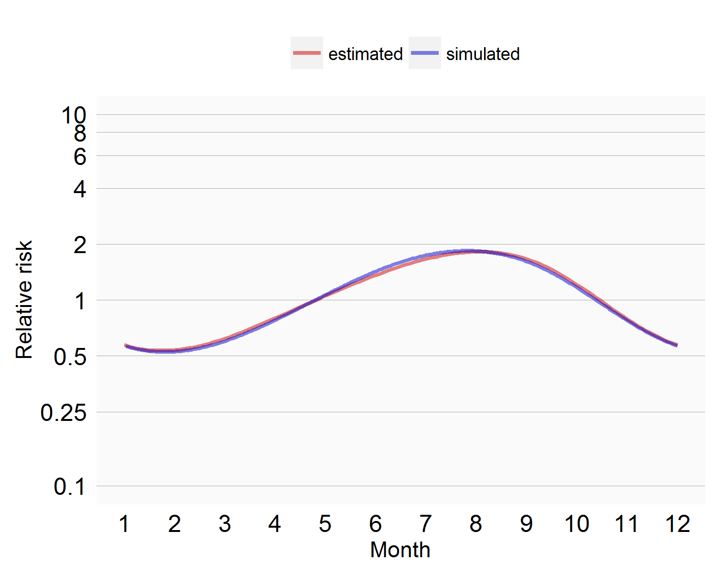
Simulation
Using simulation for more complicated functionality
E.g: SCCS seasonality modeling:

Slide 20
End-to-end verification
Can these building blocks lead to valid estimates?

Slide 21
All aspects of validity of the Methods Library
Verification
Unit tests
Simulations
Method evaluation
Who develops?
OHDSI community
Workgroup leadership reviews and approves all contributions
Open source: anyone can review
How are developments stored?
OHDSI GitHub repos
History of developments
Design decisions are (sometimes) discussed publicly in forums and issue trackers
Full commit history in GitHub is public

Slide 22
Validity of the assembly

Slide 23
Aspects of validity of a study
Verification
Code review by designated QC buddy
Testing study against questions with know answers related to the research question (negative and positive controls)
Who develops?
Should we have some vetting for who can do a study?
Open source: anyone can review
How are developments stored?
OHDSI GitHub repos
History of developments
Design decisions are (sometimes) discussed publicly in forums and issue trackers
Full commit history in GitHub is public

Slide 24
Layers of validity
Study analysis code
Methods Library
R
C++
Java
Fortran
R is ‘validated’, just like SAS:
https://www.r-project.org/doc/R-FDA.pdf
File system
DBMS
Operating system
Hardware

Slide 25
Conclusions
I feel pretty good about the validity of the Methods Library
Drafting a more formal document to support this, will post on forums
What steps to take to feel good about the validity of OHDSI studies?
Other ways to think about validity?

Slide 26
Topic of next meeting(s)?
?

Slide 27
Next workgroup meeting
Western hemisphere: November 9
6pm Central European time
12pm New York
9am Los Angeles / Stanford
Eastern hemisphere: November 1
3pm Hong Kong / Taiwan
4pm South Korea
5:30pm Adelaide
8am Central European time
7am UK time
http://www.ohdsi.org/web/wiki/doku.php?id=projects:workgroups:est-methods

