Slide 1
Observational Health Data Sciences and Informatics (OHDSI)
Natural Language Processing (NLP) Working Group
05/09/2018

Slide 2
AGENDA
Introduction of new members
Presentation – Paris Nichols
Updates on ongoing projects
Rules for defining term_exists – led by Stephane Meystre
Mapping of CUIs to standard terminology – Juan Banda
Mapping of Note Types to LOINC/standard vocabulary –Karthik Natarajan, Ruth Reeves, Jon Duke and Hua Xu– Report type list discussion
Landscape Analysis of section identifier systems and proposal of a standard terminology for use – Hua Xu, Karthik Natarajan
Examples and rules for term_temporal – led by George Hripsack (Sunny)
Standardization of term_modifiers and values – Hua Xu

Slide 3
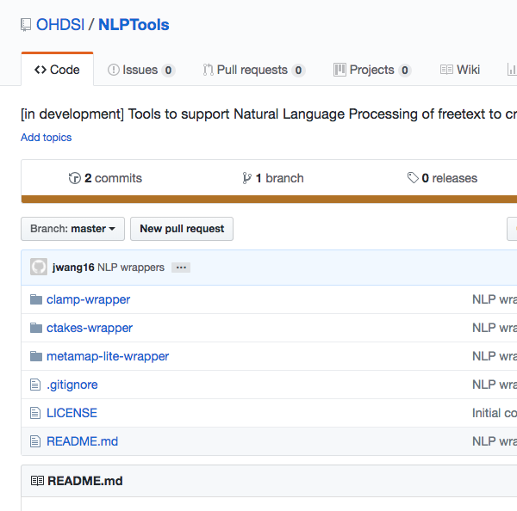
NLP Wrappers - CLAMP / cTAKES / Metamap Lite
https://github.com/OHDSI/NLPTools
Clone source code
Import existing project to Eclipse
Download dependencies
Setup UMLS account
Apply CLAMP Command line license
Ongoing
Mappings from CUI to standard concept id
Normalization of modifiers
…

