Slide 1
Method evaluation
Martijn Schuemie, PhD
Janssen Research and Development

Slide 2
Method Evaluation Task Force
Objectives:
Develop the methodology for evaluating methods
Use the developed methodology to systematically evaluate a large set of study designs and design choices

Slide 3
Task force members
Alejandro Schuler | Mike Goodman
Anthony Sena | Nicole Pratt
Brian Saur | Niham Shah
Chan YouSeng | Patrick Ryan
David Madigan | Peter Rijnbeek
Eldar Allakhverdiiev | Rae Woong Park
George Hripcsak | Sara Dempster
Jamie Weaver | Teng Liaw
Marc Suchard | Vojtech Huser
Martijn Schuemie | Yuxi Tian

Slide 4
Getting philosophical
Suitability of a method
In general?
For a specific clinical question?
bench·mark
ˈben(t)SHmärk/
usually bench mark : a mark on a permanent object (as a concrete post set into the ground) indicating elevation and serving as a reference in topographic surveys and tidal observations
a : a point of reference from which measurements may be made
b : something that serves as a standard by which others may be measured or judged . a stock whose performance is a benchmark against which other stocks can be measured
c : a standardized problem or test that serves as a basis for evaluation or comparison (as of computer system performance)

Slide 5
Method Evaluation Task Force
Objectives:
Develop the methodology for evaluating methods
Use the developed methodology to systematically evaluate a large set of study designs and design choices

Slide 6
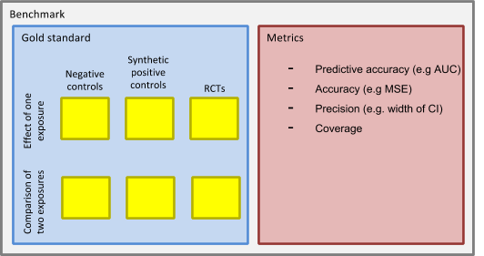
OHDSI Methods Benchmark

Slide 7
OHDSI Methods Benchmark
Two types of tasks:
Estimate effect of one exposure
Case-control
SCCS
Case-crossover
Cohort study when comparator is non-active
Comparison of two exposures
Cohort study
Comparative SCCS

Slide 8
OHDSI Methods Benchmark
Three types of data sets:
Real negative controls
Synthetic positive controls
RCTs

Slide 9
Negative control evaluation
Are negative controls truly and exactly negative (RR = 1)?

Slide 10
Negative control evaluation
Select trials from clinicaltrials.gov that are
Randomized
Placebo-controlled
Report number of (potential adverse) events
Apply criteria for negative controls to intervention-event pairs
Compute odds ratios for negative controls

Slide 11
RCT estimates for negative controls

Slide 12
Generating negative controls
Select exposures of interest
(Select comparators)
Use LAERTES to select all possible negative control outcomes
Well-known outcome
Not associated with outcome in literature, labels, and spontaneous reports
Sufficiently prevalent
How to pick exposures (and comparators)?
Chronic vs intermittent use
Strongly confounded vs clean

Slide 13
Injecting outcomes on negative controls
Patient 1
Target
Patient 2
Comparator
Patient 3
Target
Patient 4
Comparator
Patient 5
Target
Patient 6
Comparator
New RR = 2 (but with same observed confounding)
Ingrowing nail
Injected ingrowing nail
Predictive model of outcome indicates this is a high-risk patient

Slide 14
Synthesizing positive controls
Take negative controls
Choose effect to inject
Risk window
Effect model (e.g. Poisson, Survival, …)
Effect size
Inject effect
How to pick effect model?
Hazard curve?
Heterogeneity?

Slide 15
Implementing RCTs
Select RCTs
Identify target, comparator, outcome
Implement inclusion criteria against CDM
How to pick RCTs?
Large trials only, so the result of the trial has some accuracy which is nice in a gold standard
Recent trials, so we can restrict our observational data to time prior to when the results of the trial were known
Only trials of drugs that were already on the market at the time of the trial, so we actually have observational data prior to the trial
Trials with inclusion/exclusion criteria we can also apply to our replication.

Slide 16
Metrics
Predictive accuracy (AUC)
Accuracy (MSE)
Precision (e.g. width of confidence interval)
Coverage
Other metrics?
Before and after confidence interval calibration?

Slide 17
Benchmark tasks
Identify exposures of interest and negative controls
Decide approach to positive control synthesis
Identify RCTs and implement inclusion criteria
Develop evaluation metrics

Slide 18
Next workgroup meeting
Eastern hemisphere: April 19
3pm Hong Kong / Taiwan
4pm South Korea
4:30pm Adelaide
9am Central European time
8am UK time
Western hemisphere: April 13
6pm Central European time
12pm New York
9am Los Angeles / Stanford
http://www.ohdsi.org/web/wiki/doku.php?id=projects:workgroups:est-methods

