Slide 1
Population level estimation workgroup
Martijn Schuemie
Marc Suchard

Slide 2
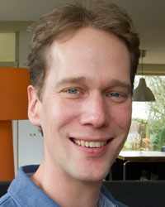
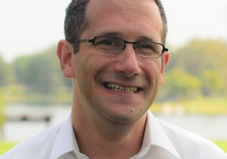
Your workgroup leaders
Martijn Schuemie
Marc Suchard

Slide 3
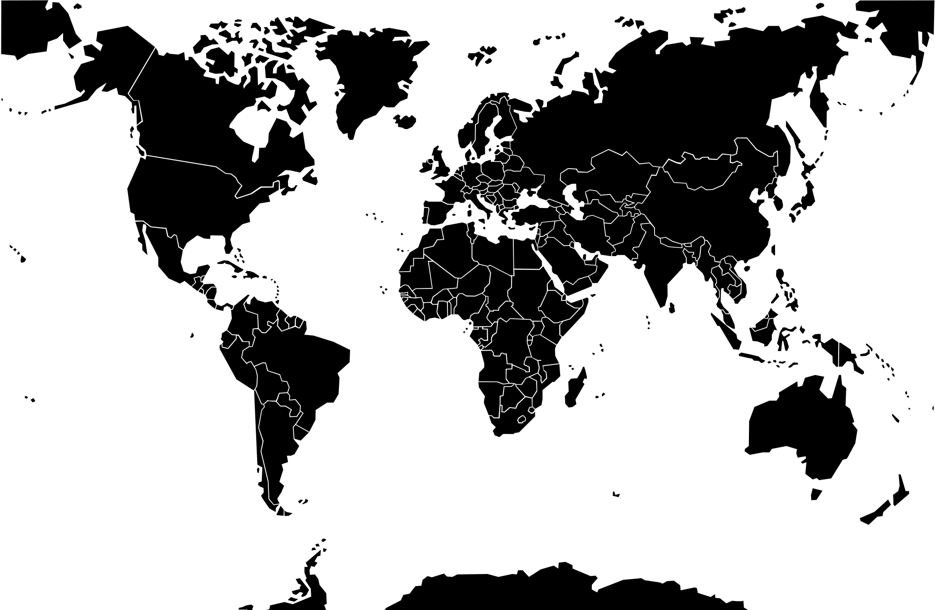
Workgroup meetings
Western hemisphere
Eastern hemisphere

Slide 4
Methods
“The real purpose of the scientific method is to make sure nature hasn’t misled you into thinking you know something you actually don’t know.”
Robert Pirsig, Zen and the Art of Motorcycle Maintenance

Slide 5
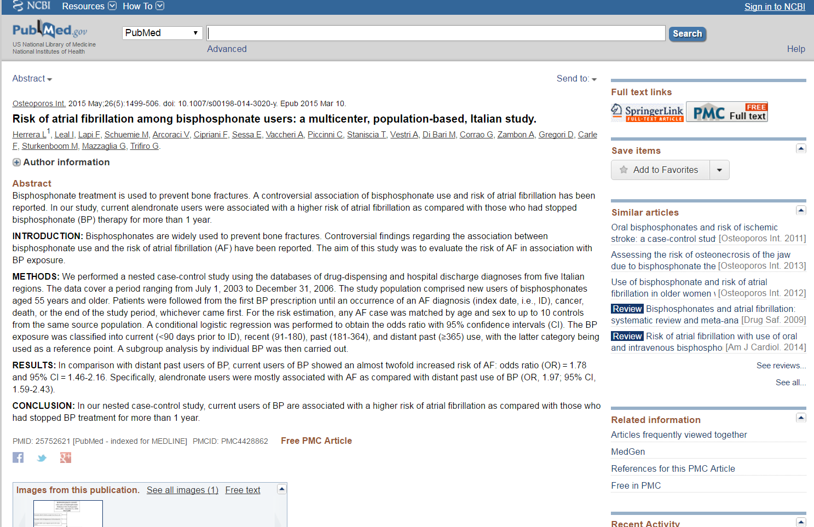
What do we think we know?

Slide 6
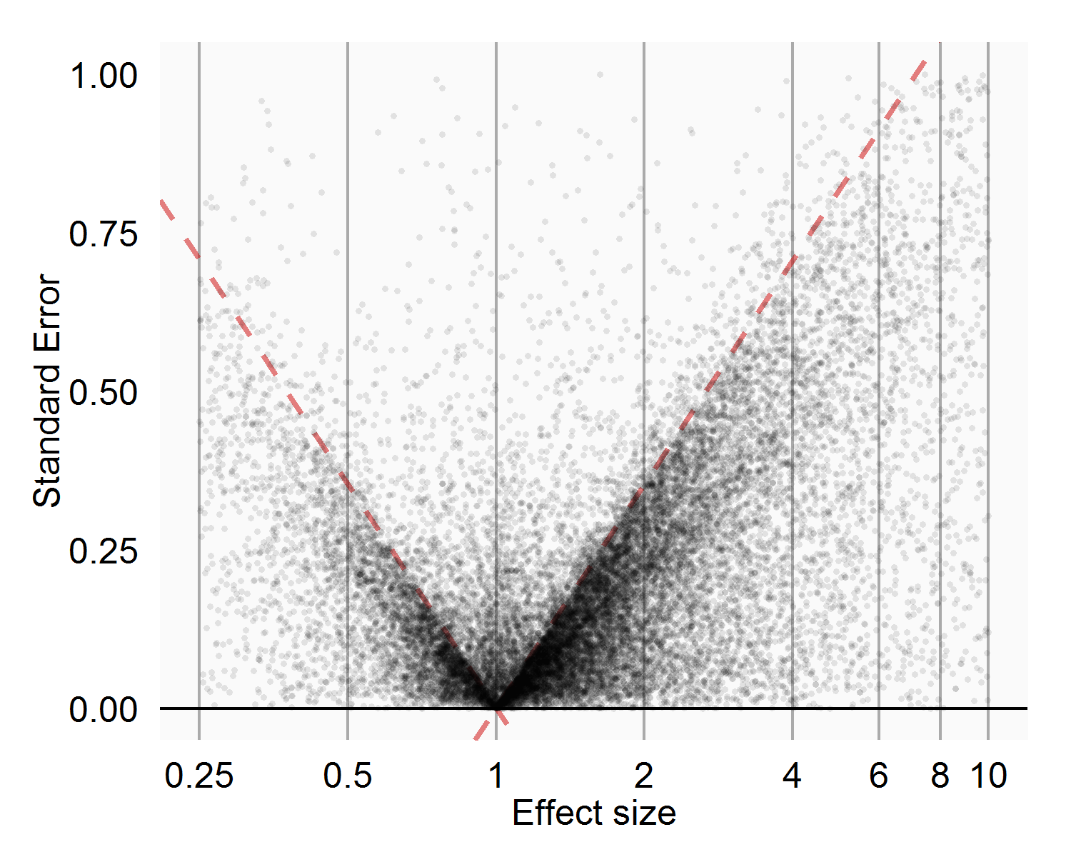
What do we think we know?
Observational studies in MEDLINE
83% of exposure-outcome pairs have p < .05
23,138 estimates
9,214 papers

Slide 7
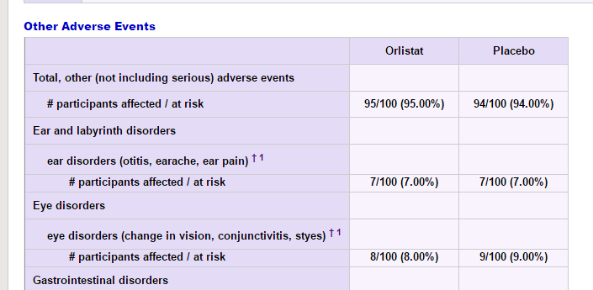
True effect sizes

Slide 8
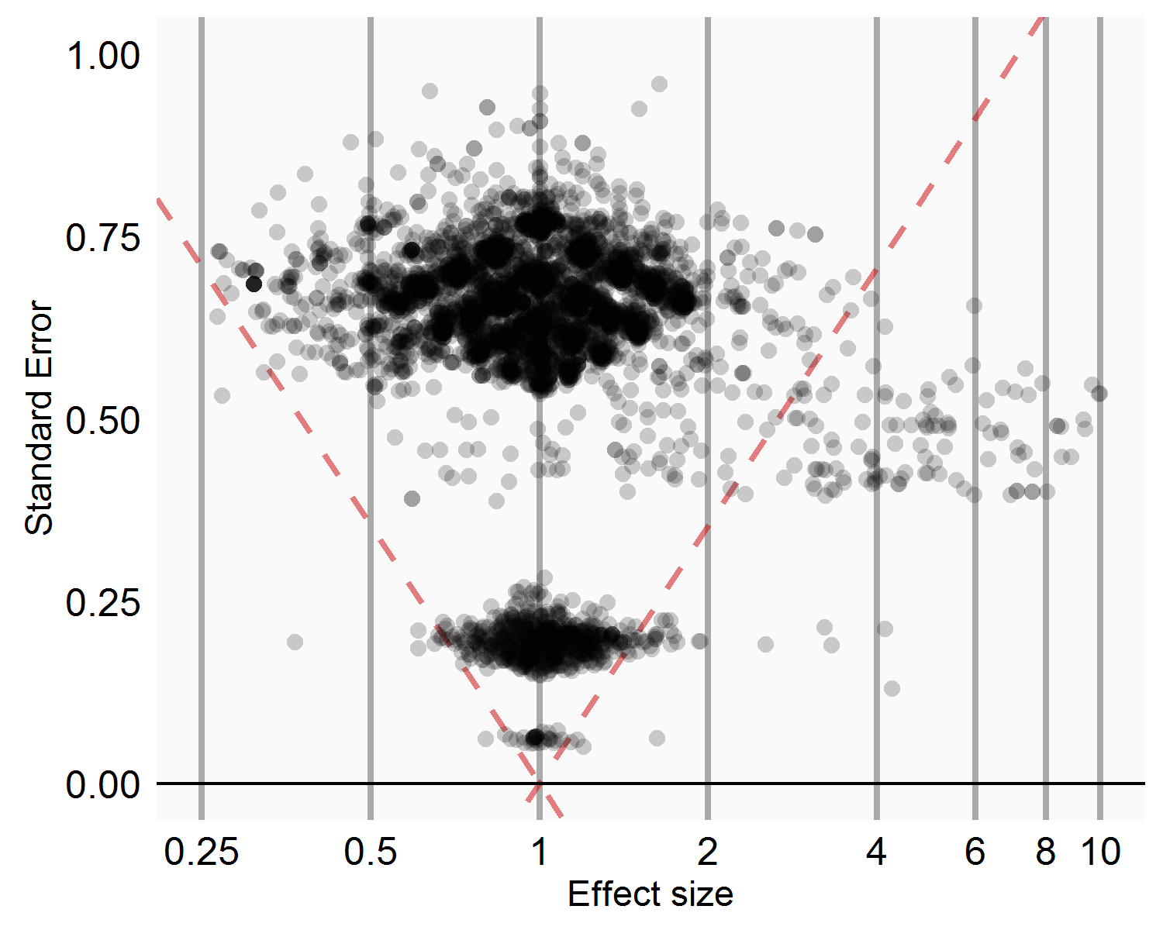
True effect sizes
ADRs in placebo-controlled RCTs in ClinicalTrials.gov
Estimated 3% of exposure -outcome pairs have true RR <> 1
5,039 estimates
1,114 trials

Slide 9
What do we think we know?
Observational studies in MEDLINE
83% of exposure-outcome pairs have p < .05
23,138 estimates
9,214 papers

Slide 10
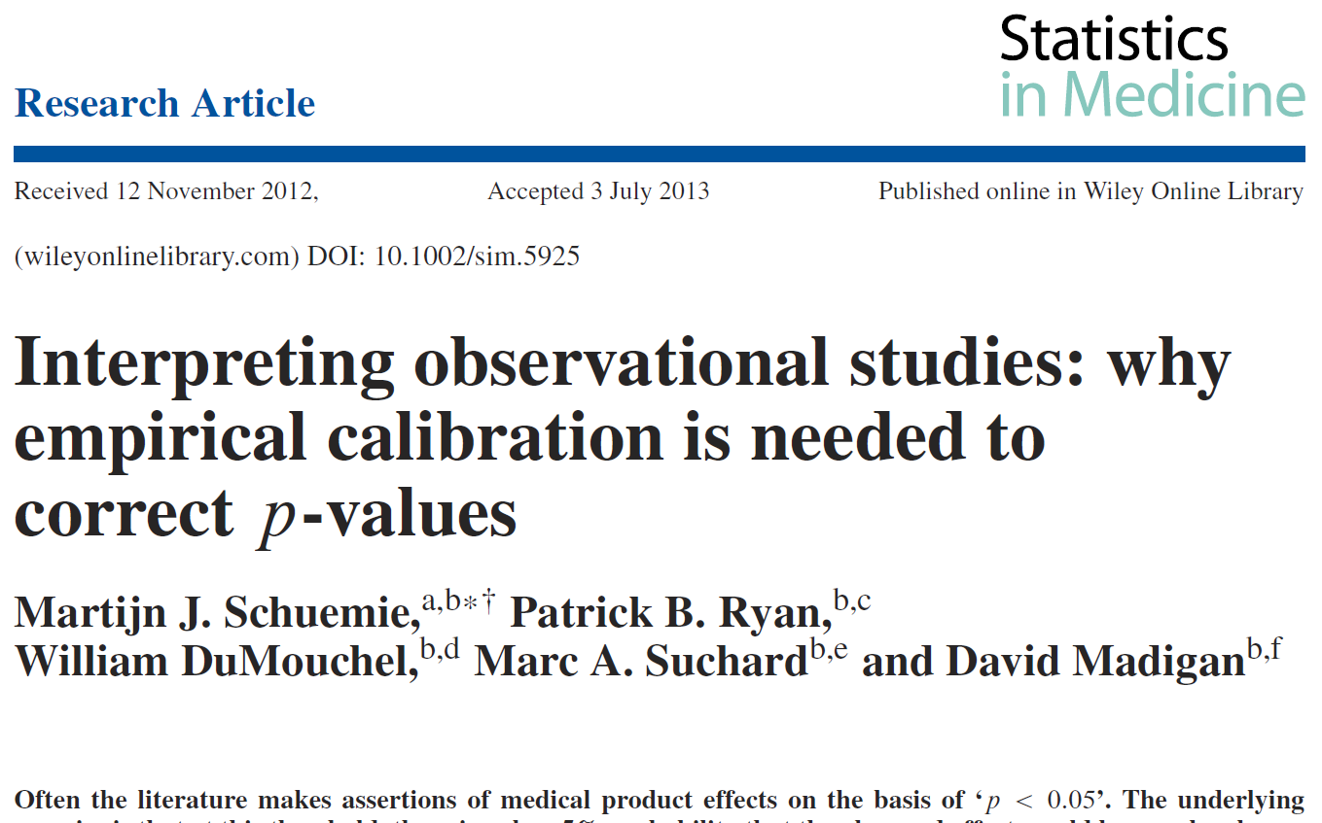
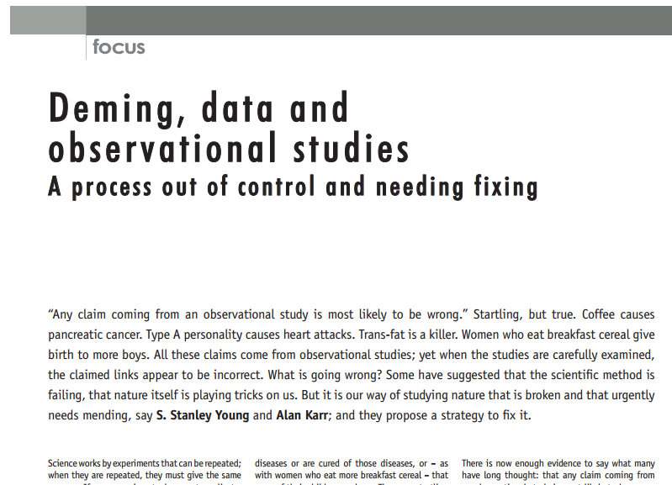
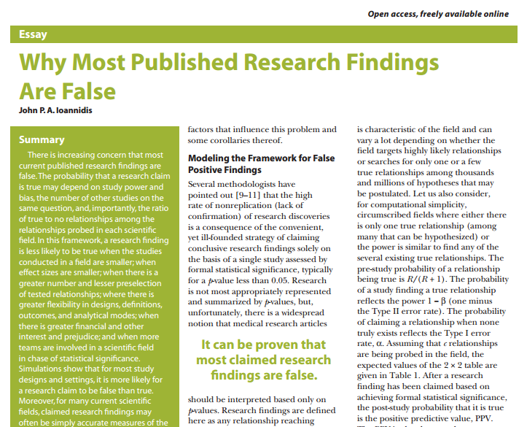
What do we think we know?
100% of the observational claims failed to replicate (in RCTs)
at least 54% of findings with p < 0.05 are not actually statistically significant
for most study designs and settings, it is more likely for a research claim to be false than true.

Slide 11
How did nature mislead us?
Observational study bias
Publication bias
P-hacking

Slide 12
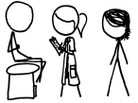
Observational study bias
I have a headache and my stomach
really hurts!
I took drug A, now
I have a stomach bleeding!
I’ll prescribe drug A for your headache,
it’s safe for people at risk of stomach
bleeding.
Ha! Drug A causes
stomach bleedings!
One week later…

Slide 13
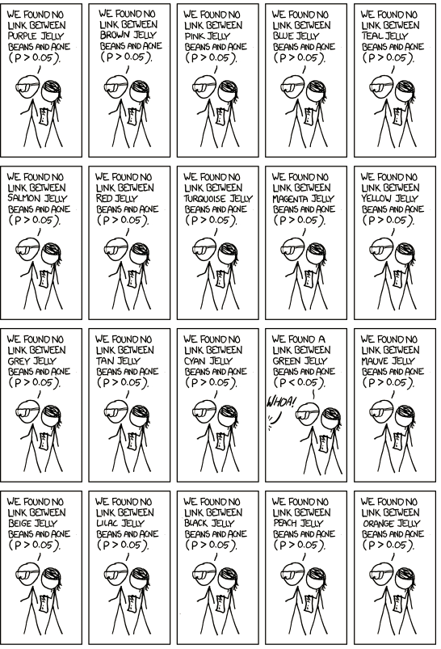
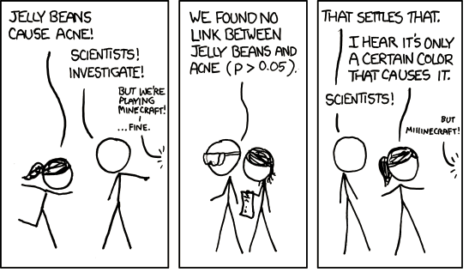
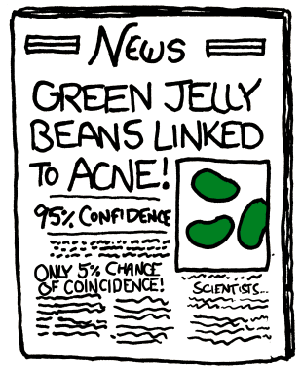
Publication bias
http://xkcd.com/882/

Slide 14
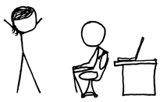
P-hacking
PhD Student!
I think A may cause B,
go investigate!
I ran the analysis:
p > .05
After adjustment
for Z, p < .05!
But did you adjust
for confounder Z?
Yay! Lets publish
a paper!
Ehh, no
Let me get
right back to you
Yes professor!

Slide 15
Interactions
Observational study bias
Publication bias
P-hacking
Observational studies are prone to study bias
Study bias + publication bias = extra bad: biased results are more likely to be published
Study bias makes p-hacking easier
Observational studies are cheap: publication bias more likely
Strong publication bias is an incentive for p-hacking

Slide 16
Workgroup objective
Develop scientific methods for observational research leading to population level estimates that are
Accurate
Reliable
Reproducable
And enable researchers to use these methods

Slide 17
Topics for this workgroup
Best practices for estimation studies
How to present and interpret results from estimation studies
what is the use of p-values?
should we produce posterior distributions instead?
what use is a relative risk without knowing the population it applies to?
empirical calibration?
Should we not do single studies anymore?
Should humans make analysis choices, or do we let the data decide?
Overview of the current methods library
what is missing?
developing new methods?
Evaluation of methods
Training on methods
Funding and collaboration opportunities
Whatever comes up for discussion

Slide 18
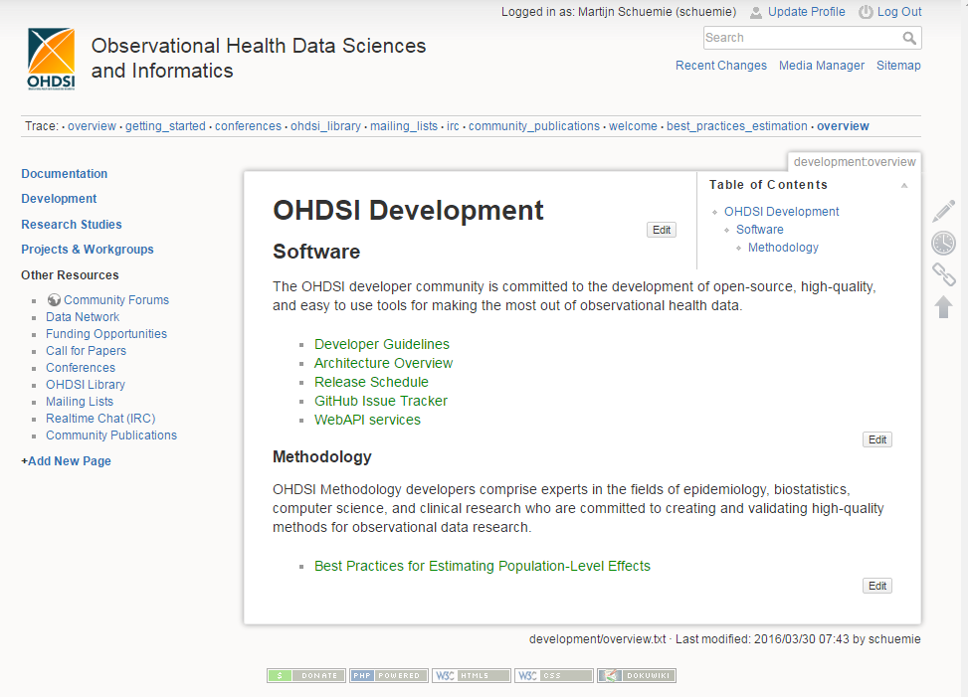
OHDSI best practices
1
2

Slide 19
Funding opportunities
Anyone?

Slide 20
Next workgroup meeting(s)
Western hemisphere: April 13
6pm Central European time
5pm UK time
Noon Eastern Time (New York)
9am Pacific Coast Time (LA)
Eastern hemisphere: April 20
3pm Hong Kong / Taiwan
4pm South Korea
4:30pm Adelaide
(9am Central European time)
http://www.ohdsi.org/web/wiki/doku.php?id=projects:workgroups:est-methods

