Slide 1
Annotations in OHDSI and the OMOP CDM: Thinking through Chart Reviews
Community Meeting
Jon D. Duke
3/20/2018

Slide 2
The OMOP CDM Holds Stuff Nicely
Discrete data that fit nicely into terminologies
no sweat
Characterizing relationships between different entities
Fact_relationship table
Highly flexible (but caution advised!)

Slide 3
We People!
CDM is very person-centric
Most CDM tables have a person_id field
Those without (NOTE_NLP and COST) reference back indirectly to persons
There are exceptions
Health system tables provide organizational relationships
CDM_Source provides info about the dataset
METADATA

Slide 4
OHDSI Community Works the Problem!
http://www.ohdsi.org/web/wiki/lib/exe/fetch.php?media=symposium_2017:ajitlondhe_annotationsposter_final.pdf

Slide 5
OHDSI Community Working the Problem

Slide 7
Annotation Problems Come in Lots of Flavors
Annotating something about a data source
Lost our feed to death data from 2011-2013
Annotating something about a place
A hurricane knocked out power in Houston Texas from 8/25/17 – 9/2/17
Annotating something about a procedure
Katie Couric underwent a live colonoscopy on the Today Show 3/7/2000

Slide 8
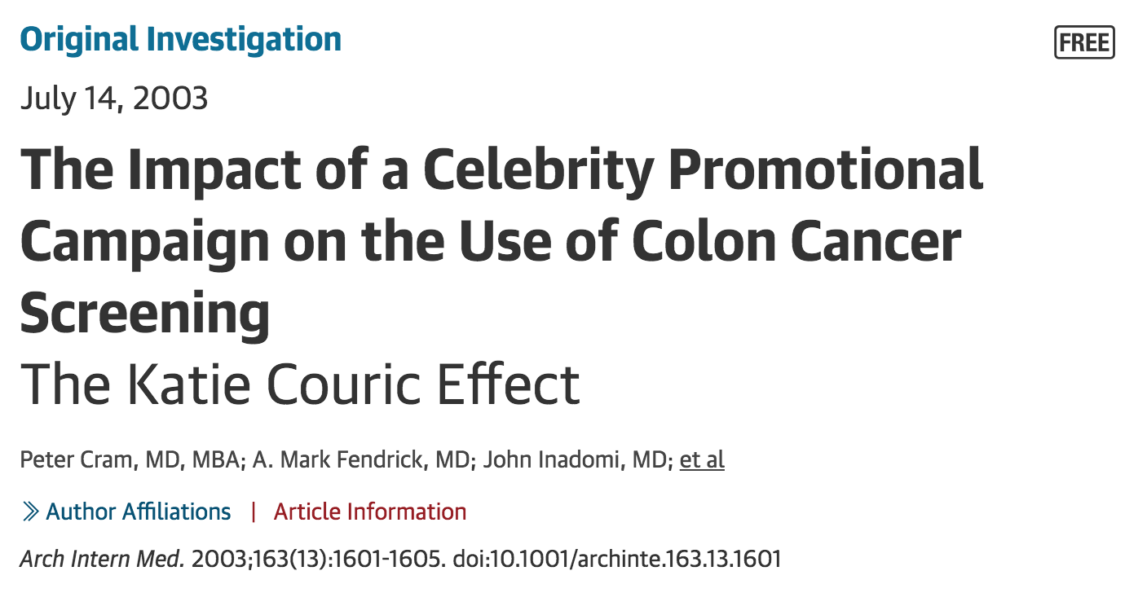

Slide 9
Methods A population-based observational study was conducted using 2 different data sources: (1) The Clinical Outcomes Research Initiative (CORI) database—a voluntary consortium of 400 endoscopists who performed 95 000 colonoscopies from July 1998 to December 2000; and (2) 44 000 adult members of a managed care organization. Using change point analyses and linear regression models, we compared colonoscopy utilization rates before and after Ms Couric's March 2000 television series.
Results The number of colonoscopies performed per CORI physician per month after Ms Couric's campaign increased significantly (15.0 per month before campaign; 18.1 after campaign; P<.001). After adjusting for temporal trends, a significantly higher post-campaign colonoscopy rate was sustained for 9 months. Analysis also demonstrated a trend toward an increase in the percentage of colonoscopies performed on women (43.4% before campaign; 47.4% after campaign; P = .054). Colonoscopy rates also increased significantly in the managed care organization after Ms Couric's campaign (1.3 per 1000 members per month before; 1.8 after; P<.001).

Slide 10
Annotation Problems Come in Lots of Flavors
Annotating something about a medication
New indications
New warnings
Goes off patient
New competitors
DTC advertising
Formulary changes

Slide 11
But does this belong in the CDM?
Are these things part of an OMOP CDM?
Are they part of the OHDSI schema?
Another OHDSI common resource (such as LAERTES)?
And how would we approach storing such a vast and diverse set of information in a way that is consistent with the famed OHDSI rigor

Slide 12
Deep Thoughts.
Let’s get back to Persons for a moment

Slide 13
Annotation Problems Come in Lots of Flavors
Annotating things about Persons
Chart review / Chart abstraction is a common activity performed for clinical research of all stripes
Often done to pull data points from a chart (research, quality, billing etc)
We use frequently to validate phenotype definitions (is this person a case or not a case?)

Slide 14
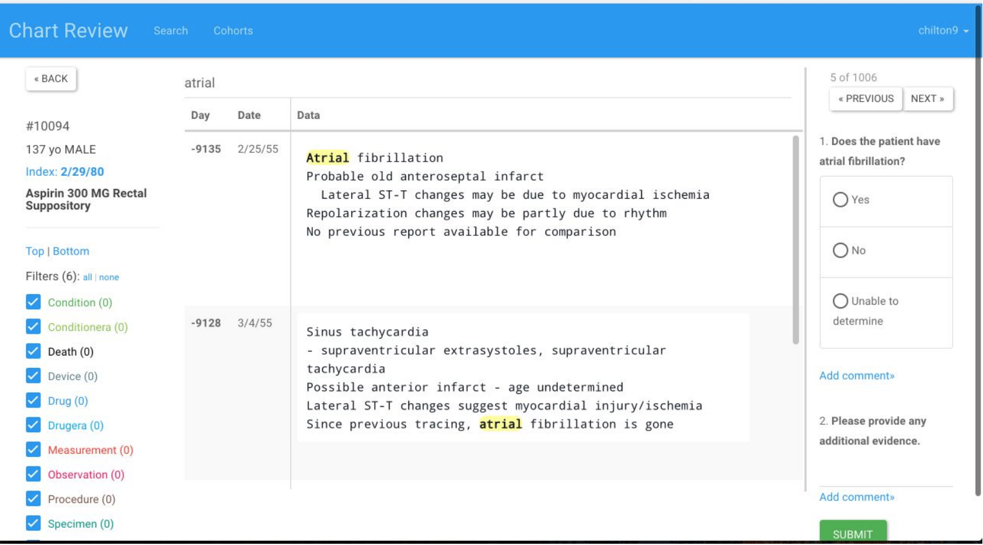

Slide 15
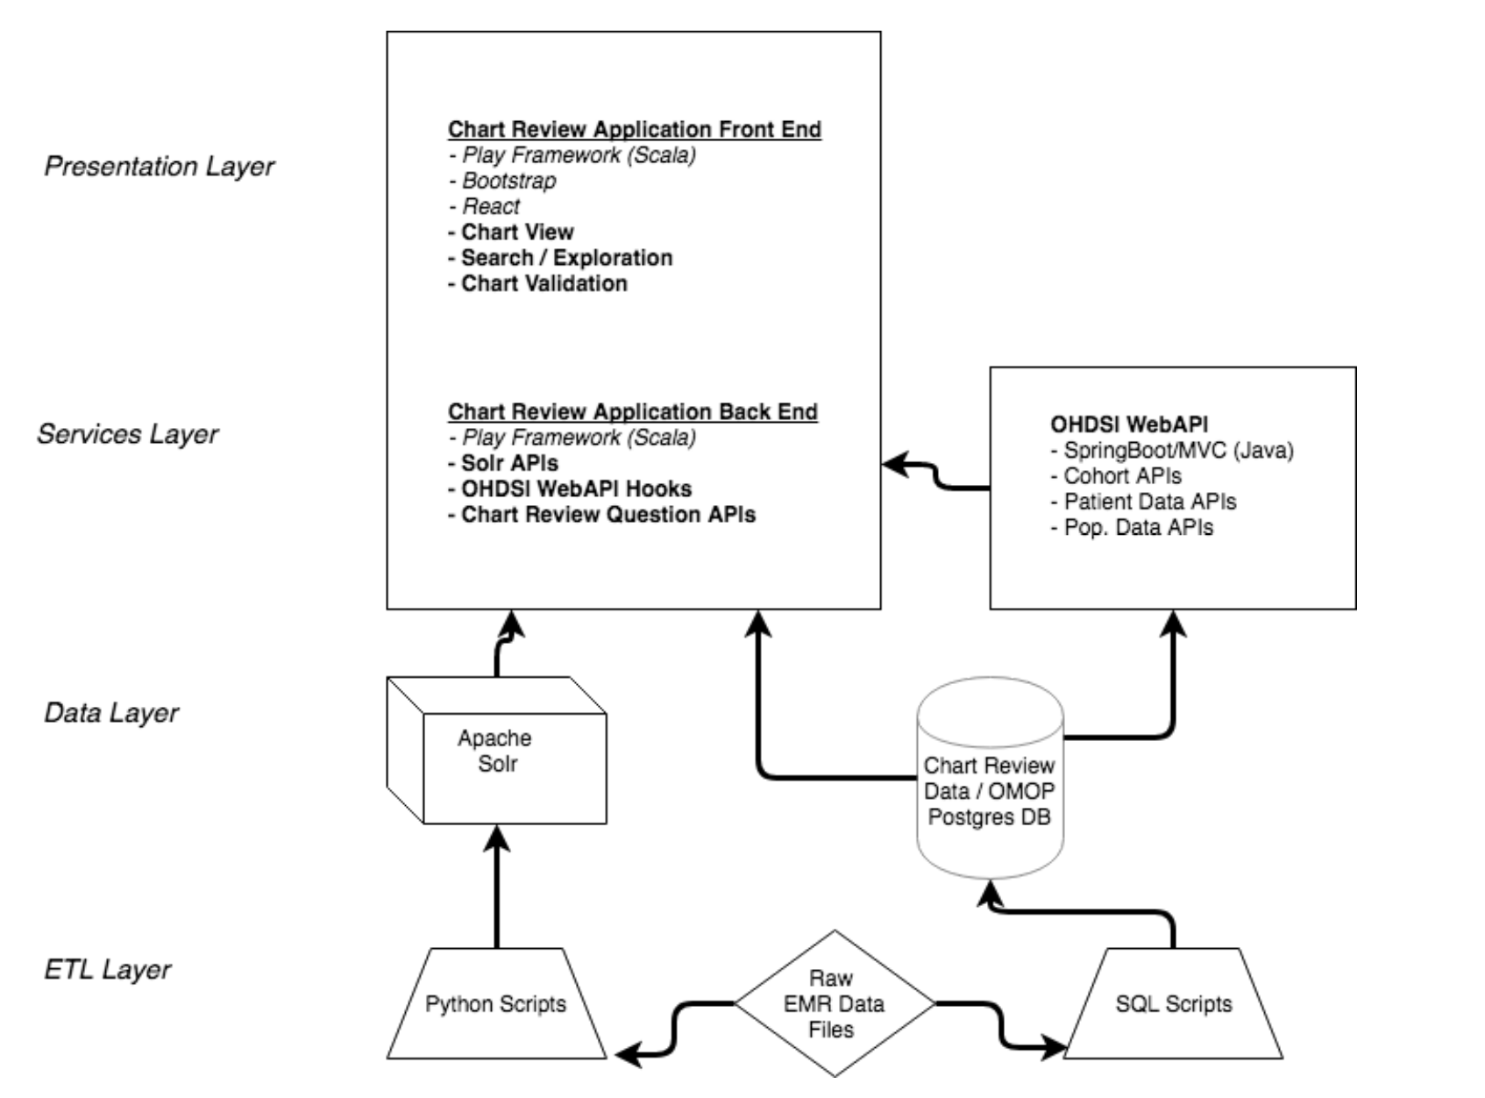

Slide 16
Connecting a Phenotype with Questions
Chart Review was designed to let you just assign any set of questions of interest to a phenotype
Then you could assign to 1..n reviewers to go through an answer the questions
Let’s try an example

Slide 17
How Would You Use These Data?
For scoring performance
For defining new phenotypes
By defining combinations of responses as X
By serving as gold standards for eg Aphrodite
As a learning system (for our definitions but also for the evaluation process itself)

Slide 18
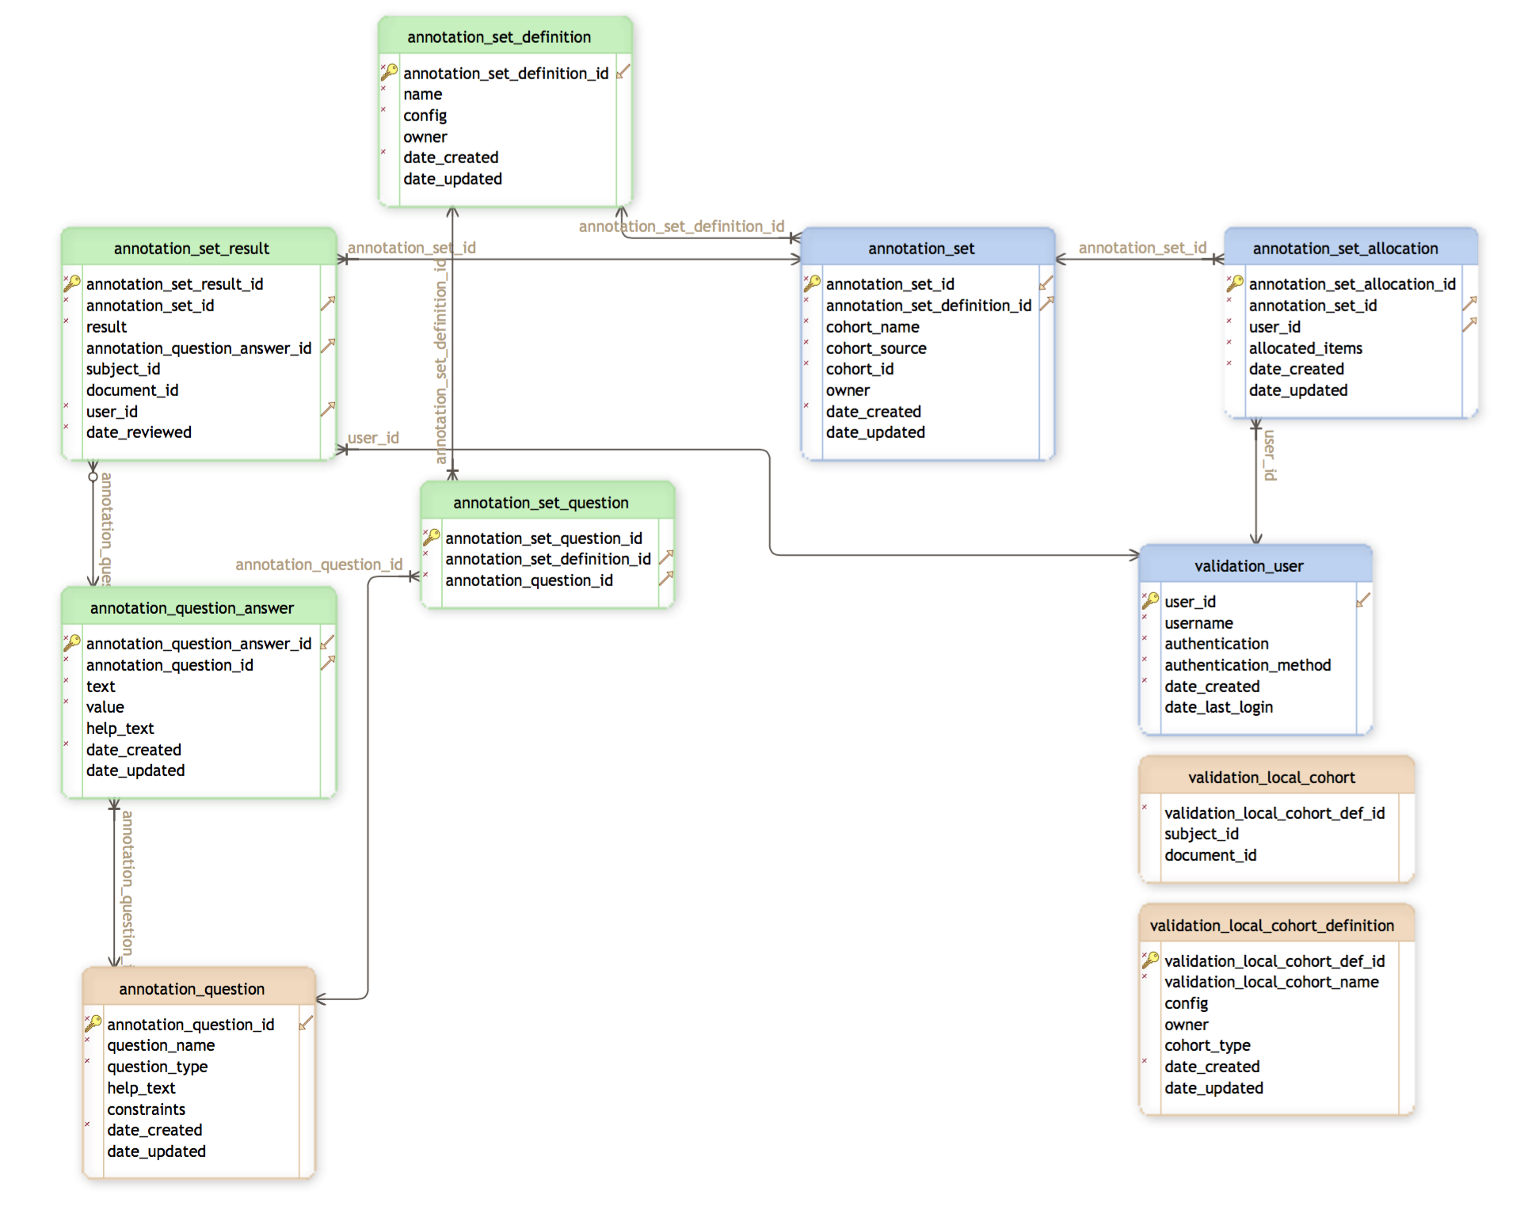
How Do We Store this Stuff Now?

