Slide 1
FeatureExtraction v2.0
Martijn Schuemie

Slide 2
OHDSI Methods Library
Cohort Method
Self-Controlled Case Series
Self-Controlled Cohort
IC Temporal Pattern Disc.
s
s
s
s
New-user cohort studies using large-scale regression for propensity and outcome models
Self-Controlled Case Series analysis using few or many predictors, includes splines for age and seasonality.
A self-controlled cohort design, where time preceding exposure is used as control.
A self-controlled design, but using temporal patterns around other exposures and outcomes to correct for time-varying confounding.
Estimation methods
Case-control
s
Case-crossover
s
Case-control studies, matching controls on age, gender, provider, and visit date. Allows nesting of the study in another cohort.
Case-crossover design including the option to adjust for time-trends in exposures (so-called case-time-control).
Patient Level Prediction
Feature Extraction
s
s
Build and evaluate predictive models for user-specified outcomes, using a wide array of machine learning algorithms.
Automatically extract large sets of features for user-specified cohorts using data in the CDM.
Prediction methods
Empirical Calibration
Method Evaluation
s
s
Use negative control exposure-outcome pairs to profile and calibrate a particular analysis design.
Use real data and established reference sets as well as simulations injected in real data to evaluate the performance of methods.
Method characterization
Database Connector
Sql Render
Cyclops
Ohdsi R Tools
s
s
s
s
Connect directly to a wide range of database platforms, including SQL Server, Oracle, and PostgreSQL.
Generate SQL on the fly for the various SQL dialects.
Highly efficient implementation of regularized logistic, Poisson and Cox regression.
Support tools that didn’t fit other categories, including tools for maintaining R libraries.
Supporting packages
Under construction

Slide 3
FeatureExtraction v2.0
Start of development announced on the forum: http://forums.ohdsi.org/t/featureextraction-2-0/2996
Initial major objectives:
More flexibility in time windows
More flexibility in adding and maintaining features
Allow cohort characterization (skipping person-level data)
Added major objectives:
Support temporal covariates
Allow specifying set of covariate IDs (not concept IDs) to include
Integration with WebAPI
Current status: testing + adding more functionality

Slide 4
Analyses
An analysis is defined as:
An analysis ID
A reference to a (heavily) parameterized SQL file
Parameters, which (almost) always includes:
Aggregated
Temporal
Start and end of window relative to cohort_start_date
Concept IDs to include or exclude
Covariate IDs to include
An analysis produces:
Zero, one, or more covariates with covariate IDs
To avoid collisions, the last 3 digits of the covariate ID are the analysis ID

Slide 5
Three levels of settings
Default settings yes / no
Same as current input:
List of prespecified analyses yes / no
Window definitions (short / medium / long term)
Included and excluded concept IDs and covariate IDs
Detailed analyses specs. List of :
Analysis ID
Name of parameterized SQL file
SQL parameter values, including
Included and excluded concept IDs and covariate IDs

Slide 6
Level 1 input
covariateSettings <- createDefaultCovariateSettings()

Slide 7
Level 2 input
covariateSettings <- createCovariateSettings(useDemographicsGender = TRUE,
useDemographicsAge = FALSE,
useDemographicsIndexYear = FALSE,
useDemographicsIndexMonth = FALSE,
useConditionOccurrenceLongTerm = FALSE,
useConditionOccurrenceShortTerm = FALSE,
useConditionEraLongTerm = FALSE,
useConditionEraShortTerm = FALSE,
useConditionGroupEraLongTerm = FALSE,
useConditionGroupEraShortTerm = FALSE,
useDrugExposureLongTerm = FALSE,
useDrugExposureShortTerm = FALSE,
useDrugEraLongTerm = FALSE,
useDrugEraShortTerm = FALSE,
useDrugGroupEraLongTerm = FALSE,
useDrugGroupEraShortTerm = FALSE,
useProcedureOccurrenceLongTerm = FALSE,
useProcedureOccurrenceShortTerm = FALSE,
useDeviceExposureLongTerm = FALSE,
useDeviceExposureShortTerm = FALSE,
useMeasurementLongTerm = FALSE,
useMeasurementShortTerm = FALSE,
useObservationLongTerm = FALSE,
useObservationShortTerm = FALSE,
useCharlsonIndex = TRUE,
longTermStartDays = -365,
shortTermStartDays = -30,
endDays = 0,
excludedCovariateConceptIds = c(),
addDescendantsToExclude = FALSE,
includedCovariateConceptIds = c(),
addDescendantsToInclude = FALSE,
includedCovariateIds = c())

Slide 8
Level 3 input
analysisDetails <- createAnalysisDetails(analysisId = 1,
sqlFileName = "DemographicsGender.sql",
parameters = list(analysisId = 1,
analysisName = "Gender",
domainId = "Demographics"),
includedCovariateConceptIds = c(),
addDescendantsToInclude = FALSE,
excludedCovariateConceptIds = c(),
addDescendantsToExclude = FALSE,
includedCovariateIds = c())
covariateSettings <- createDetailedCovariateSettings(analyses = list(analysisDetails))

Slide 9
Output
Aggregated = FALSE, temporal = FALSE
rowId
covariateId
covariateValue
Aggregated = TRUE, temporal = FALSE
Binary variables:
covariateId
sumValue
averageValue
Continous variables:
covariateId
countValue
averageValue, standardDeviation
min, p10, p25, median, p75, p90, max
Aggregated = FALSE, temporal = TRUE
timeId
rowId
covariateId
covariateValue
Aggregated = TRUE, temporal = TRUE
Binary variables:
timeId
covariateId
countValue
averageValue
Continous variables:
timeId
covariateId
countValue
averageValue, standardDeviation
min, p10, p25, median, p75, p90, max

Slide 10
Metadata output
CovariateRef
covariateId
covariateName
conceptId
analysisId
AnalysisRef
analysisId
analysisName
domainId
startDay
endDay
isBinary
missingMeansZero

Slide 11
Additional changes
Normalization and removal of redundant covariates no longer done automatically! Call tidyCovariateData before using in a model instead
Can specify covariate IDs to create. Use case:
Create all features
Build predictive model
For other population: only create covariates used in model
Apply predictive model
Will be integrated with ATLAS!
Support for simple tables 1

Slide 12
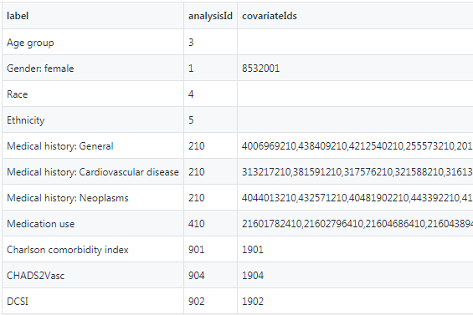
Table 1 generation
covariateData
+

Slide 13
Table 1
Characteristic | % (n = 132,951) |  | Characteristic | % (n = 132,951)
Age group |  |  | Medical history: Neoplasms
30-31 | <1 |  | Hematologic neoplasm | 3
40-41 | <1 |  | Malignant lymphoma | 1
45-46 | <1 |  | Malignant neoplasm of anorectum | <1
50-51 | <1 |  | Malignant neoplastic disease | 18
55-56 | <1 |  | Malignant tumor of breast | 3
60-61 | 1 |  | Malignant tumor of colon | 1
65-66 | 14 |  | Malignant tumor of lung | 1
70-71 | 17 |  | Malignant tumor of urinary bladder | 1
75-76 | 19 |  | Primary malignant neoplasm of prostate | 4
80-81 | 20 |  | Medication use
85-86 | 16 |  | Agents acting on the renin-angiotensin system | 62
90-91 | 9 |  | Antibacterials for systemic use | 61
95-96 | 3 |  | Antidepressants | 36
100-101 | <1 |  | Antiepileptics | 39
105-106 | <1 |  | Antiinflammatory and antirheumatic products | 38
Gender: female | 62 |  | Antineoplastic agents | 17
Medical history: General |  |  | Antipsoriatics | 8
Acute respiratory disease | 16 |  | Antithrombotic agents | 18
Attention deficit hyperactivity disorder | <1 |  | Beta blocking agents | 74
Chronic liver disease | 1 |  | Calcium channel blockers | 66
Chronic obstructive lung disease | 10 |  | Diuretics | 82
Crohn's disease | 1 |  | Drugs for acid related disorders | 51
Dementia | 4 |  | Drugs for obstructive airway diseases | 34
Depressive disorder | 6 |  | Drugs used in diabetes | 28
Diabetes mellitus | 18 |  | Immunosuppressants | 6
Gastroesophageal reflux disease | 9 |  | Lipid modifying agents | 53
Gastrointestinal hemorrhage | 3 |  | Opioids | 36
Human immunodeficiency virus infection | <1 |  | Psycholeptics | 60
Hyperlipidemia | 25 |  | Psychostimulants, agents used for adhd and nootropics | 40
Hypertensive disorder | 47
Lesion of liver | 1 |  | Characteristic | Value
Obesity | 2 |  | Charlson comorbidity index
Osteoarthritis | 20 |  | Minimum | 0
Pneumonia | 5 |  | 25th percentile | 0
Psoriasis | 1 |  | Median | 2
Renal impairment | 6 |  | 75th percentile | 4
Rheumatoid arthritis | 3 |  | Maximum | 22
Schizophrenia | <1 |  | CHADS2Vasc
Ulcerative colitis | 1 |  | Minimum | 0
Urinary tract infectious disease | 9 |  | 25th percentile | 0
Viral hepatitis C | <1 |  | Median | 1
Visual system disorder | 77 |  | 75th percentile | 2
Medical history: Cardiovascular disease |  |  | Maximum | 6
Atrial fibrillation | 9 |  | DCSI
Cerebrovascular disease | 6 |  | Minimum | 0
Coronary arteriosclerosis | 15 |  | 25th percentile | 0
Heart disease | 36 |  | Median | 1
Heart failure | 9 |  | 75th percentile | 3
Ischemic heart disease | 7 |  | Maximum | 13
Peripheral vascular disease | 19
Pulmonary embolism | 1
Venous thrombosis | 3

Slide 14
Method evaluation
Martijn Schuemie

Slide 15
Method benchmark
Target | Comparator | Nesting | Outcome | True effect size
Eszopiclone | Triazolam | Insomnia | Acute pancreatitis | 1
Eszopiclone | Triazolam | Insomnia | Acute pancreatitis, RR=1.5 | 1.5
Eszopiclone | Triazolam | Insomnia | Acute pancreatitis, RR=2 | 2
Eszopiclone | Triazolam | Insomnia | Acute pancreatitis, RR=4 | 4
Ciprofloxacin | Azithromycin | Otitis media | Alcohol abuse | 1
Ciprofloxacin | Azithromycin | Otitis media | Alcohol abuse, RR=1.5 | 1.5
Ciprofloxacin | Azithromycin | Otitis media | Alcohol abuse, RR=2 | 2
Ciprofloxacin | Azithromycin | Otitis media | Alcohol abuse, RR=4 | 4
… | … | … | … | …

Slide 16
Method benchmark
Target | Comparator | Nesting | Outcome | True effect size
Eszopiclone | Triazolam | Insomnia | Acute pancreatitis | 1
Eszopiclone | Triazolam | Insomnia | Acute pancreatitis, RR=1.5 | 1.5
Eszopiclone | Triazolam | Insomnia | Acute pancreatitis, RR=2 | 2
Eszopiclone | Triazolam | Insomnia | Acute pancreatitis, RR=4 | 4
Ciprofloxacin | Azithromycin | Otitis media | Alcohol abuse | 1
Ciprofloxacin | Azithromycin | Otitis media | Alcohol abuse, RR=1.5 | 1.5
Ciprofloxacin | Azithromycin | Otitis media | Alcohol abuse, RR=2 | 2
Ciprofloxacin | Azithromycin | Otitis media | Alcohol abuse, RR=4 | 4
… | … | … | … | …
Real negative controls and synthetic positive controls

Slide 17
Method benchmark
Target | Comparator | Nesting | Outcome | True effect size
Eszopiclone | Triazolam | Insomnia | Acute pancreatitis | 1
Eszopiclone | Triazolam | Insomnia | Acute pancreatitis, RR=1.5 | 1.5
Eszopiclone | Triazolam | Insomnia | Acute pancreatitis, RR=2 | 2
Eszopiclone | Triazolam | Insomnia | Acute pancreatitis, RR=4 | 4
Ciprofloxacin | Azithromycin | Otitis media | Alcohol abuse | 1
Ciprofloxacin | Azithromycin | Otitis media | Alcohol abuse, RR=1.5 | 1.5
Ciprofloxacin | Azithromycin | Otitis media | Alcohol abuse, RR=2 | 2
Ciprofloxacin | Azithromycin | Otitis media | Alcohol abuse, RR=4 | 4
… | … | … | … | …
Can be used both for
Effect estimation: Effect of Target on Outcome

Slide 18
Method benchmark
Target | Comparator | Nesting | Outcome | True effect size
Eszopiclone | Triazolam | Insomnia | Acute pancreatitis | 1
Eszopiclone | Triazolam | Insomnia | Acute pancreatitis, RR=1.5 | 1.5
Eszopiclone | Triazolam | Insomnia | Acute pancreatitis, RR=2 | 2
Eszopiclone | Triazolam | Insomnia | Acute pancreatitis, RR=4 | 4
Ciprofloxacin | Azithromycin | Otitis media | Alcohol abuse | 1
Ciprofloxacin | Azithromycin | Otitis media | Alcohol abuse, RR=1.5 | 1.5
Ciprofloxacin | Azithromycin | Otitis media | Alcohol abuse, RR=2 | 2
Ciprofloxacin | Azithromycin | Otitis media | Alcohol abuse, RR=4 | 4
… | … | … | … | …
Can be used both for
Effect estimation: Effect of Target on Outcome
Comparative effect estimation: Effect of Target on Outcome compared to Comparator

Slide 19
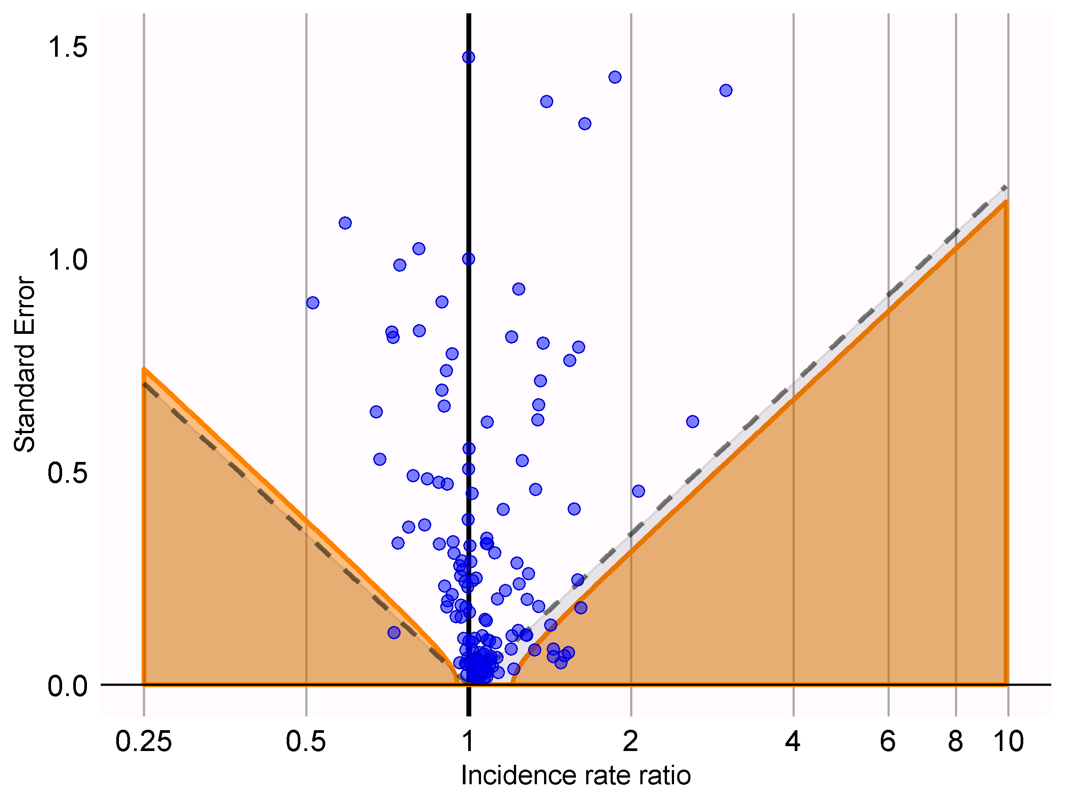
Revisting Case-time-control
Remember that case-time-control looked promising?

Slide 20
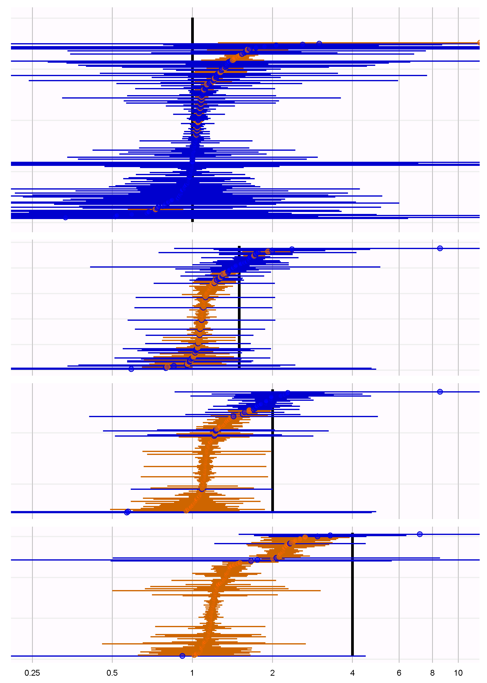
Revisting Case-time-control
Positive controls show extreme bias towards the null
Investigation suggests this is due to Breslow approximation to conditional logistic regression

Slide 21
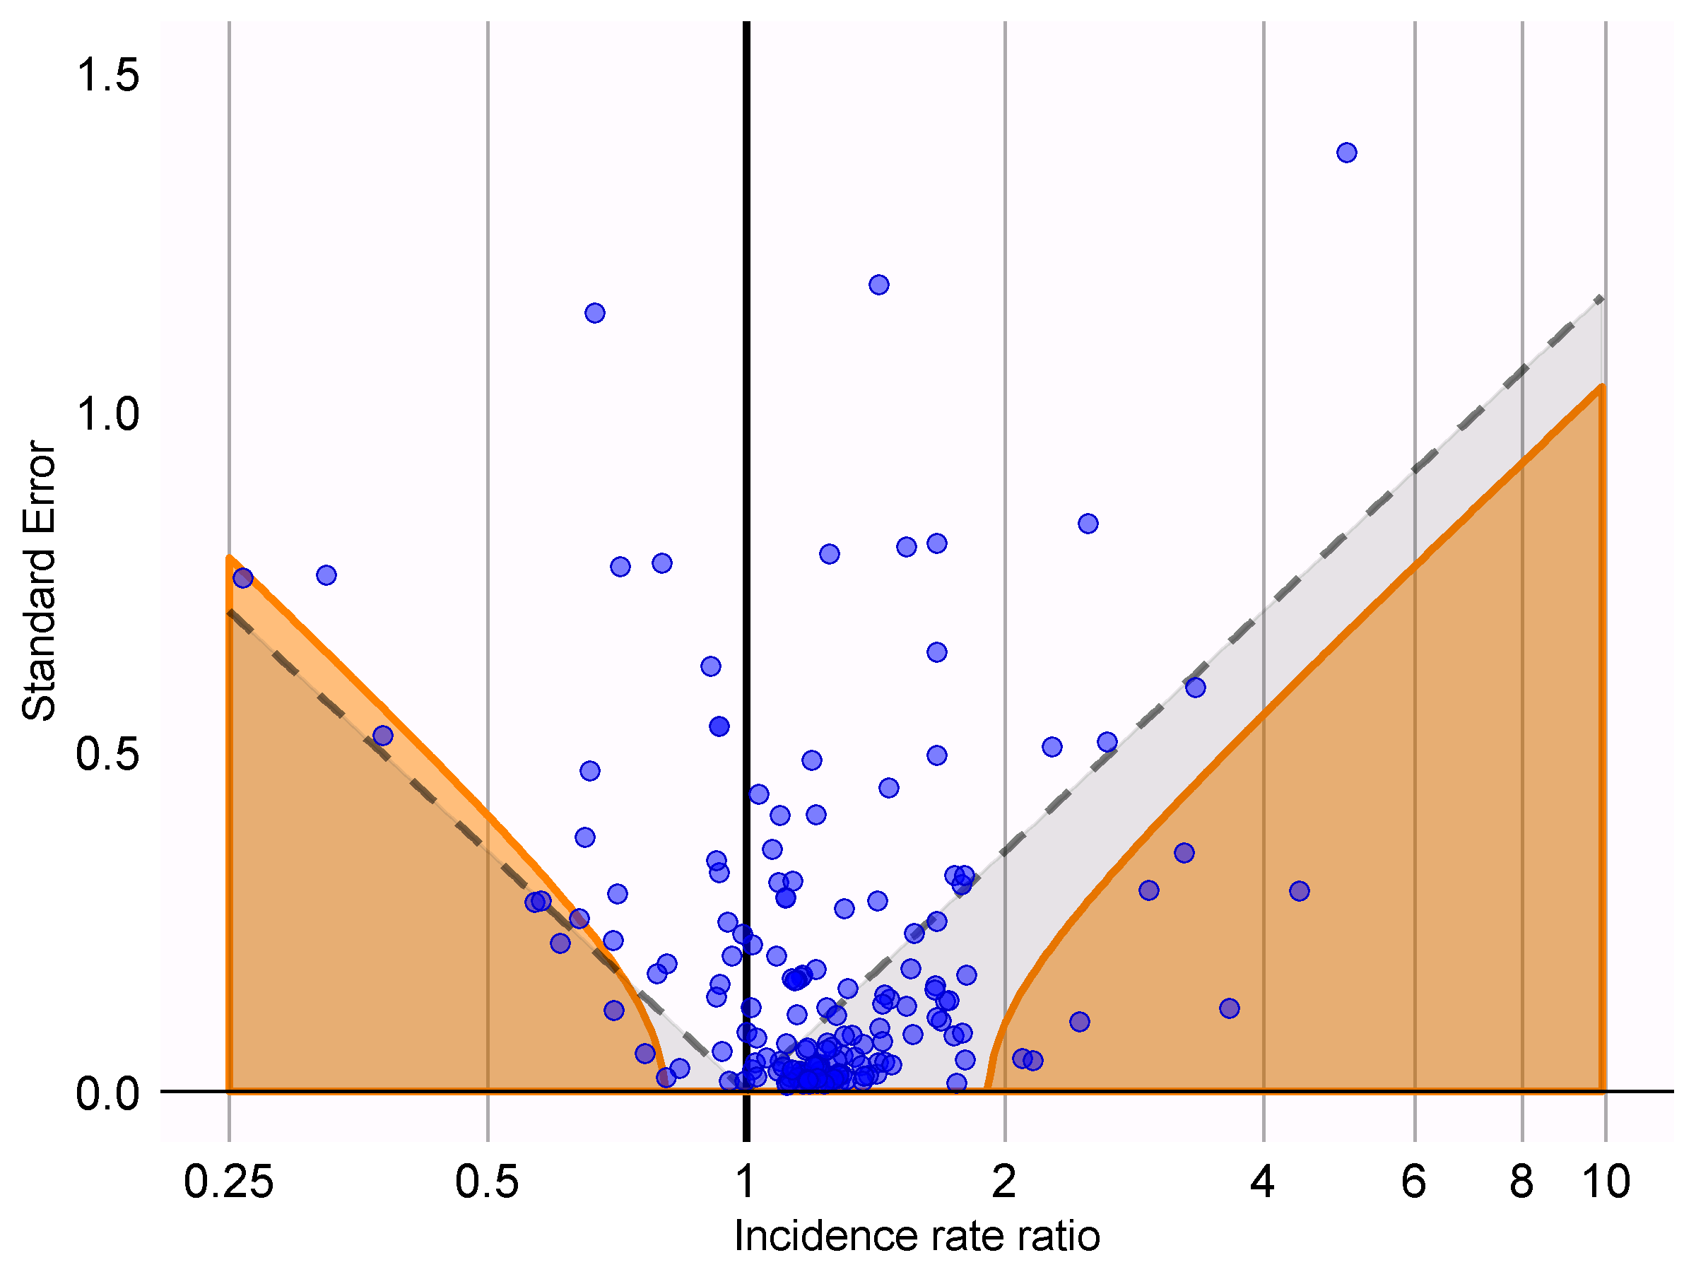
Case-control as bad as ever
Nest case-control design, matching on age and gender. Up to 10 controls per case

Slide 22
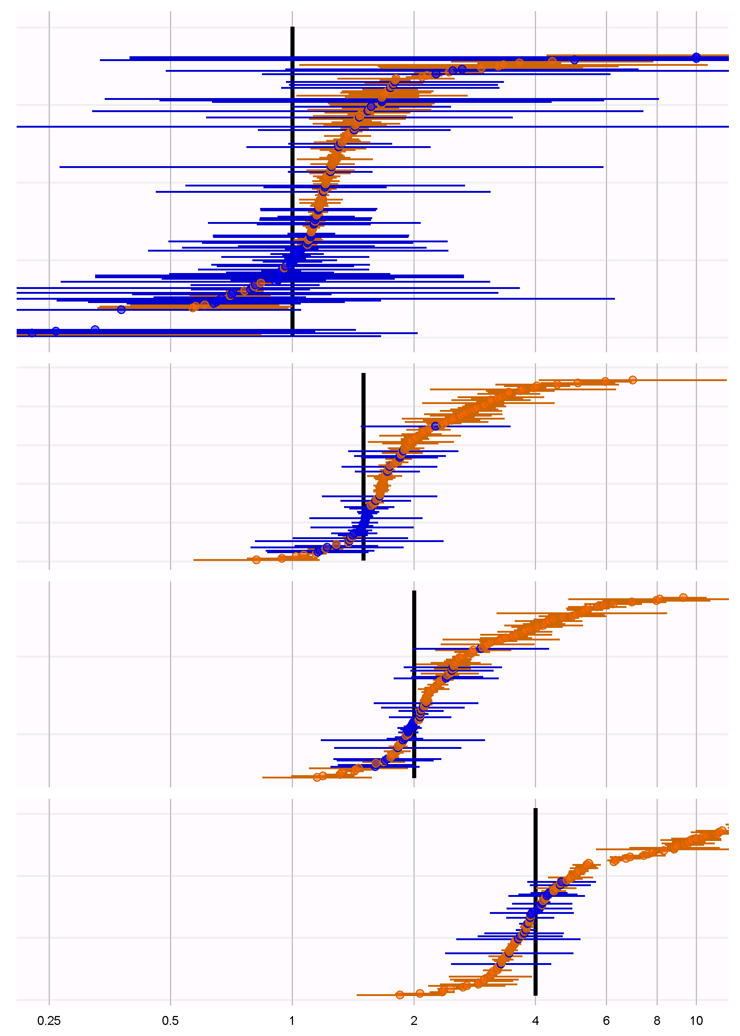
Case-control gets worse when true effect size > 0
Nest case-control design, matching on age and gender. Up to 10 controls per case

Slide 23
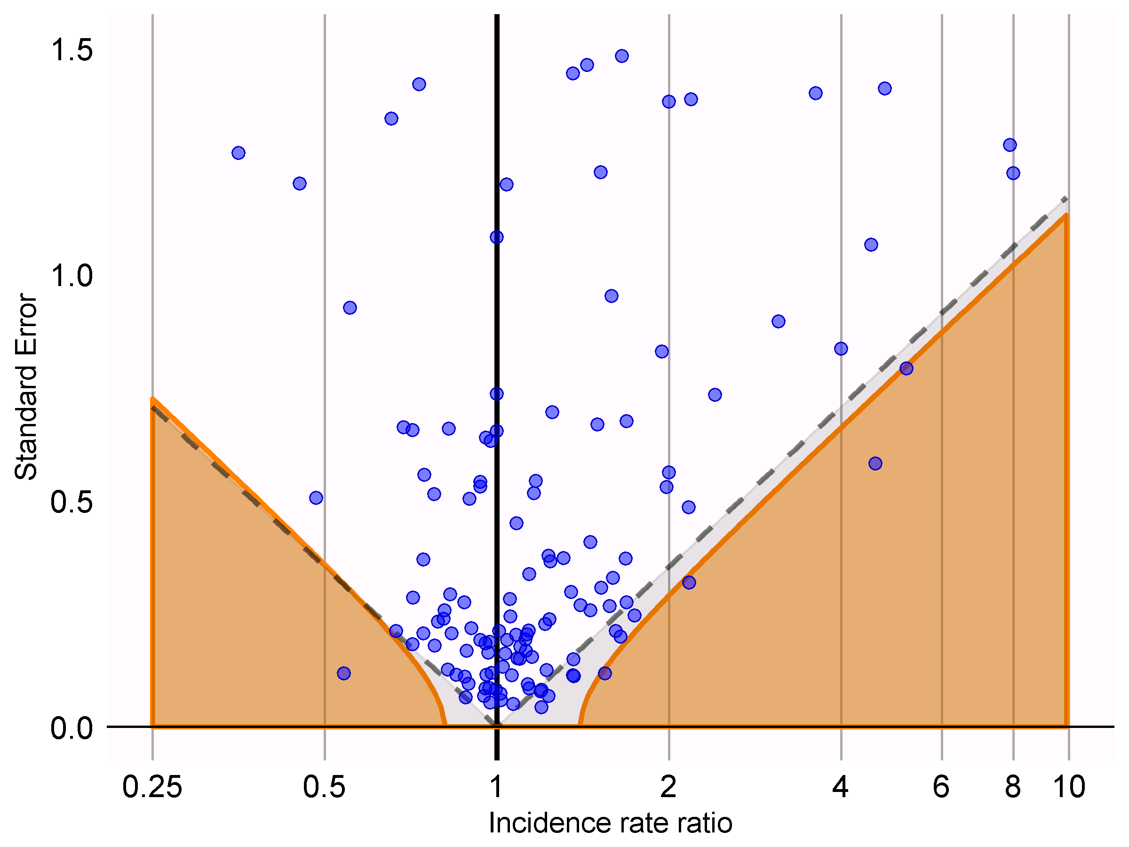
Cohort Method has a bit more bias than expected
New-user cohort method using variable ratio propensity score matching

Slide 24
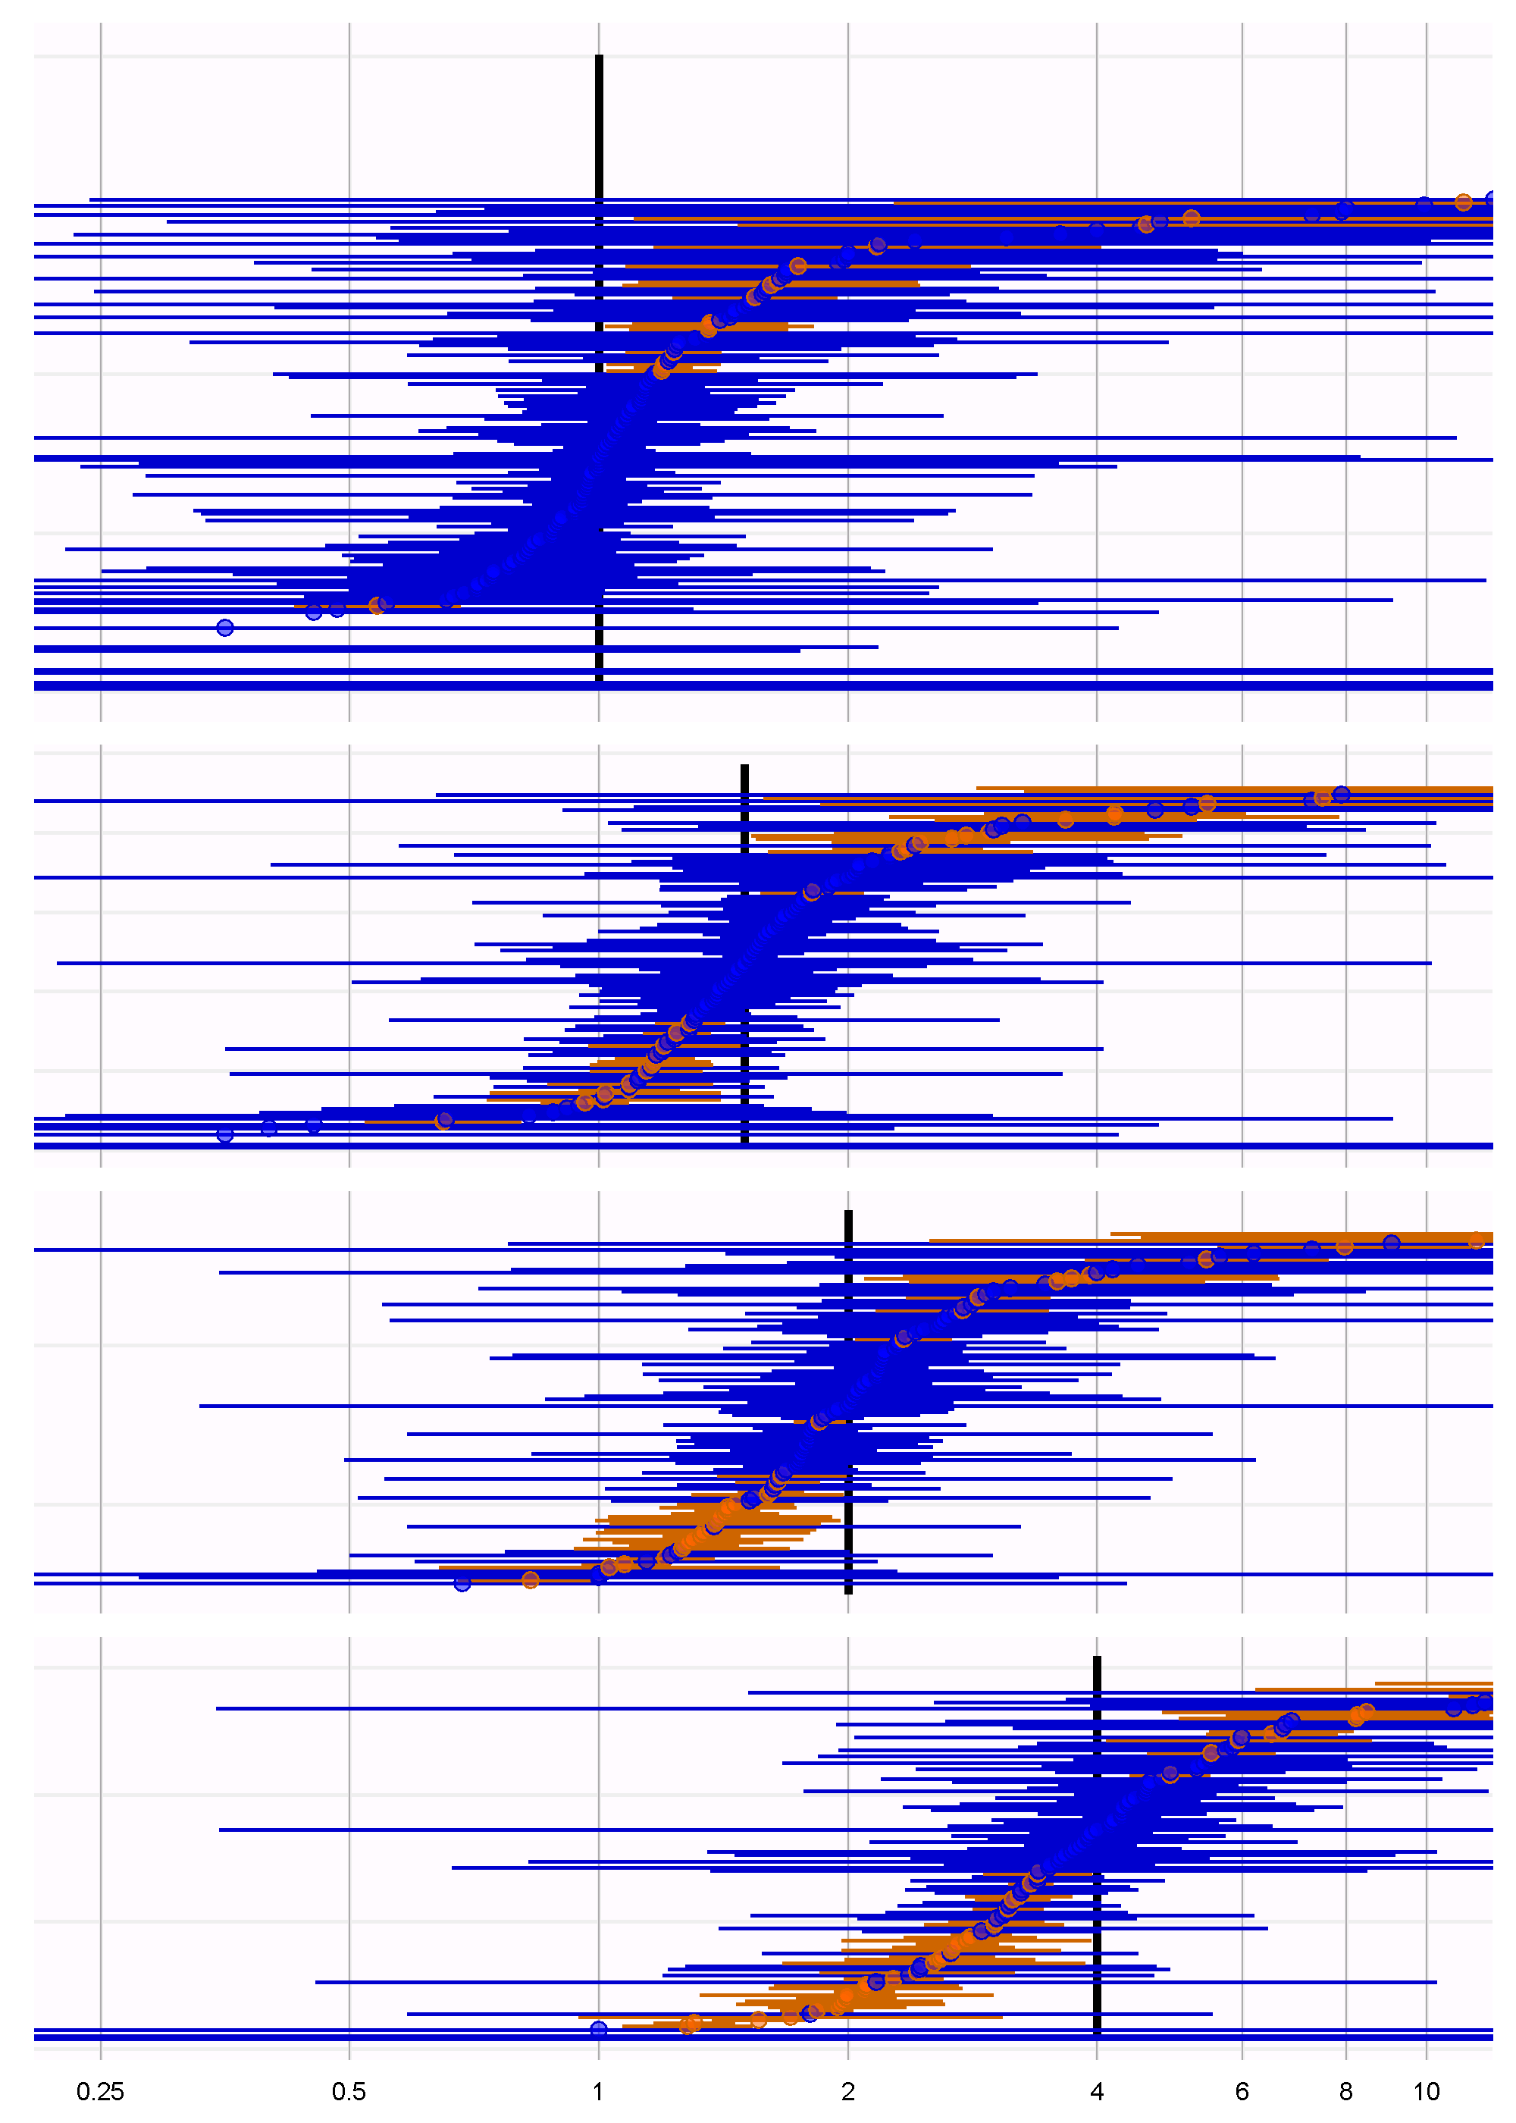
Not so much bias towards the null as in Yuxi’s experiment

Slide 25
Some issues with evaluation
Some outcomes are very rare
Some outcomes / exposures are extremely prevalent

Slide 26
Topic of next meeting(s)?
?

Slide 27
Next workgroup meeting
Western hemisphere: September 28
6pm Central European time
12pm New York
9am Los Angeles / Stanford
Eastern hemisphere: September 20
3pm Hong Kong / Taiwan
4pm South Korea
4:30pm Adelaide
9am Central European time
8am UK time
http://www.ohdsi.org/web/wiki/doku.php?id=projects:workgroups:est-methods

