Slide 1
A critical assessment of the utility of the case-control design in population-based databases
Martijn Schuemie

Slide 2
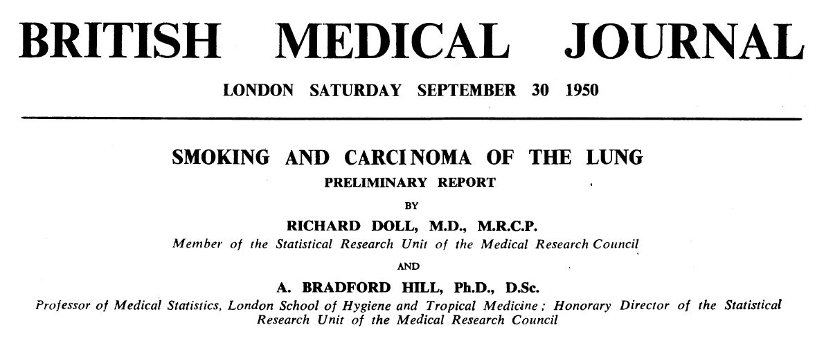
History
Originated in a time when data was not readily available
Mayor success: Doll & Hill’s study showing the link between smoking and lung cancer
Nowadays extensively used in retrospective population-based databases (e.g. CPRD)

Slide 3
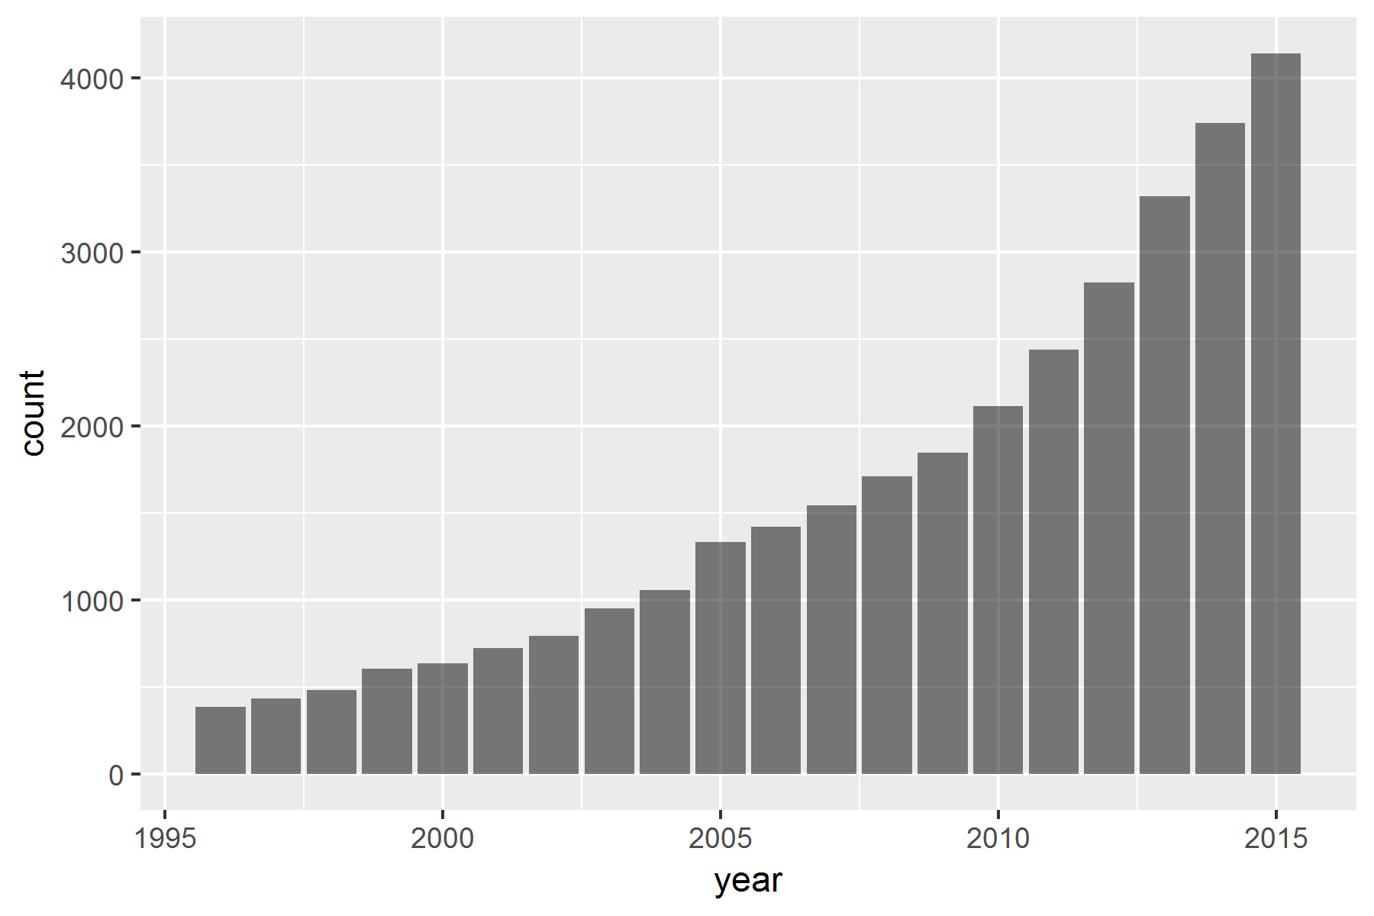
Case-control still very popular
("Case-Control Studies"[MeSH] OR "case control"[Title/Abstract])
AND
("population-based" [Title/Abstract] OR observational [Title/Abstract] OR pharmacoepidemiology [Title/Abstract])

Slide 4
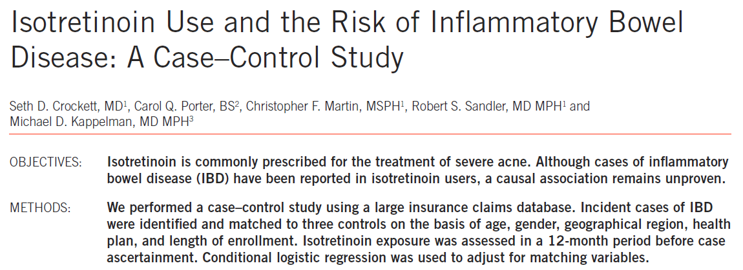
Example study
Crockett et al. 2010
Does isotretinoin use cause IBD (UC)?
Database: PharMetrics

Slide 5
Case-control (Crocket et al. 2010)
For every case (person with the outcome) find n controls
Determine exposure status on or before index date (= date of outcome)
Matching on
Calendar time
Age
Gender
Time enrolled
Region (east, south, midwest, and west)
Health plan
Outcome
Case
isotretinoin
isotretinoin
Jan 10, 2001
Exposed in past year?
Control 1
isotretinoin
Jan 10, 2001
Exposed in past year?
Control 2
Jan 10, 2001
Exposed in past year?

Slide 6
Changing perspective
View same data as a cohort design
Outcome
Case
isotretinoin
isotretinoin
Jan 10, 2001
Exposed in past year?
Control 1
isotretinoin
Jan 10, 2001
Exposed in past year?
Control 2
Jan 10, 2001
Exposed in past year?

Slide 7
Changing perspective
View same data as a cohort design
Target cohort:
Isotretinoin users
Severe cystic acne and acne not responsive to other treatments
- Index date: any use of drug (not just first)
Outcome
Target 1
isotretinoin
isotretinoin
Jan 10, 2001
Comparator cohort:
Random persons
Matched by age, gender, and time enrolled
Index date: random point in time
Outcome in 1 year follow-up?
Target 2
isotretinoin
Jan 10, 2001
Outcome in 1 year follow-up?
Comparator 1
Jan 10, 2001
Outcome in 1 year follow-up?

Slide 8
Theoretical objections
Target cohort:
Isotretinoin users
Severe cystic acne and acne not responsive to other treatments
Index date: any use of drug
Comparator cohort:
Random persons
Matched by age, gender, time enrolled, region, plan
Index date: random point in time

Slide 9
Theoretical objections
Target cohort:
Isotretinoin users
Severe cystic acne and acne not responsive to other treatments
Index date: any use of drug
Comparator cohort:
Random persons
Matched by age, gender, time enrolled, region, plan
Index date: random point in time
Vulnerable to between-person confounding

Slide 10
Theoretical objections
Target cohort:
Isotretinoin users
Severe cystic acne and acne not responsive to other treatments
Index date: any use of drug
Comparator cohort:
Random persons
Matched by age, gender, time enrolled, region, plan
Index date: random point in time
Vulnerable to within-person (time varying) confounding

Slide 11
Empirical evidence to support theory
Replication of Crockett study
Faithful except no matching on
Region (east, south, midwest, and west)
Health plan
Data: Truven CCAE

Slide 12
Potential for between-person confounding
Std diff | name
0.60 | Aminosalicylic acid and similar agents
0.57 | INTESTINAL ANTIINFLAMMATORY AGENTS
0.56 | INTESTINAL ANTIINFLAMMATORY AGENTS
0.56 | ANTIDIARRHEALS, INTESTINAL ANTIINFLAMMATORY/ANTIINFECTIVE AGENTS
0.55 | INTESTINAL ANTIINFLAMMATORY AGENTS
0.54 | Aminosalicylic acid and similar agents
0.53 | Aminosalicylic acid and similar agents
0.51 | ANTIDIARRHEALS, INTESTINAL ANTIINFLAMMATORY/ANTIINFECTIVE AGENTS
0.50 | mesalamine
0.49 | INTESTINAL ANTIINFLAMMATORY AGENTS
0.47 | ANTIDIARRHEALS, INTESTINAL ANTIINFLAMMATORY/ANTIINFECTIVE AGENTS
0.46 | Aminosalicylic acid and similar agents
0.45 | mesalamine
0.41 | ALIMENTARY TRACT AND METABOLISM
0.41 | ANTIDIARRHEALS, INTESTINAL ANTIINFLAMMATORY/ANTIINFECTIVE AGENTS
0.39 | Crohn's disease
0.39 | Number of distinct drug ingredients
0.38 | ALIMENTARY TRACT AND METABOLISM
0.38 | ALIMENTARY TRACT AND METABOLISM
0.38 | Number of distinct conditions
0.38 | mesalamine
0.37 | ANTIDIARRHEALS, INTESTINAL ANTIINFLAMMATORY/ANTIINFECTIVE AGENTS
0.37 | ANTIDIARRHEALS, INTESTINAL ANTIINFLAMMATORY/ANTIINFECTIVE AGENTS
0.37 | INTESTINAL ANTIINFLAMMATORY AGENTS
0.37 | Noninfectious colitis
Covariates with highest standardized difference between cases and controls, captured 720-365 days prior to index

Slide 13
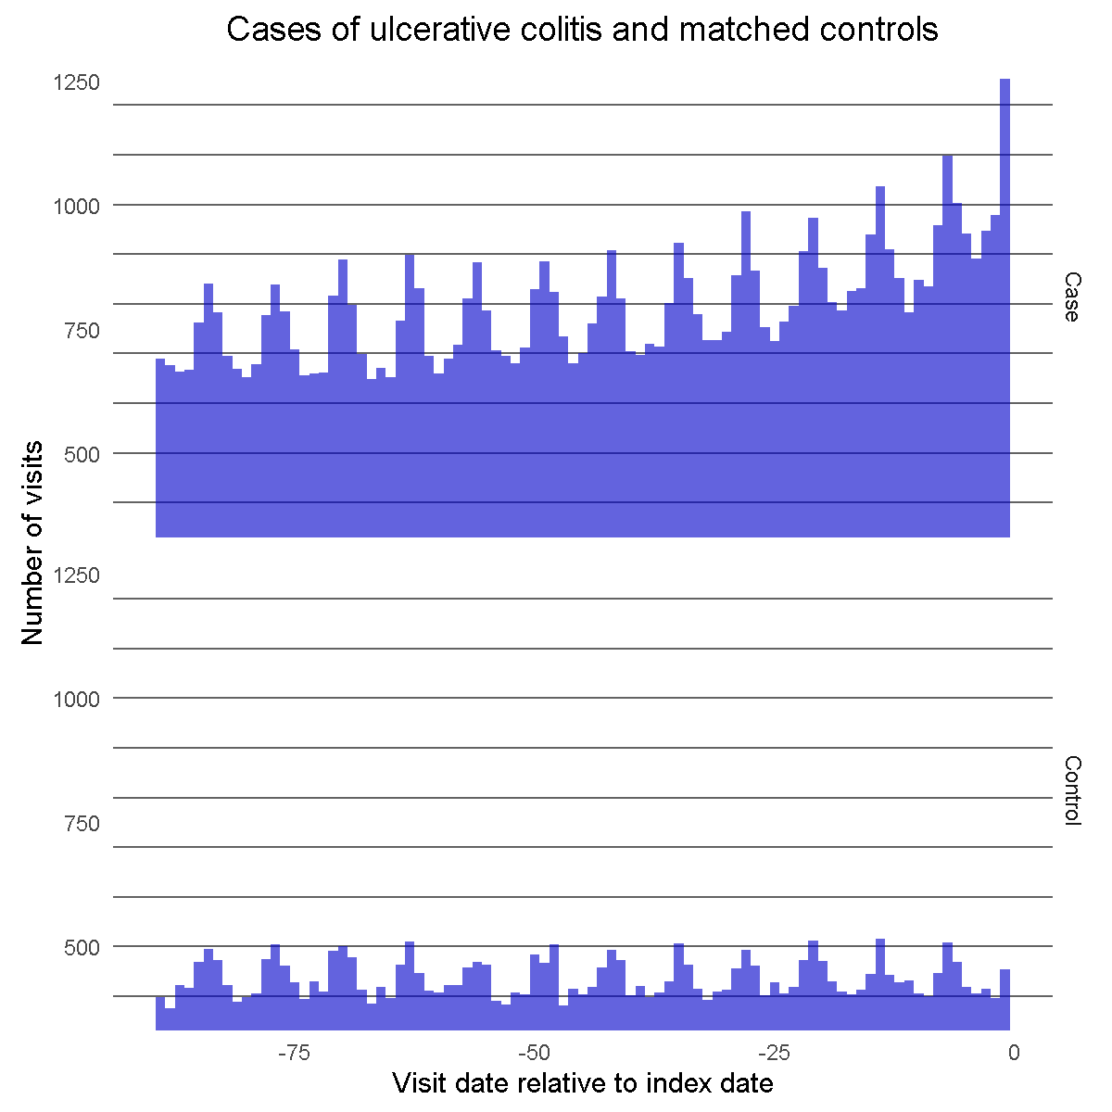
Potential for within-person counfounding

Slide 14
Estimating residual bias
Same design + outcome definition
25 negative control exposures (drugs we believe do not cause IBD)
Evaluate consistency of ORs with the null

Slide 15
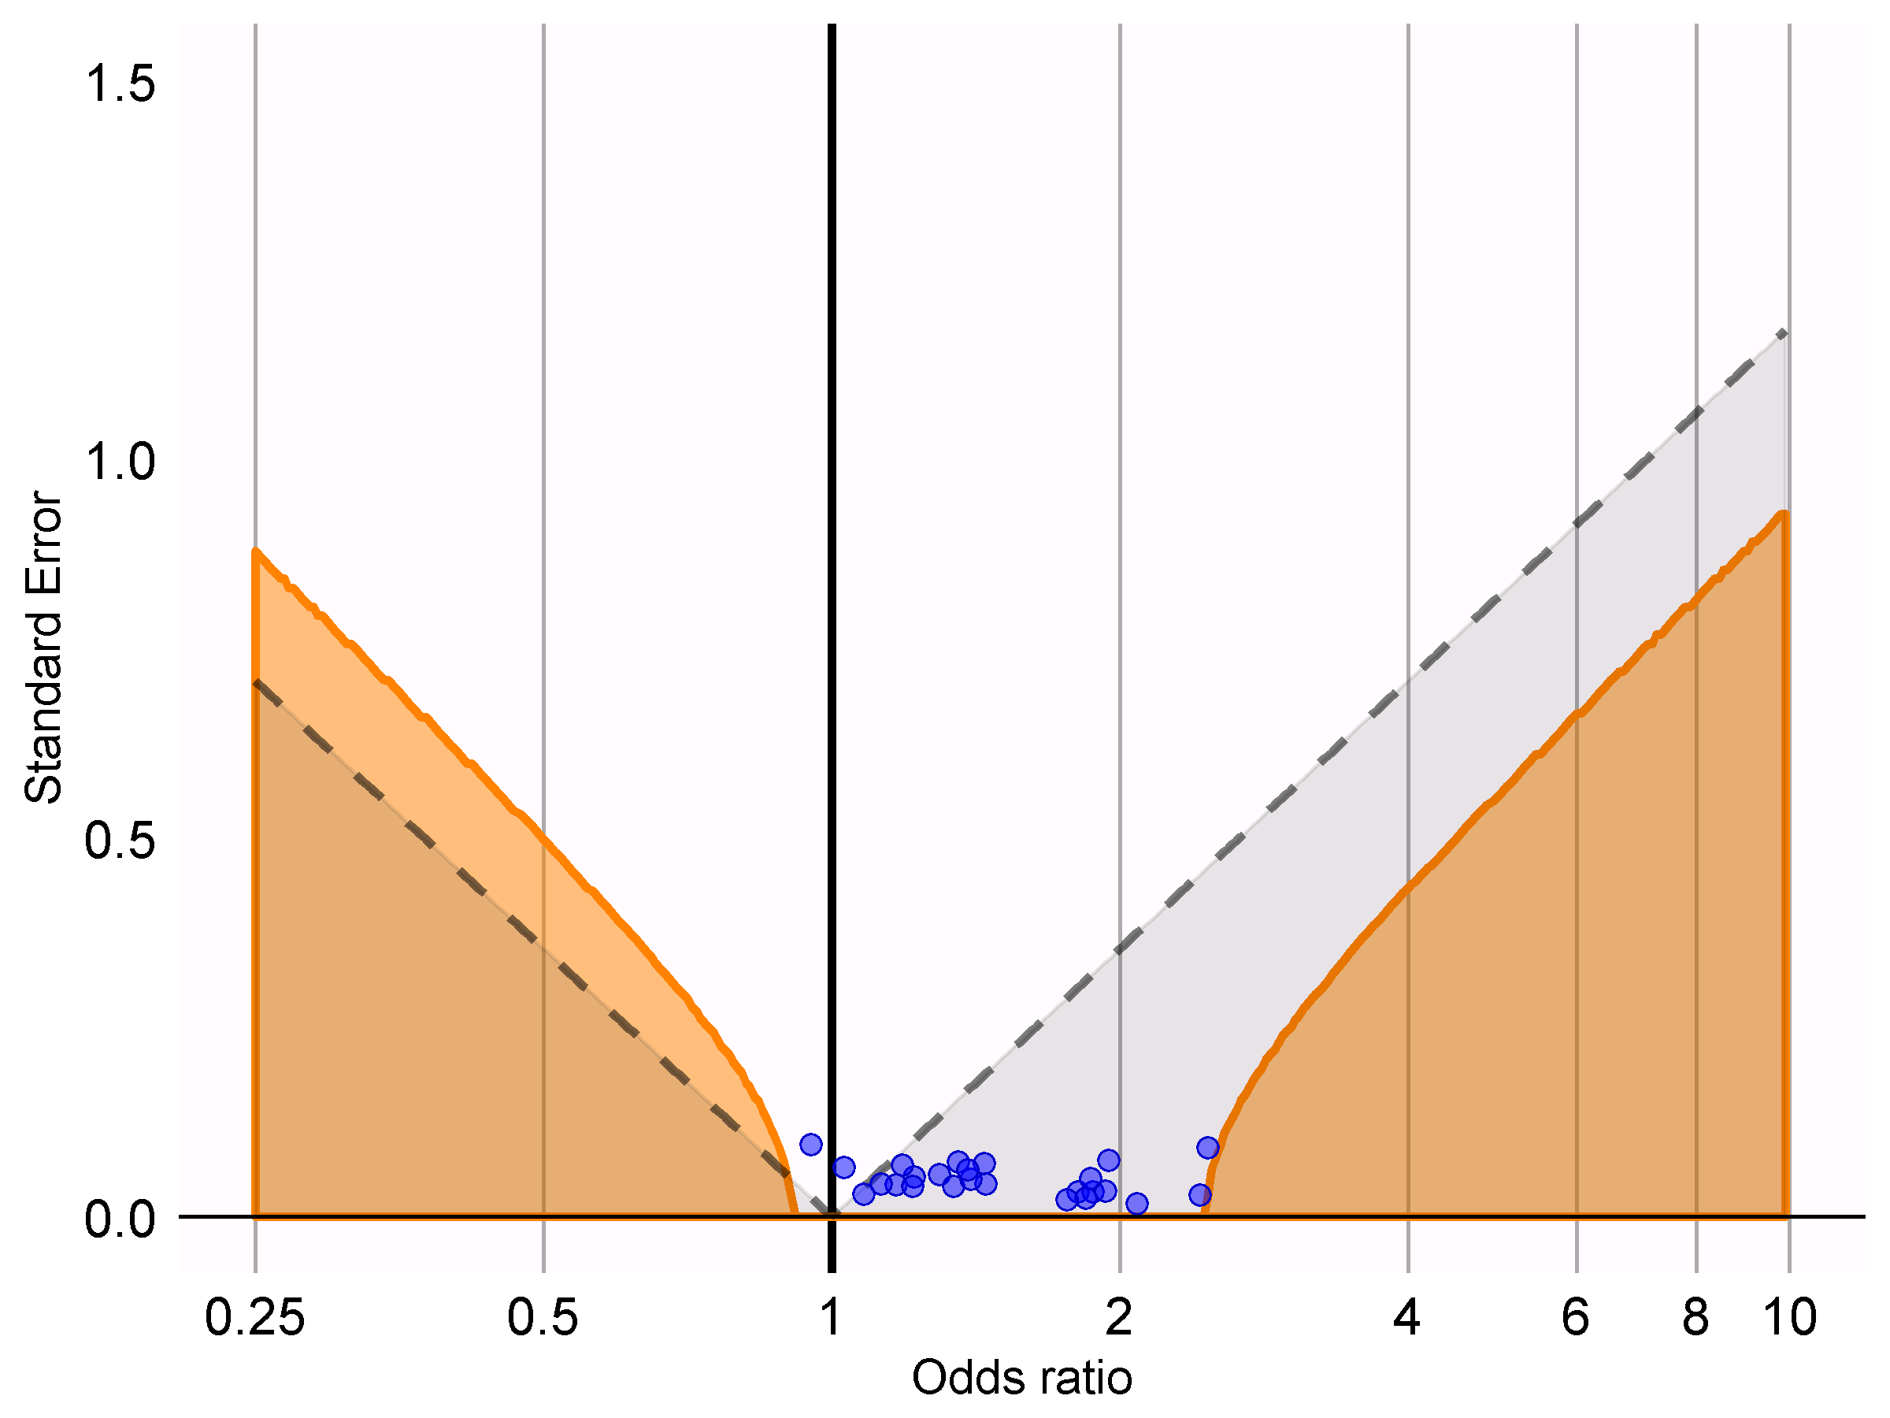
Residual bias

Slide 16
Bad example?
“Most case-control studies nowadays are nested”
“Most case-control studies nowadays include additional covariates”

Slide 17
Example study 2
Chou et al. 2014
Do DPP-4 inhibitors cause acute pancreatitis?
Database: Taiwan’s NHIRD database
Nested in T2DM
Matching on age, sex, and cohort entry year
Adjusting for covariates (gallstone disease, alcohol-related disease, hypertriglyceridemia, cystic fibrosis, neoplasm, obesity, tobacco use, DCSI, furosemide, NSAIDs, corticosteroids, antibiotics, and cancer drugs)

Slide 18
Reformulating as a cohort study
Target cohort:
DPP-4 inhibitor users
Index date: any use of drug
Comparator cohort:
Random persons with T2DM
Matched by age, gender, and time in cohort
Index date: random point in time
Outcome model:
- Include hand-picked covariates

Slide 19
Empirical evidence to support theory
Replication of Chou study
Faithful except we probably don’t have smoking status
Data: Truven CCAE

Slide 20
Potential for between-person confounding
Std diff | name
0.49 | Acute pancreatitis
0.49 | Type 2 diabetes mellitus
0.44 | Abdominal pain
0.42 | Number of distinct conditions
0.41 | Abdominal pain
0.41 | Number of distinct drug ingredients
0.40 | Imaging of abdomen
0.38 | Emergency department patient visit
0.36 | Number of distinct procedures
0.36 | Epigastric pain
0.36 | A comprehensive history
0.34 | Essential hypertension
0.34 | Evaluation and management of inpatient
0.34 | Radiologic imaging, special views and positions
0.34 | Acute pancreatitis
0.34 | Diagnostic radiography of abdomen
0.33 | NERVOUS SYSTEM
0.33 | Initial patient assessment
0.33 | Procedure on abdomen
0.33 | PSYCHOLEPTICS
0.32 | Imaging by body site
0.32 | ANXIOLYTICS
0.32 | Diagnostic radiography, posteroanterior
0.32 | Generalized abdominal pain
0.32 | Ultrasonography
Covariates with highest standardized difference between cases and controls, captured 372-7 days prior to index

Slide 21
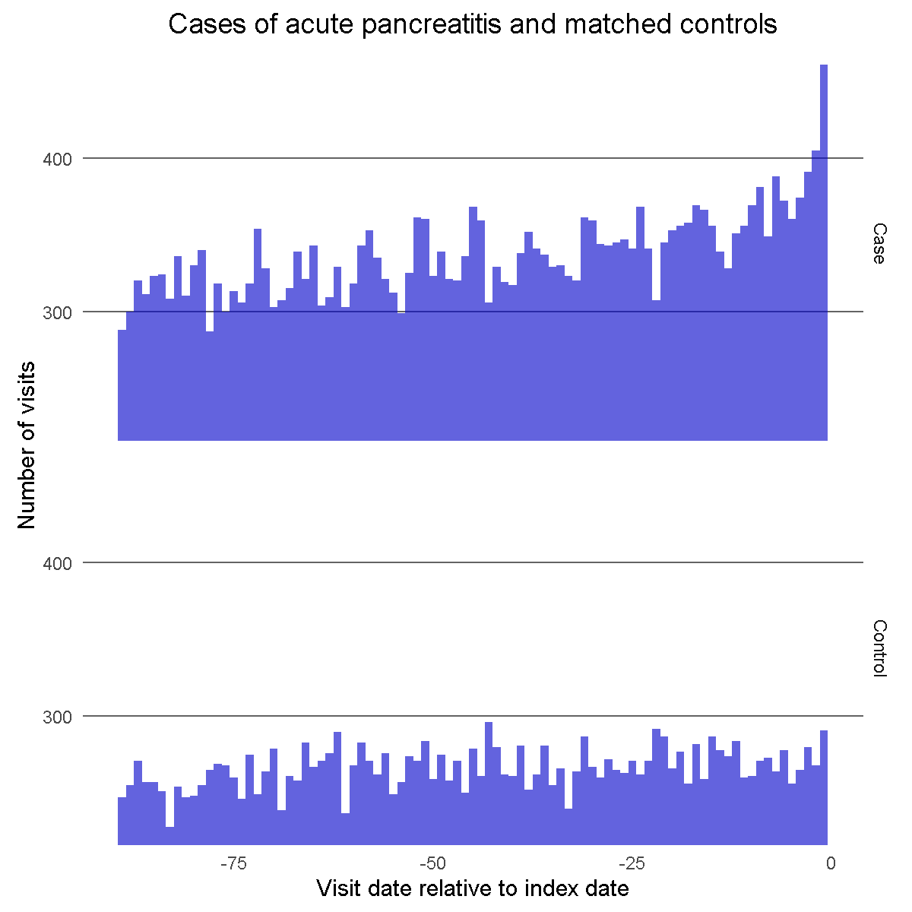
Potential for within-person counfounding

Slide 22
Estimating residual bias
Same design + outcome definition
25 negative control exposures (drugs we believe do not cause AP)
25 corresponding nesting cohorts
Evaluate consistency of ORs with the null

Slide 23
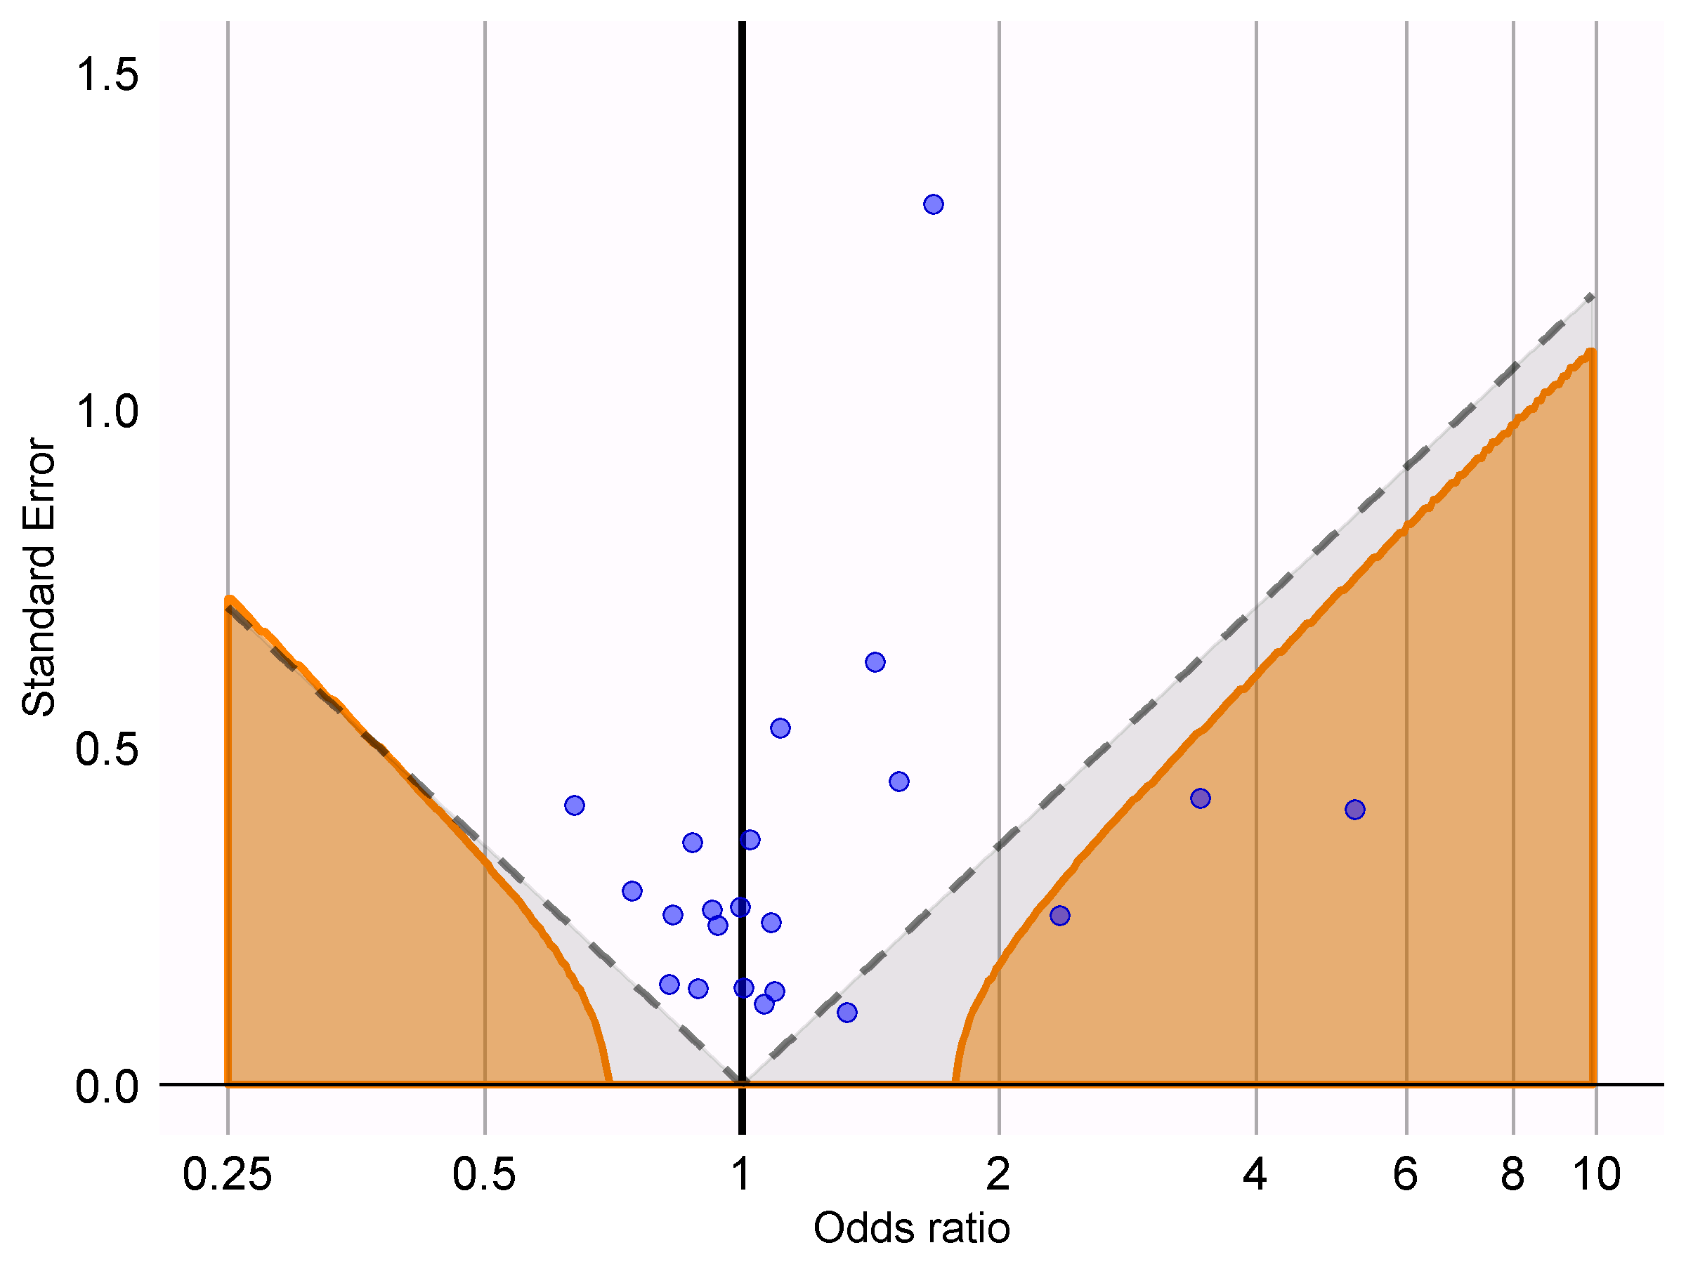
Residual bias

Slide 24
Conclusions
Case-control design is vulnerable to both between-person and within-person confounding
It combines the weaknesses of a cohort design with the weaknesses of a self-controlled design
Both designs are therefore expected to have better performance
At equal costs (since the data is already collected)

Slide 25
OHDSI Symposium is coming! (October 18)
Posters?
OHDSI methods benchmark
Results of large set of methods on benchmark
…

Slide 26
Topic of next meeting(s)?
?

Slide 27
Next workgroup meeting
Western hemisphere: July 6 No WG meeting in two weeks!
6pm Central European time
12pm New York
9am Los Angeles / Stanford
Eastern hemisphere: June 14
3pm Hong Kong / Taiwan
4pm South Korea
4:30pm Adelaide
9am Central European time
8am UK time
http://www.ohdsi.org/web/wiki/doku.php?id=projects:workgroups:est-methods

