Slide 1
OHDSI Methods Library
Martijn Schuemie, Marc Suchard, Patrick Ryan, Tomas Bergvall

Slide 2
Quick recap of previous meetings
Martijn held almost same talk in western (4 participants) and eastern (16 participants) hemisphere
Sceptical about evidence generated through observation research so far
Root causes of problem: study bias, publication bias, and p-hacking
Defined workgroup objective and started discussion on best practices
Nicole and Martijn started discussion on SCCS best practices

Slide 3
Workgroup objective
Develop scientific methods for observational research leading to population level estimates that are
Accurate
Reliable
Reproducable
And enable researchers to use these methods

Slide 4
Methods library
Population-level estimation analysis designs
New-user cohort method using propensity scores
Self-Controlled Case Series
Self-Controlled Cohort
IC Temporal Pattern Discovery
Implemented as open source R packages
Run against the CDM
In (almost) any environment
Windows, Linux, Mac
PostgreSQL, Oracle, SQL Server, Amazon RedShift, Microsoft APS
Lots of flexibility
‘Validated’ (unit tests + simulations)

Slide 5
Where?
https://github.com/OHDSI

Slide 6
CohortMethod package
cmd <- getDbCohortMethodData(connectionDetails,
cdmDatabaseSchema = cdmSchema,
targetId = 1118084,
comparatorId = 1124300,
outcomeId = 192671,
washoutPeriod = 183,
firstExposureOnly = TRUE,
removeDuplicateSubjects = TRUE,
excludeDrugsFromCovariates = TRUE,
covariateSettings = createCovariateSettings())
studyPop <- createStudyPopulation(cohortMethodData = cmd,
outcomeId = 192671,
removeSubjectsWithPriorOutcome = TRUE,
minDaysAtRisk = 1,
riskWindowStart = 0,
riskWindowEnd = 30,
addExposureDaysToEnd = TRUE)
ps <- createPs(cmd, studyPop)
plotPs(ps)
stratPop <- matchOnPs(ps,
caliper = 0.25,
caliperScale = "standardized",
maxRatio = 1)
plotPs(stratPop, ps)
balance <- computeCovariateBalance(strata, cmd)
plotCovariateBalanceScatterPlot(balance)
plotCovariateBalanceOfTopVariables(balance)
outcomeModel <- fitOutcomeModel(stratPop,
cmd
useCovariates = TRUE,
modelType = "cox",
stratified = TRUE)
plotKaplanMeier(stratPop, includeZero = FALSE)
drawAttritionDiagram(stratPop)
outcomeModel

Slide 7
CohortMethod package
These 13 statements
Implement a full study
Celecoxib vs diclofenac for risk of GI bleed
Interact directly with database in CDM
Many covariates constructed
Demographics
Every drug (+ class)
Every condition (+ group)
Every procedure
Every observation
Charleston, CHAD2, etc.
Propensity model using LASSO
1-on-1 matching on propensity score
Fitting a Cox model
including same covariates used in PS model
cmd <- getDbCohortMethodData(connectionDetails,
cdmDatabaseSchema = cdmSchema,
targetId = 1118084,
comparatorId = 1124300,
outcomeId = 192671,
washoutPeriod = 183,
firstExposureOnly = TRUE,
removeDuplicateSubjects = TRUE,
excludeDrugsFromCovariates = TRUE,
covariateSettings = createCovariateSettings())
studyPop <- createStudyPopulation(cohortMethodData = cmd,
outcomeId = 192671,
removeSubjectsWithPriorOutcome = TRUE,
minDaysAtRisk = 1,
riskWindowStart = 0,
riskWindowEnd = 30,
addExposureDaysToEnd = TRUE)
ps <- createPs(cmd, studyPop)
plotPs(ps)
stratPop <- matchOnPs(ps,
caliper = 0.25,
caliperScale = "standardized",
maxRatio = 1)
plotPs(stratPop, ps)
balance <- computeCovariateBalance(strata, cmd)
plotCovariateBalanceScatterPlot(balance)
plotCovariateBalanceOfTopVariables(balance)
outcomeModel <- fitOutcomeModel(stratPop,
cmd
useCovariates = TRUE,
modelType = "cox",
stratified = TRUE)
plotKaplanMeier(stratPop, includeZero = FALSE)
drawAttritionDiagram(stratPop)
outcomeModel

Slide 8
CohortMethod package
cmd <- getDbCohortMethodData(connectionDetails,
cdmDatabaseSchema = cdmSchema,
targetId = 1118084,
comparatorId = 1124300,
outcomeId = 192671,
washoutPeriod = 183,
firstExposureOnly = TRUE,
removeDuplicateSubjects = TRUE,
excludeDrugsFromCovariates = TRUE,
covariateSettings = createCovariateSettings())
studyPop <- createStudyPopulation(cohortMethodData = cmd,
outcomeId = 192671,
removeSubjectsWithPriorOutcome = TRUE,
minDaysAtRisk = 1,
riskWindowStart = 0,
riskWindowEnd = 30,
addExposureDaysToEnd = TRUE)
ps <- createPs(cmd, studyPop)
plotPs(ps)
stratPop <- matchOnPs(ps,
caliper = 0.25,
caliperScale = "standardized",
maxRatio = 1)
plotPs(stratPop, ps)
balance <- computeCovariateBalance(strata, cmd)
plotCovariateBalanceScatterPlot(balance)
plotCovariateBalanceOfTopVariables(balance)
outcomeModel <- fitOutcomeModel(stratPop,
cmd
useCovariates = TRUE,
modelType = "cox",
stratified = TRUE)
plotKaplanMeier(stratPop, includeZero = FALSE)
drawAttritionDiagram(stratPop)
outcomeModel
Specify the two exposure groups and the outcome.
Here using drug_era and condition_era tables (default)
Typically using Circe-defined cohorts

Slide 9
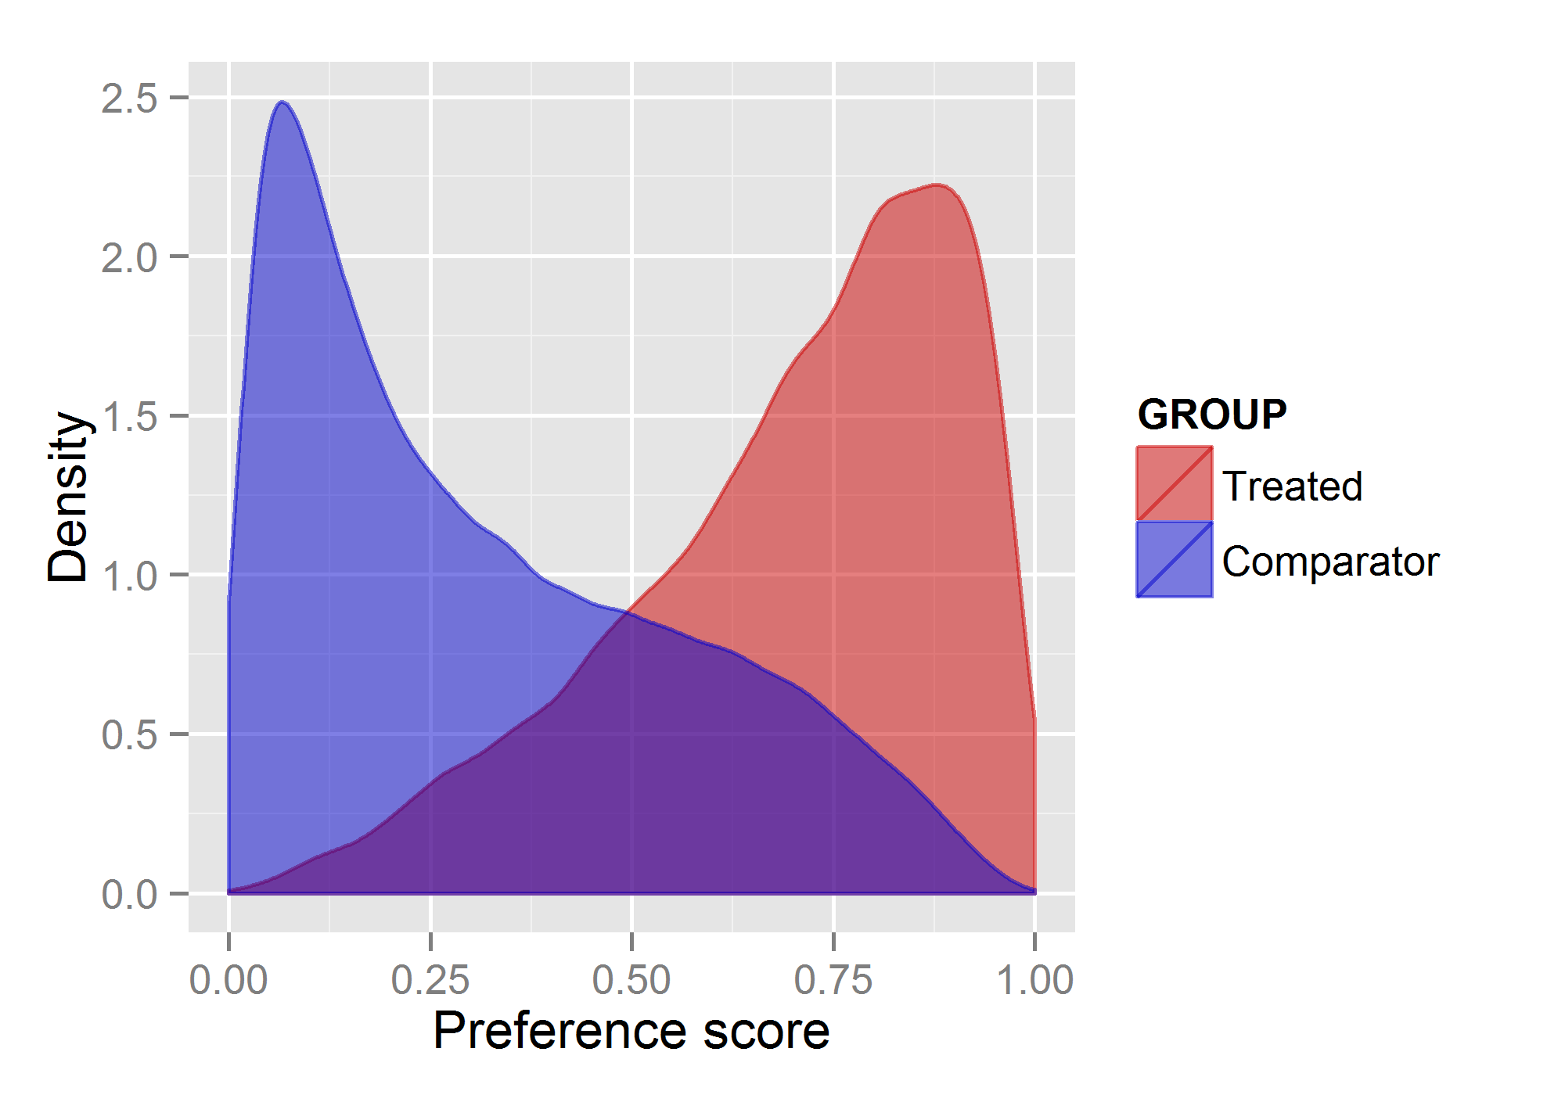
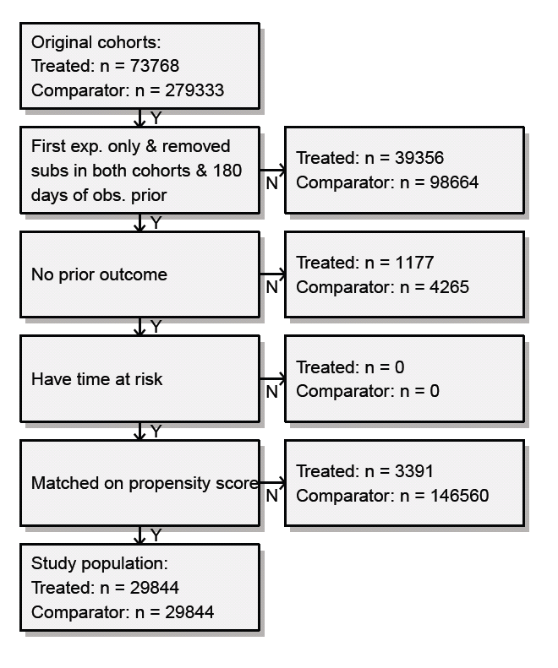
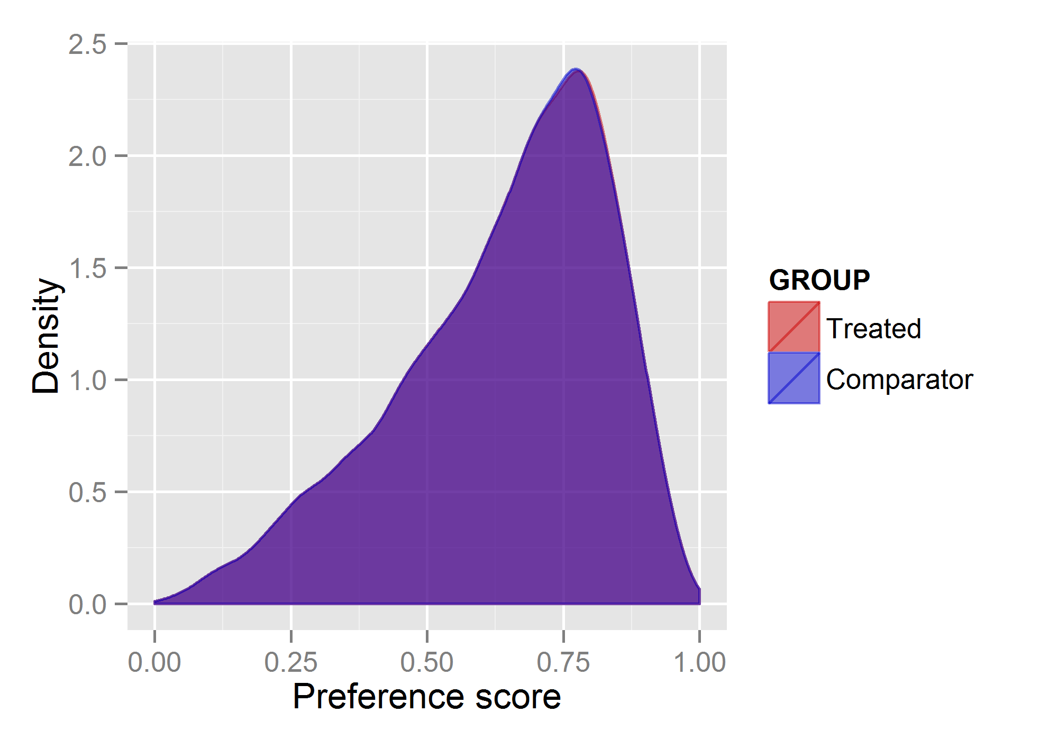
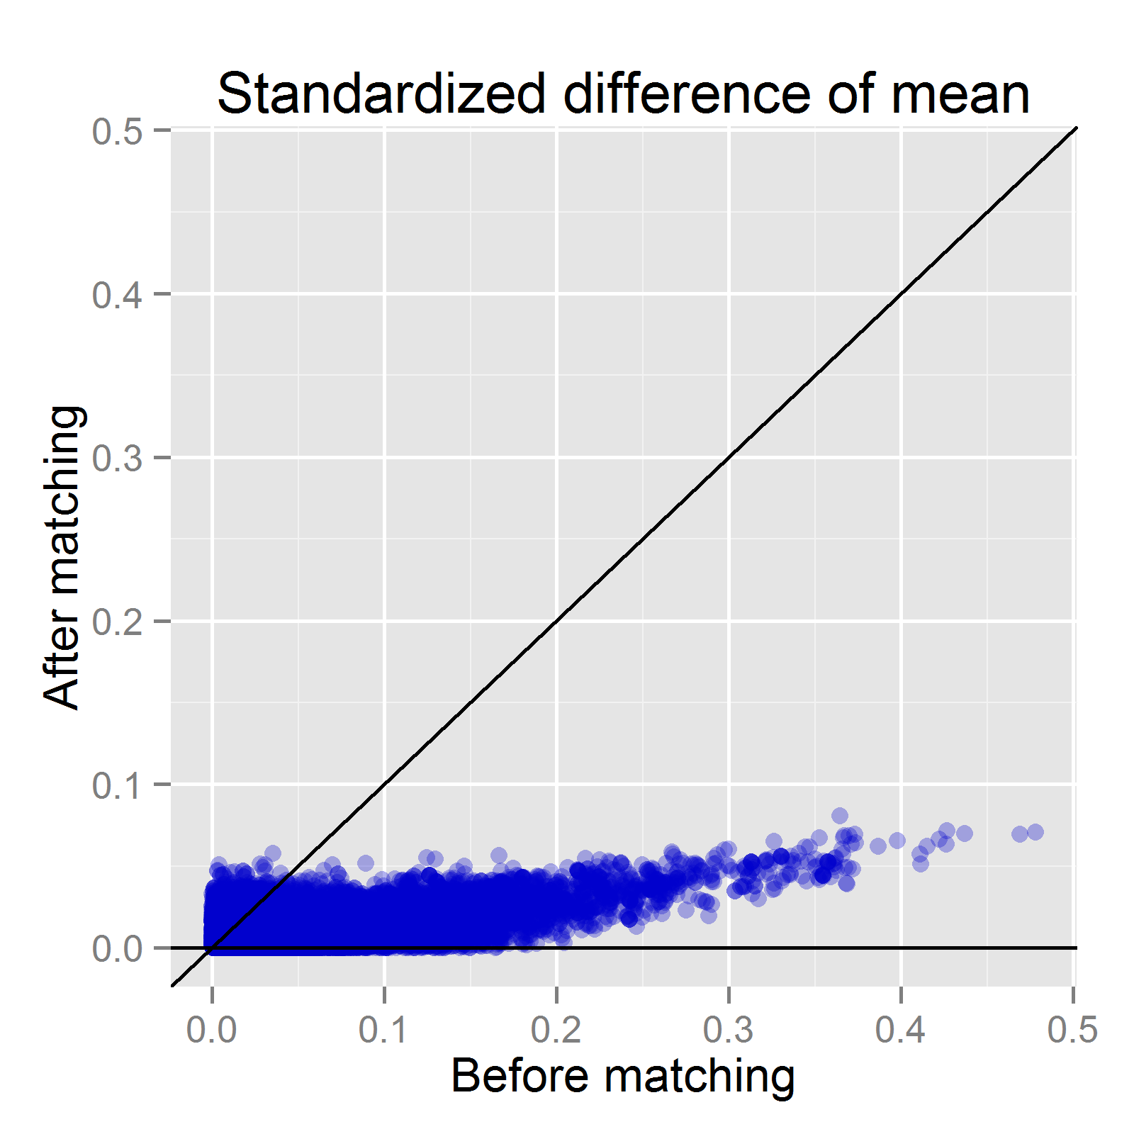
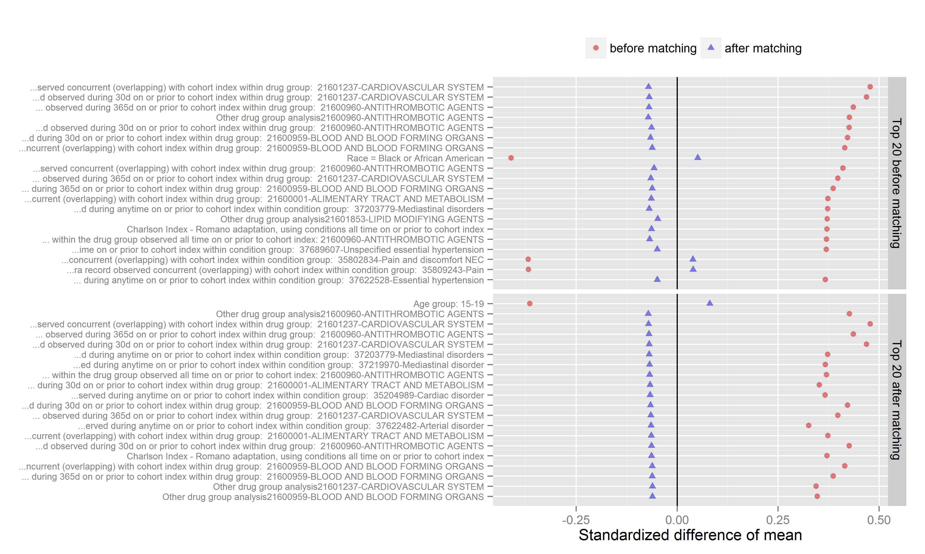
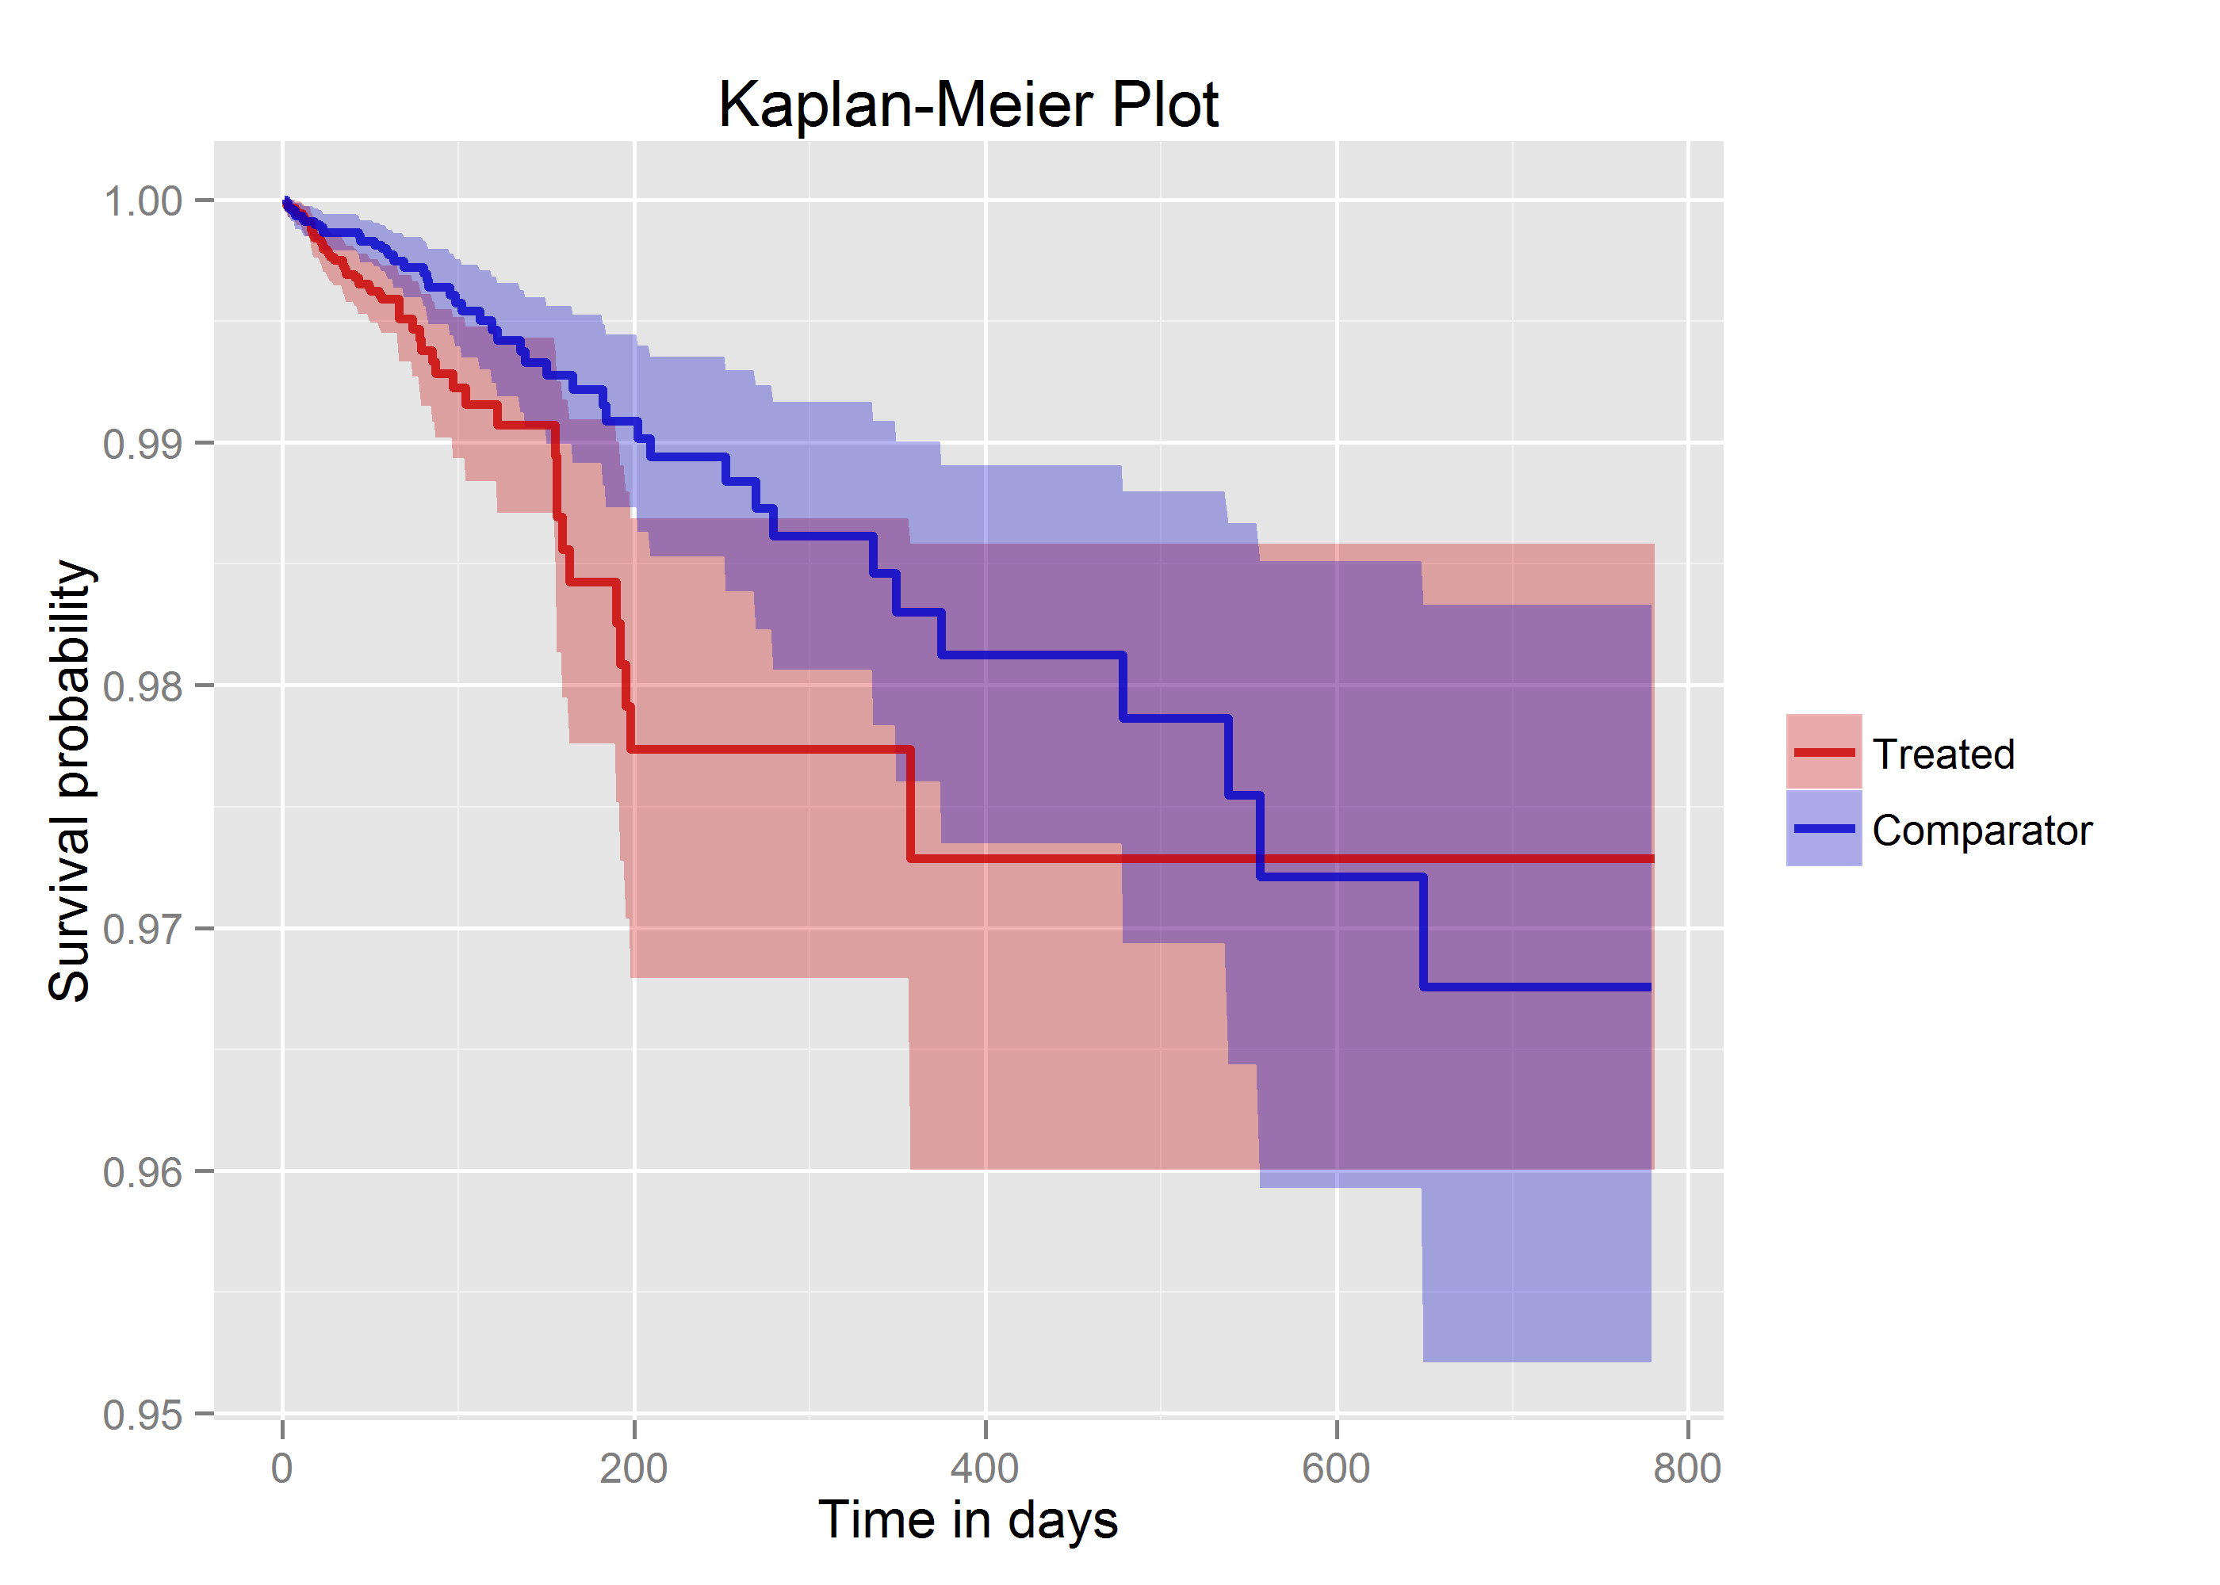
CohortMethod package
cmd <- getDbCohortMethodData(connectionDetails,
cdmDatabaseSchema = cdmSchema,
targetId = 1118084,
comparatorId = 1124300,
outcomeId = 192671,
washoutPeriod = 183,
firstExposureOnly = TRUE,
removeDuplicateSubjects = TRUE,
excludeDrugsFromCovariates = TRUE,
covariateSettings = createCovariateSettings())
studyPop <- createStudyPopulation(cohortMethodData = cmd,
outcomeId = 192671,
removeSubjectsWithPriorOutcome = TRUE,
minDaysAtRisk = 1,
riskWindowStart = 0,
riskWindowEnd = 30,
addExposureDaysToEnd = TRUE)
ps <- createPs(cmd, studyPop)
plotPs(ps)
stratPop <- matchOnPs(ps,
caliper = 0.25,
caliperScale = "standardized",
maxRatio = 1)
plotPs(stratPop, ps)
balance <- computeCovariateBalance(strata, cmd)
plotCovariateBalanceScatterPlot(balance)
plotCovariateBalanceOfTopVariables(balance)
outcomeModel <- fitOutcomeModel(stratPop,
cmd
useCovariates = TRUE,
modelType = "cox",
stratified = TRUE)
plotKaplanMeier(stratPop, includeZero = FALSE)
drawAttritionDiagram(stratPop)
outcomeModel
HR = .83 (0.67 – 1.01)

Slide 10
All-by-all support
Target – (Comparator) - Outcome
Analysis settings
Target – (Comparator) - Outcome
Analysis settings
Target – (Comparator) - Outcome
Analysis settings
Drug – (Comparator) - Outcome
Analysis settings
Method
For:
Sensitivity analyses
Including negative controls
Methods research
Safety surveillance?
Estimates, Diagnostics

Slide 11
Validation
Unit tests
Simulations

Slide 12
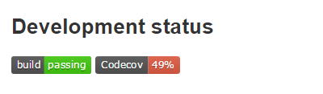
Unit tests
A unit test is a piece of code that tests a function:
test_that("Simple 1-on-1 matching", {
rowId <- 1:5
treatment <- c(1, 0, 1, 0, 1)
propensityScore <- c(0, 0.1, 0.3, 0.4, 1)
data <- data.frame(rowId = rowId,
treatment = treatment,
propensityScore = propensityScore)
result <- matchOnPs(data, caliper = 0, maxRatio = 1)
expect_equal(result$stratumId, c(0, 0, 1, 1))
})
All unit tests are executed every time a change is made to the package:

Slide 13
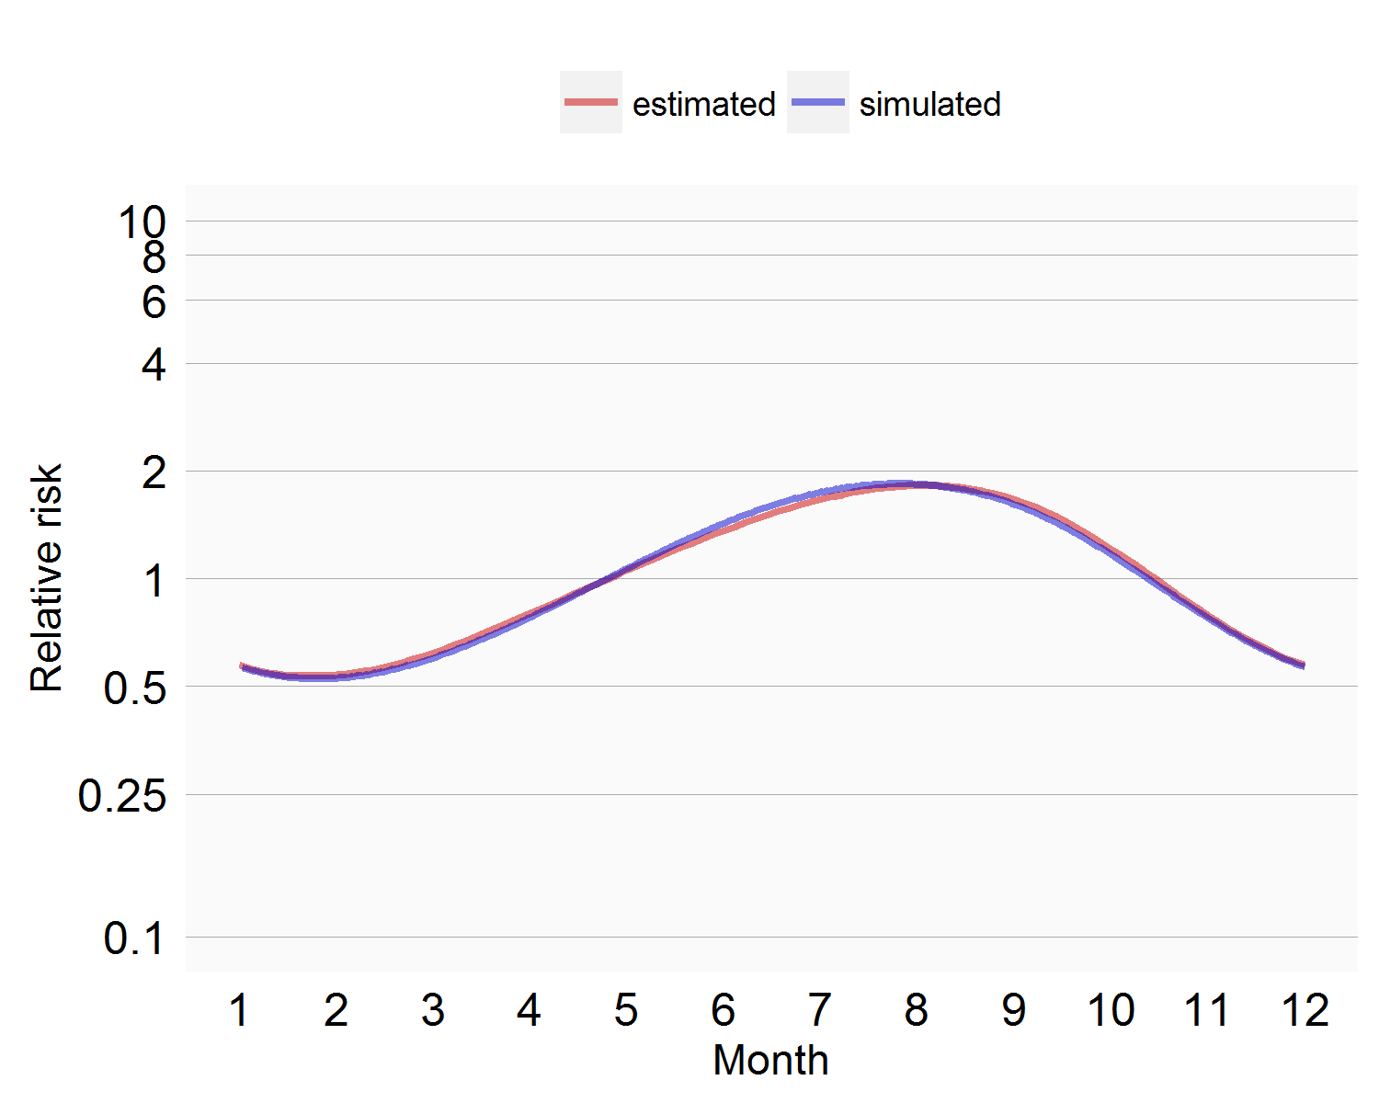
Simulation
Using simulation for more complicated functionality
E.g: SCCS seasonality modeling:

Slide 14
Validation
Unit tests
Simulations
Not
Double coding

Slide 15
Discussion on validation
Are unit tests and simulations enough?
Do we need (and believe in) double coding?
Can we formulate best practices around validation?

Slide 16
Implemented methods
New-user cohort method using propensity scores
Self-Controlled Case Series
Self-Controlled Cohort
IC Temporal Pattern Discovery

Slide 17
New-user cohort method
Compare new users of drug A to drug B for outcome X
Automatic propensity score construction
Trim, stratify, or match on PS
Outcome modeling
Cox, Poisson, or logistic
Option to include same 50k+ covariates in outcome model
Diagnostics
PS distribution overlap
Covariate balance after matching
Kaplan-Meier plot

Slide 18
New-user cohort method
Strengths
Compare apples to apples (near zero residual bias)
Subjects with same baseline characteristics
Comparable point in time (initiation of a new treatment)
Comparative effectiveness (is drug A safer than drug B?)
Stop-go diagnostics
Easy to interpret (similar to RCT)
Weaknesses
‘Absolute’ safety (does drug A cause outcome X?)
Data hungry
Only works with a good comparator
Sensitive to unmeasured between-person confounding

Slide 19
Self-Controlled Case Series
Compare time on drug to time not on drug
Self-controlled: adjusting for all constant patient characteristics
Flexible risk window definitions
Correct for age and seasonality
Constant effect within a calendar month
Spline smoothing across months
Add other drugs to model (e.g. concomittant use)
User picked
All other drugs (MSCCS model using regularized Poisson regression)
Adjust for event-dependent observation end

Slide 20
Self-Controlled Case Series
Strengths
‘Absolute’ safety (does drug A cause outcome X?)
Adjust for all patient characteristics that are constant in time
Weaknesses
Comparative effectiveness (is drug A safer than drug B?)
Sensitive to within-person time-varying confounding
Lots of things happen when you take a drug
Sensitive to violations of underlying assumptions
Does the event affect probability of exposure?
Doest the event affect probability of subsequent events?
Does the event affect probability of censoring (e.g. death)?
Problematic for both chronic exposures and lethal outcomes
Hard to interpret

Slide 21
Self-Controlled Cohort
Compare time on drug to time just prior to starting drug
Risk window definitions
Length of risk window and control window
Filter subjects who do not have full control period available

Slide 22
Self-Controlled Cohort
Strengths
Fast
Adjusts for patient baseline characteristics
Best performer in OMOP experiment
Weaknesses
Positively biased when there’s contra-indication
Sensitive to within-person time-varying confounding
Lots of things happen when you take a drug

Slide 23
IC Temporal Pattern Discovery
Similar to Self-Controlled Cohort
Pick different control period (e.g. one year ago)
Adjust for typical pattern when initiating a drug
Produces an IC statistic instead of an effect size estimate

Slide 24
IC Temporal Pattern Discovery
Strengths
Fast
Adjusts for patient baseline characteristics
More robust to contra-indications
Weaknesses
IC statistic is hard to interpret
Sensitive to within-person time-varying confounding
Lots of things happen when you take a drug

Slide 25
Methods Library R packages
Cohort Method
Self-Controlled Case Series
Self-Controlled Cohort
IC Temporal Pattern Disc.
s
s
s
s
New-user cohort studies using large-scale regression for propensity and outcome models
Self-Controlled Case Series analysis using few or many predictors, includes splines for age and seasonality.
A self-controlled cohort design, where time preceding exposure is used as control.
A self-controlled design, but using temporal patterns around other exposures and outcomes to correct for time-varying confounding.
Estimation methods
Feature Extraction
Patient Level Prediction
s
s
Automatically extract large sets of features for user-specified cohorts using data in the CDM.
Build and evaluate predictive models for user-specified outcomes, using a wide array of machine learning algorithms.
Prediction methods
Empirical Calibration
Method Evaluation
s
s
Use negative control exposure-outcome pairs (where relative risk is assumed to be 1) to profile and calibrate a particular analysis design.
Use real data and established reference sets as well as simulations injected in real data to evaluate the performance of methods.
Method characterization
Database Connector
Sql Render
Cyclops
s
s
s
Ohdsi R Tools
s
Connect directly to a wide range of database platforms, including SQL Server, Oracle, and PostgreSQL.
Generate SQL on the fly for the various SQL dialects.
Highly efficient implementation of regularized logistic, Poisson and Cox regression.
Support tools that didn’t fit other categories, including tools for maintaining R libraries.
Supporting packages
Under construction

Slide 26
Which methods?
Implemented:
New-user cohort method using propensity scores
Self-Controlled Case Series
Self-Controlled Cohort
IC Temporal Pattern Discovery
Not (yet) implemented:
Case – control
Case – crossover
?
Not dealing with time-varying confounding between exposure start and outcome

Slide 27
Discussion
Method package: Black box or best practice?
Packages become prescriptive, e.g.
Large scale regression is easy, hand-picking covariates is hard
New-user CM + PS is easy, case-control is hard
Template protocols per method package?
Point-and-click interface?
Training?

Slide 28
Funding opportunities
Anyone?

Slide 29
Topic of next meeting(s)?
Method evaluation
Identifying the important questions that can be answered using observational research
CohortMethod package in-depth
Replicating RCTs in observational data
?

Slide 30
Next workgroup meeting(s)
Western hemisphere: April 27
6pm Central European time
5pm UK time
Noon Eastern Time (New York)
9am Pacific Coast Time (LA)
Eastern hemisphere: May 4
3pm Hong Kong / Taiwan
4pm South Korea
4:30pm Adelaide
(9am Central European time)
http://www.ohdsi.org/web/wiki/doku.php?id=projects:workgroups:est-methods

Slide 31
Under the hood
CDM
JDBC
SqlRender
SQL
Database
Connector
FF
Data processing
Results
FF
Cyclops

