Slide 1
The Book of OHDSI
How to edit

Slide 2
Install R, R-Studio, Git, and bookdown
R: https://cran.r-project.org/
R-Studio: https://www.rstudio.com/
Git: https://git-scm.com/
bookdown:
install.packages("bookdown")

Slide 3
Fork TheBookOfOhdsi

Slide 4
Clone your fork
R-Studio → File → New Project → Version Control → Git → <paste URL> → Create Project

Slide 5
Create a new chapter
R-Studio → File → New File → Text File
Add text:
Save as “08-MyChapter.Rmd”
Name doesn’t really matter, but chapters are based on order of file name
# My chapter

Slide 6
Preview in R-Studio

Slide 7
MarkDown syntax
Element | Markdown Syntax
Heading | # H1 ## H2 ### H3
Bold | **bold text**
Italic | *italicized text*
Bold and italics | ***really important***
Blockquote | > blockquote
Ordered List | 1. First item 2. Second item 3. Third item
Unordered List | - First item - Second item - Third item
Code | `code`
Horizontal Rule | ---
Link | [title](https://www.example.com)
Image | ![alt text](image.jpg)

Slide 8
Extended syntax
Element | Markdown Syntax
Table | | Syntax | Description | | ----------- | ----------- | | Header | Title | | Paragraph | Text |
Footnote | Here's a sentence with a footnote. [^1] [^1]: This is the footnote.
Heading ID | ### P-value mantras{#custom-id} For more detail, see section \@ref(custom-id)
Definition list | term : definition
Strikethrough | ~~The world is flat.~~

Slide 9
RMarkDown
Use R code in your document to generate plots, tables, etc.
If you want to show R code that generated the plot:
```{r nice-fig, fig.cap='Here is a nice figure’, echo=FALSE}
plot(pressure)
```
Pressure statistics are shown in Figure \@ref(fig:nice-fig).
```{r nice-fig, fig.cap='Here is a nice figure’, echo=TRUE}
plot(pressure)
```
Pressure statistics are shown in Figure \@ref(fig:nice-fig).

Slide 10
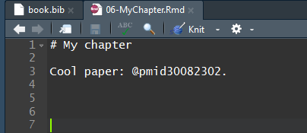
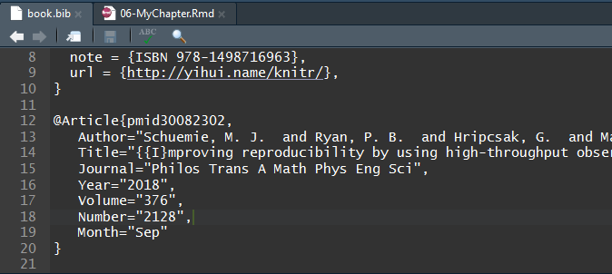
Literature references
Uses BibTex
Can generate using http://www.bioinformatics.org/texmed/
Add to book.bib
Cite using @...

Slide 11
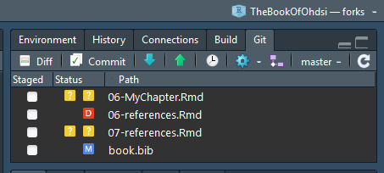
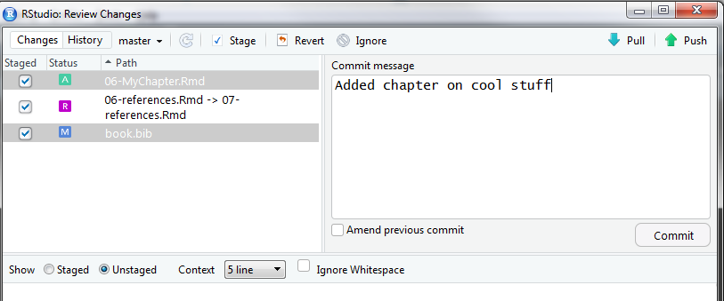
Commit, Push
5
This will push your changes to your fork
1
3
2
4

Slide 12
Pull request
This will request your changes to be added to the main book repository

Slide 13
Current version of the book
https://ohdsi.github.io/TheBookOfOhdsi/

