Slide 1
OHDSI Gold Standard Phenotype Library Working Group
Community Call Progress Update
Aaron Potvien
April 2, 2019

Slide 2
Gold Standard Phenotype Library (GSPL)
(Talked about why we need the GSPL on January 15th )
Objective:
To enable members of the OHDSI community to find, evaluate, and utilize community-validated cohort definitions for research and other activities.

Slide 3
FAIR Principles
GSPL development is being guided by FAIR Principles
Reference: The FAIR Guiding Principles for scientific data management and stewardship by Wilkinson et al. (2016)
Findable
Accessible
Interoperable
Reusable

Slide 4
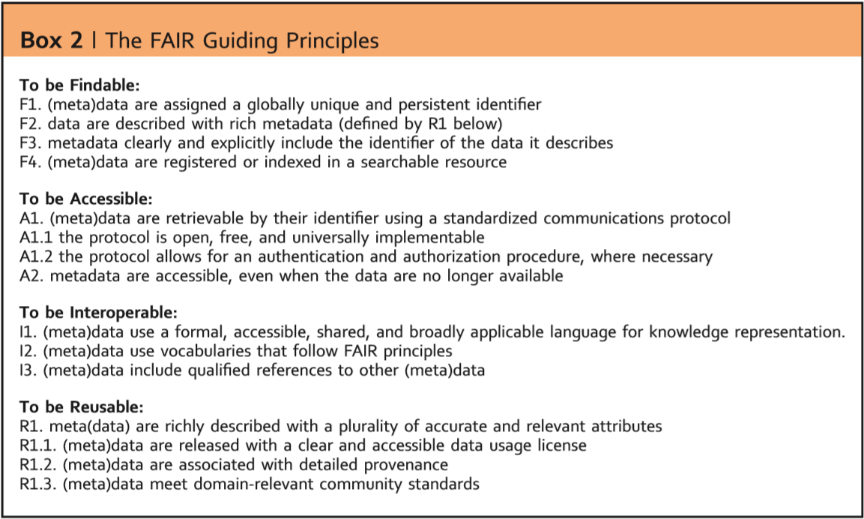
FAIR Principles

Slide 5
Library Architecture Formulation
End User
Authors
Librarians
Validators

Slide 6
“Gold Standard” you say?
What it isn’t:
- Imposing rules to make sure phenotypes have “good enough” metrics.
What it is:
- Librarians making sure that certain “gold standard processes” are being followed when a phenotype is submitted to the library and when a phenotype is validated.

Slide 7
Gold Standard Processes
Author Data Elements
Metadata:
Title
Author(s) and Affiliations
Date of Submission
Modality (Rule-Based or Computable)
Links to implementation/config files on GitHub
Development:
Purpose and Intended Use
Development Methodology
Flowchart
Identify CDM Dependencies:
Conditions
Drug Exposures
Labs
Measurements
Notes NLP
Observations
Procedures
Visits
Provenance:
Other phenotype definitions this phenotype was derived from or inspired by

Slide 8
Gold Standard Processes
Validator Data Elements
Metadata:
Title
Author(s) and Affiliations
Date of Submission
Hash of phenotype evaluated
Validation procedure
Metrics:
Sample Size
True Positives/Negatives
False Positives/Negatives
Was a THEMIS-certified dataset used?

Slide 9
Hash-based Linkage
A Phenotype is identified by a hash of its implementation file
Phenotypes
Validation Sets
Set 1
7245cf0ee90b52deb5b9965f42a5f32cff585d29
Set 2
Set 3

Slide 10
Hash-based Linkage
A Phenotype is identified by a hash of its implementation file
Phenotypes
Validation Sets
Set 1
7245cf0ee90b52deb5b9965f42a5f32cff585d29
Set 2
Set 3
Provenance
New Version
902670dcfa3ed1d636574a65915b03b33ba7fc48
Set 1
Set 2

Slide 11
Library Implementation
Data for the library will be stored on GitHub
A companion Shiny application will exist to help with searching through this data, compare and contrast phenotypes, etc.

Slide 12
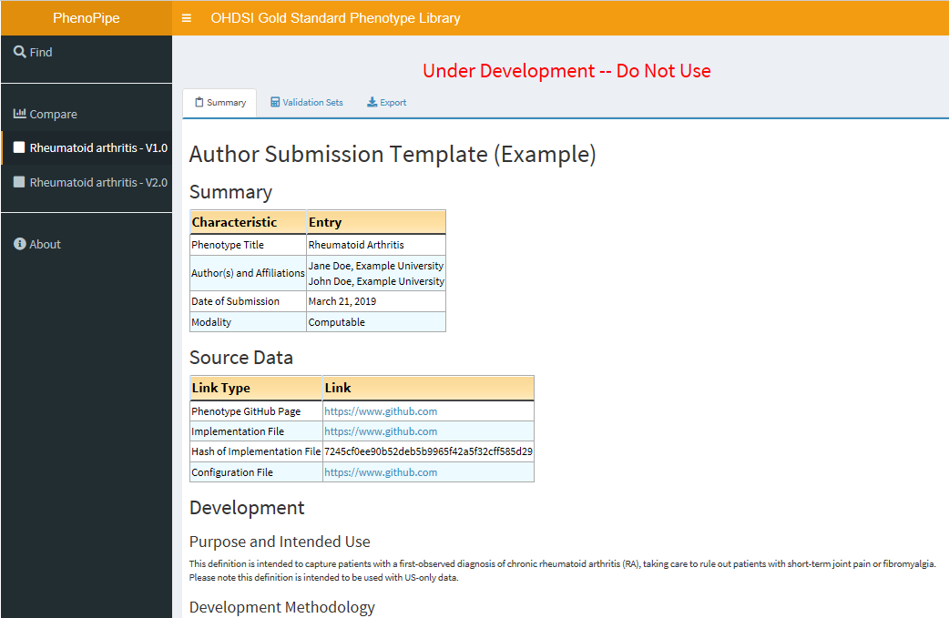
Shiny App Viewer
data.ohdsi.org/PhenotypeLibraryViewer/

Slide 13
Combining OHDSI Toolsets
Aphrodite (Juan Banda) https://github.com/OHDSI/Aphrodite
Can create phenotypes probabilistically by learning good phenotypes from a set of noisy labels
Built to interface with the OMOP CDM to automatically create and utilize features using all data in your CDM (or a subset, if you choose)
Machine learning takes into account more features than what could be considered by hand, and labeling heuristic is less time consuming
Performs internal validation and is easy to share (config file tracks how it was built; binary object output tracks the definition itself)

Slide 14
Combining OHDSI Toolsets
PheValuator (Joel Swerdel) https://github.com/OHDSI/PheValuator
Can evaluate phenotypes to see how well they perform, offering an alternative to low-powered and time-consuming clinical review
Uses a diagnostic predictive model to assign a large sample of people a predicted probability of having the condition
Assess “Truth” based on an extremely specific cohort (xSpec) or extremely sensitive cohort (xSens)
Produces all metrics (not just PPV) for a complete understanding of phenotype definition performance
Like Aphrodite, will automatically output documentation needed for being a Gold Standard Process.

Slide 15
Combining OHDSI Toolsets
Combining these tools can help to populate the library.
Phenotype Made with Aphrodite
Phenotype Library on GitHub
Data Viewed with Shiny Application
Validation Sets Created with PheValuator
Not required to be “gold standard” but available to help facilitate the process and avoid pitfalls!

Slide 16
Thanks!
Feedback Welcomed!
Forum:
http://forums.ohdsi.org/t/requirements-development-for-the-ohdsi-gold-standard-phenotype-library/4876
Wiki:
http://www.ohdsi.org/web/wiki/doku.php?id=projects:workgroups:gold-library-wg
Aphrodite:
https://github.com/OHDSI/Aphrodite/
PheValuator:
https://github.com/OHDSI/PheValuator/
Viewer Application:
http://data.ohdsi.org/PhenotypeLibraryViewer/
My e-mail:
Aaron.Potvien@gtri.gatech.edu

