Slide 1
OHDSI estimation-methods papers in progress
Martijn Schuemie, PhD
Janssen Research and Development

Slide 2
Previous Eastern Hemisphere meeting
Erica Voss: Using Established Knowledge in Population-Level Estimation In a Systematic Way

Slide 3
Population-level estimation workgroup
Meeting goals:
Awareness: what is everyone doing now?
Strategy: what needs doing next?
Marching orders: who’s going to do it? Who will help? Are grants needed?

Slide 4
Confidence interval calibration
Martijn Schuemie, PhD
Janssen Research and Development

Slide 5
Disclaimer
These are preliminary results

Slide 6
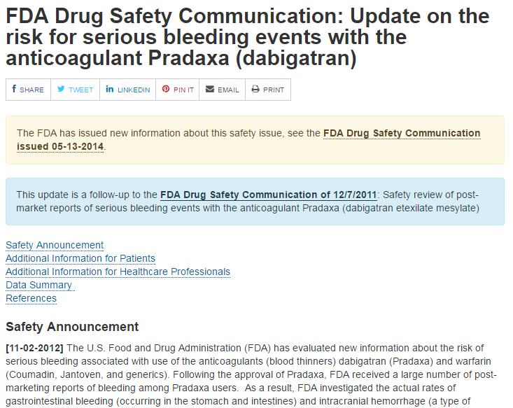
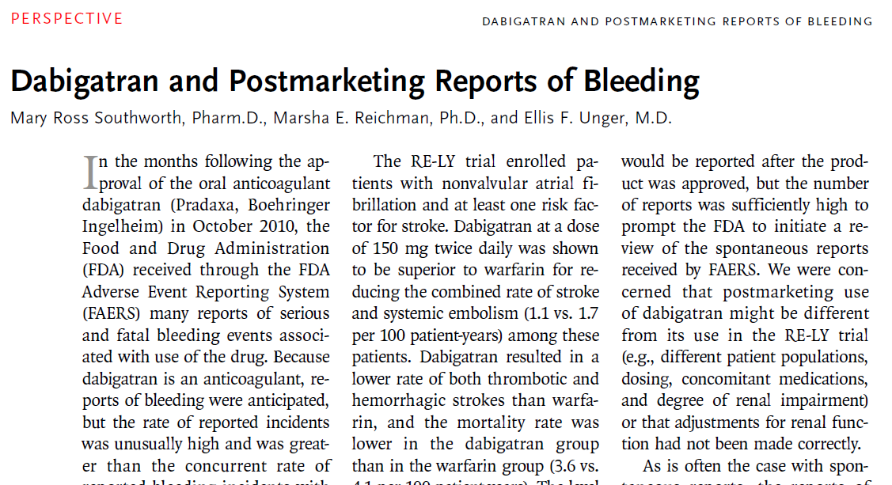
A tale of two studies
Study 1: Mini-Sentinel estimated incidence of GI bleeding in dabigatran vs warfarin
Crude comparison
IRR = 1.6 / 3.5 = 0.46
NEJM publication
FDA subsequently communicated dabigatran is safe

Slide 7
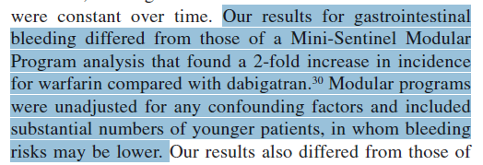
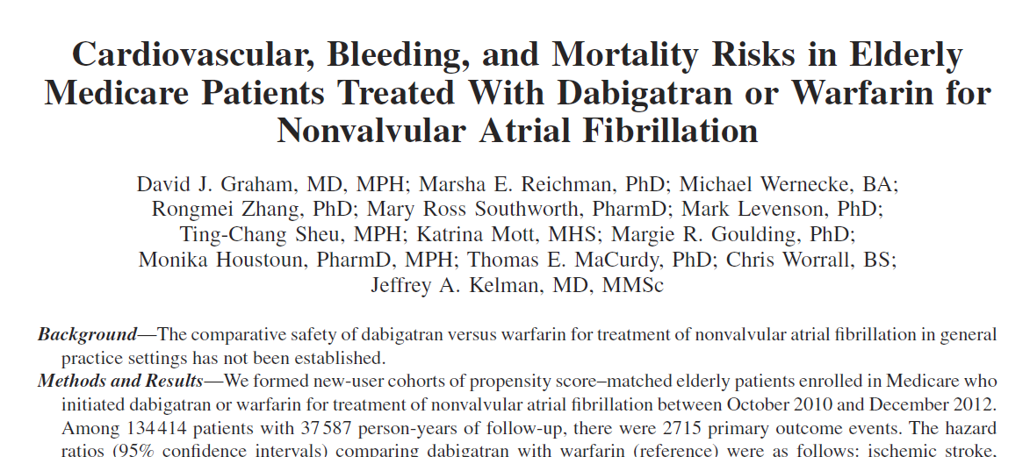
A tale of two studies
Study 2: Graham et al. also estimated incidence of GI bleeding in dabigatran vs warfarin
Propensity-score adjustment
Restricted to elderly population
HR = 1.28 (1.14–1.44)

Slide 8
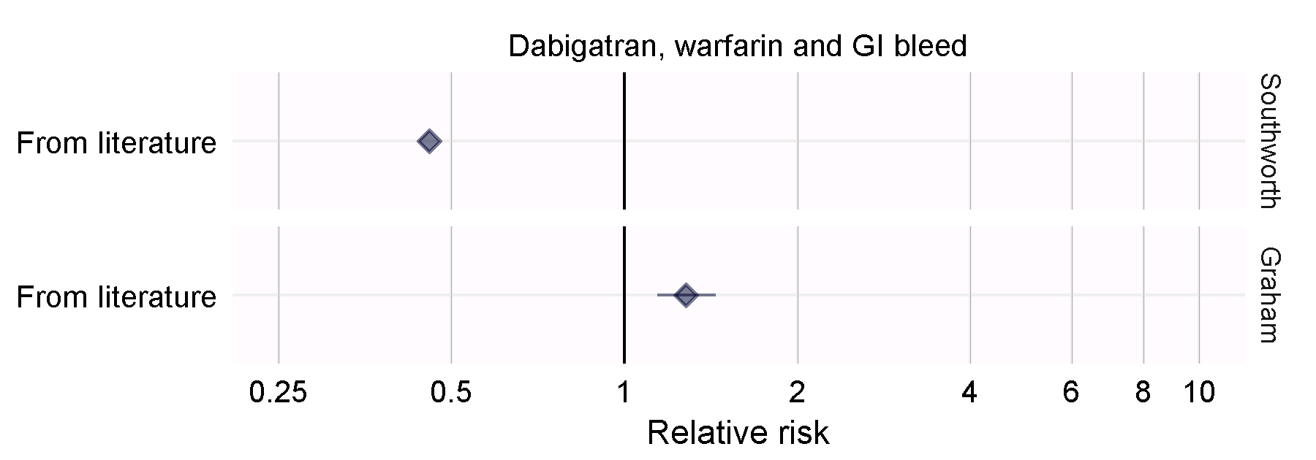
Opposite effects
Southworth: IRR = 0.46
Graham: HR = 1.28 (1.14–1.44)

Slide 9
Opposite effects
Southworth: IRR = 0.46
Graham: HR = 1.28 (1.14–1.44)
One explanation: different bias in the different studies
Can we quantify the bias?
Can we calibrate for the bias?
Does calibration make the results comparable?

Slide 10
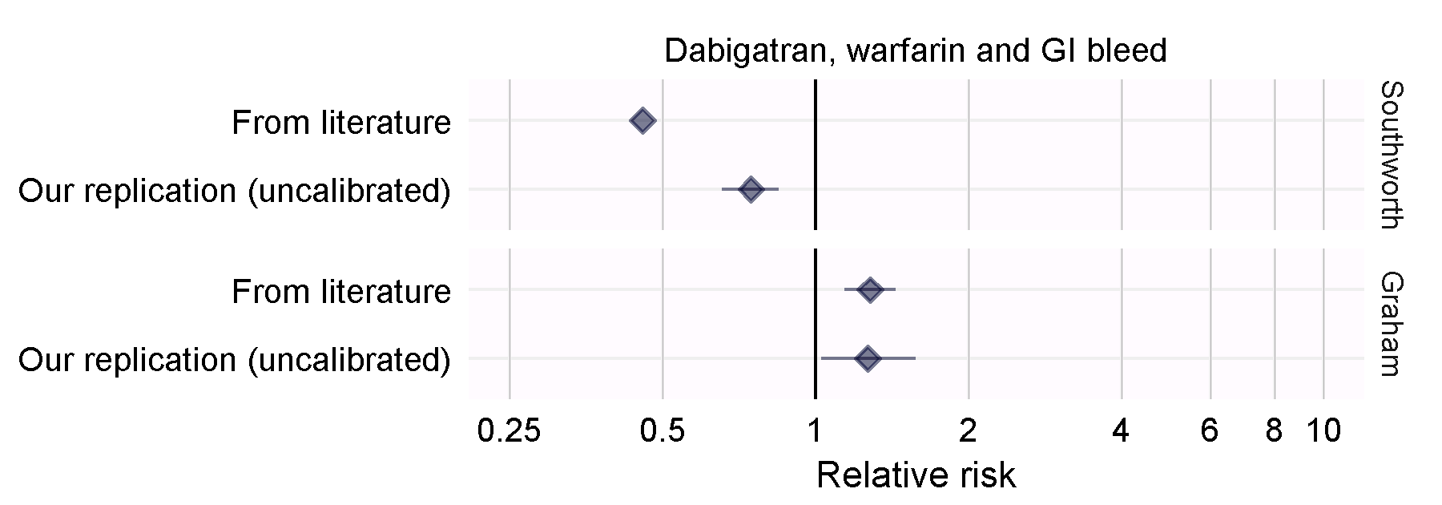
Step 1: Replicate studies
Faithful replication of all study details except database choice

Slide 11
Step 2: Negative controls
Allergic rhinitis | Infection due to Enterobacteriaceae
Anxiety disorder | Influenza
Arthritis of spine | Ingrowing nail
Arthropathy of pelvis | Instability of joint
Atelectasis | Irritable bowel syndrome
Blepharitis | Malignant neoplasm of genital structure
Cellulitis | Malignant tumor of breast
Chronic sinusitis | Megaloblastic anemia
Chronic ulcer of skin | Obesity
Curvature of spine | Osteochondropathy
Cutis laxa | Peripheral vertigo
Dehydration | Plantar fasciitis
Diabetic oculopathy | Poisoning
Diabetic renal disease | Prolapse of female genital organs
Dislocation of joint | Psychotic disorder
Drug dependence | Ptosis of eyelid
Dyssomnia | Sciatica
Effusion of joint | Seborrheic dermatitis
Fibrocystic disease of breast | Simple goiter
Fracture of lower limb | Sleep apnea
Gallstone | Streptococcal infectious disease
Gastro-esophageal reflux disease with esophagitis | Superficial mycosis
Human papilloma virus infection | Ulcerative colitis
Hyperplasia of prostate | Urge incontinence of urine
Hypokalemia | Urinary tract infectious disease

Slide 12
Negative control distribution
Southworth replication

Slide 13
Negative control distribution
Graham replication

Slide 14
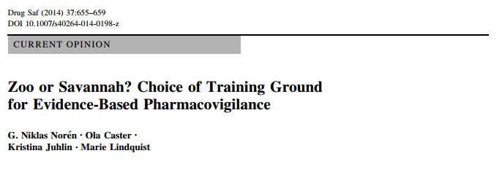
Trouble with positive controls
Often very few positive examples for a particular comparison
Exact effect size never known with certainty (and depends on population)
Doctors also know they’re positive, and will change behavior accordingly

Slide 15
Creating positive controls
Start with negative controls: RR = 1
Add simulated outcomes during exposure until desired RR is achieved
Injected outcomes should behave like ‘real’ outcomes: preserve confounding structure by injecting outcomes for people at high risk

Slide 16
Creating positive controls
Patient 1
Dabigatran
Patient 2
Warfarin
Patient 3
Dabigatran
Patient 4
Warfarin
Patient 5
Dabigatran
Patient 6
Warfarin
New RR = 2 (but with same confounding)
Ingrowing nail
Injected ingrowing nail
Predictive model of outcome indicates this is a high-risk patient

Slide 17
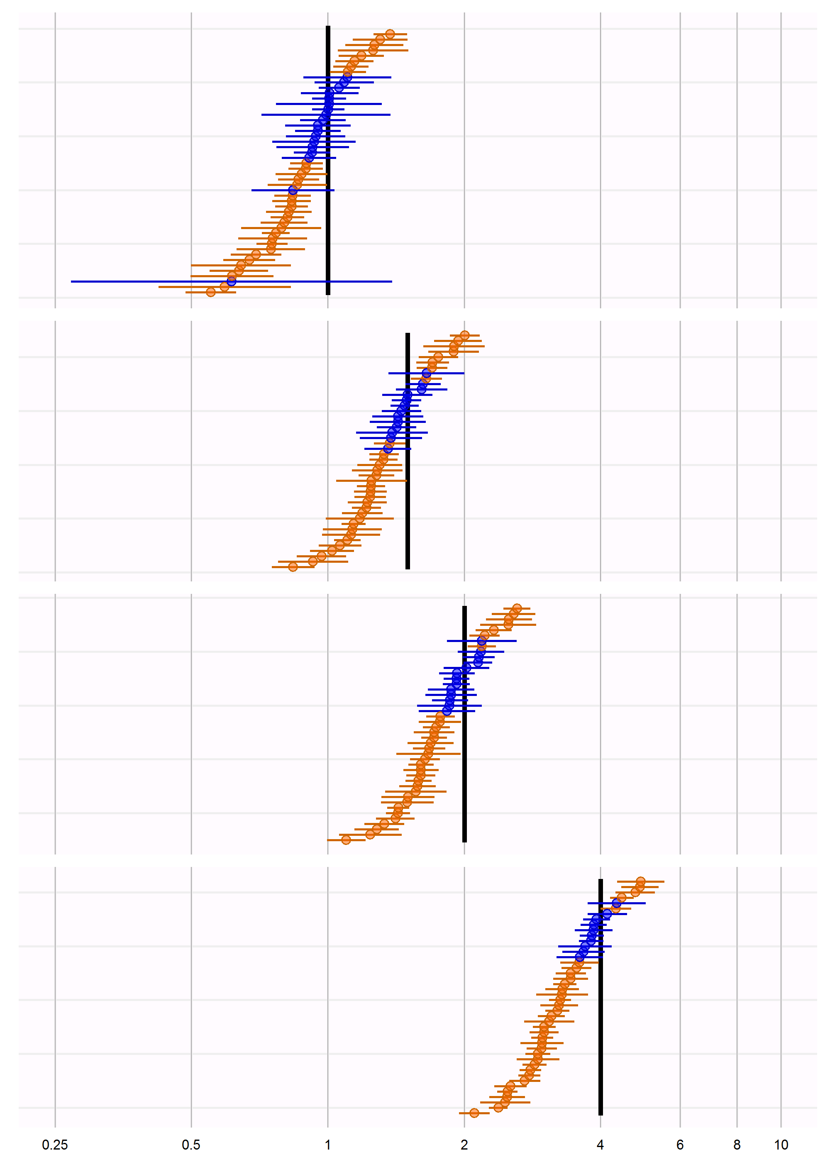
Estimating effects for positive controls
Black line indicates true hazard ratio
Southworth replication

Slide 18
Estimating effects for positive controls
Ingrowing nail
True RR = 1
Estimated RR = 0.88 (0.77 – 1.00)
Southworth replication

Slide 19
Estimating effects for positive controls
Ingrowing nail+
True RR = 1.5
Estimated RR = 1.30 (1.16 – 1.46)
Southworth replication

Slide 20
Estimating effects for positive controls
Analysis suggests bias remains constant with effect size
Southworth replication

Slide 21
Evaluating coverage of the CI
Coverage
37%
Coverage of 37% means the true effect size is outside of the 95% confidence interval 63% of the time
(when the true RR = 1)
30%
Coverage decreases with true effect size
30%
Missing the true effect size 70% of the time when the true RR = 2!
23%
Southworth replication

Slide 22
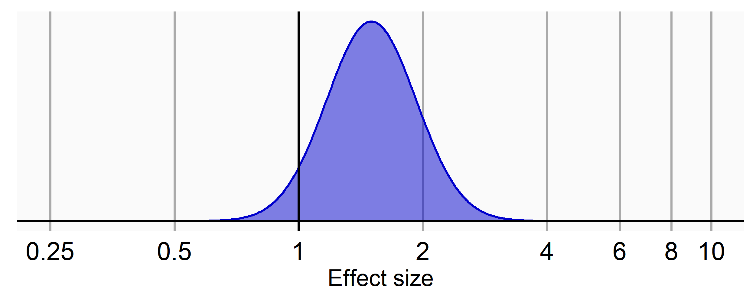
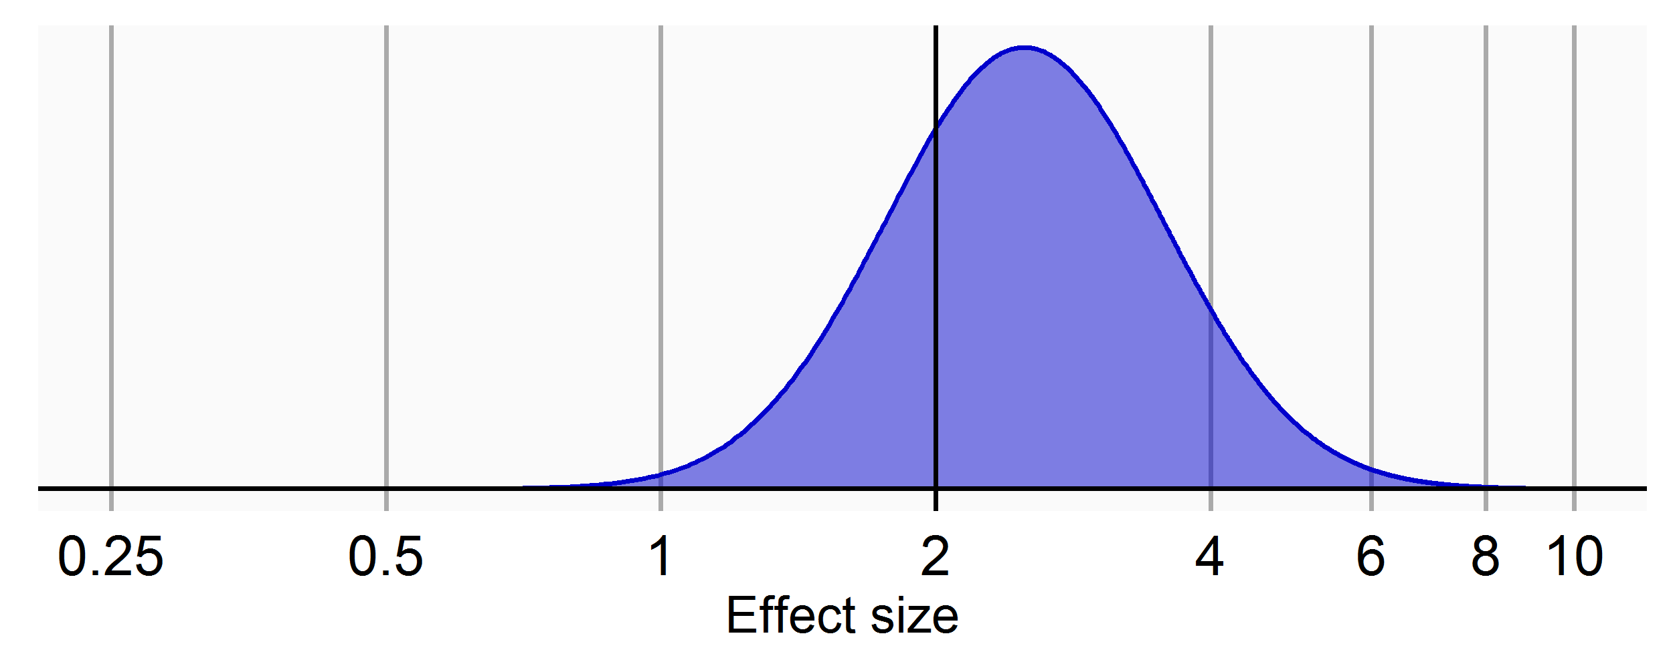
Confidence interval calibration
µ
σ
Estimated systematic error distribution
${HR}_{true}$= 1
µ
σ
${HR}_{true}$= 2
$$\text{µ}\text{ =}{ α}_{\text{µ}}\text{ + }β_{\text{µ}}{log⁡(HR}_{true})$$
σ$\text{ =}{ α}_{\text{σ}}\text{ + }β_{\text{σ}}{log⁡(HR}_{true})$

Slide 23
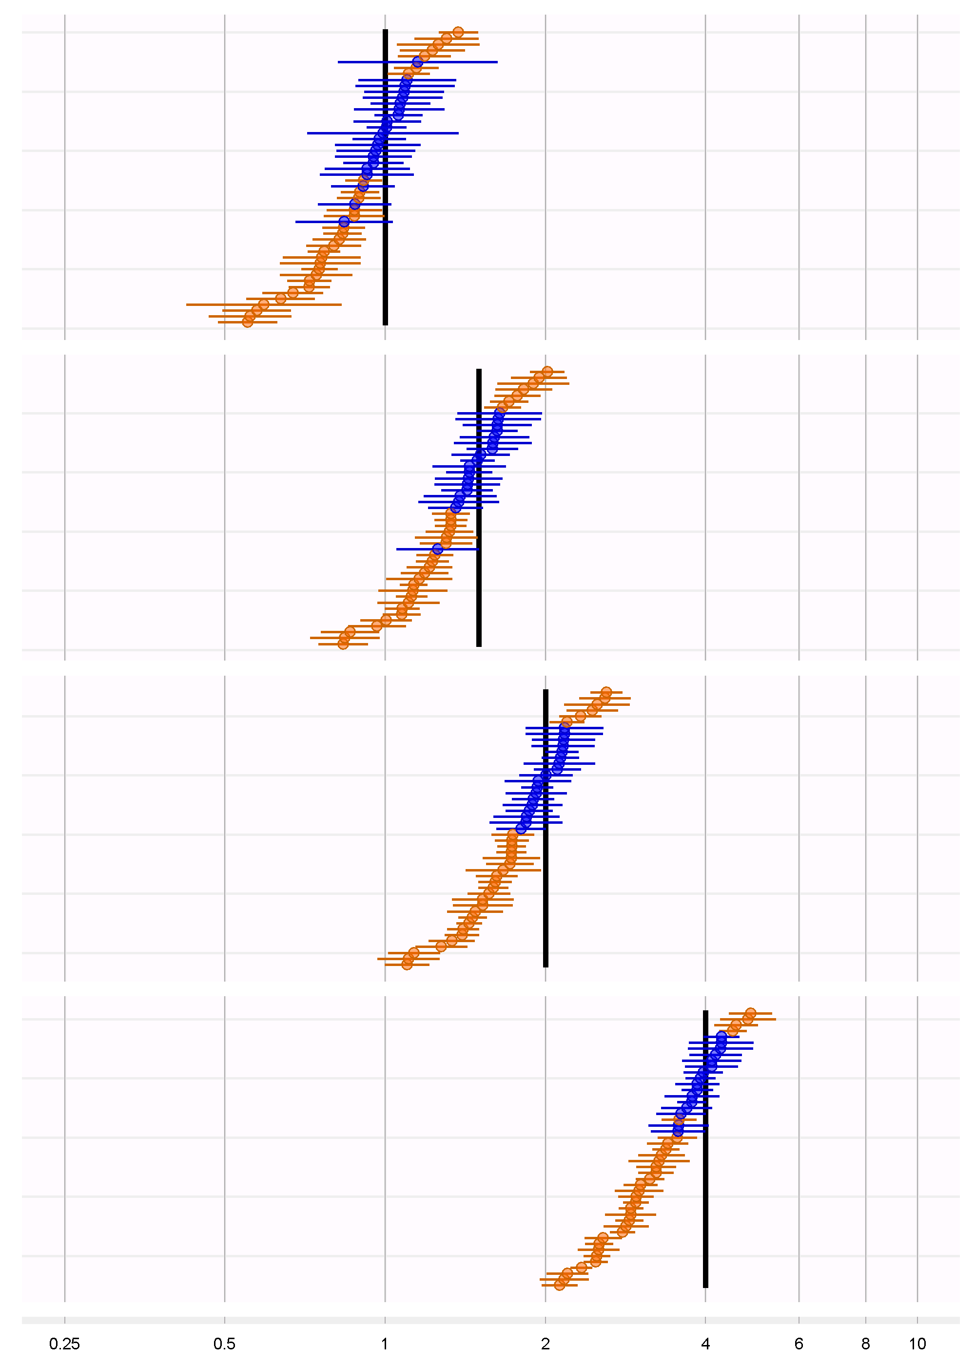
Calibrating a confidence interval
$$\text{µ}=−0.09\text{ + }.94{ log(HR}_{true})$$
σ$\text{= }\text{0.}\text{19}\text{ + }0.00 {log(HR}_{true})$
Uncalibrated
CI
Calibration
Calibrated
0.75 (0.66 – 0.85)
0.81 (0.53 – 1.23)
Confidence intervals were too narrow, so made wider to get to nominal coverage

Slide 24
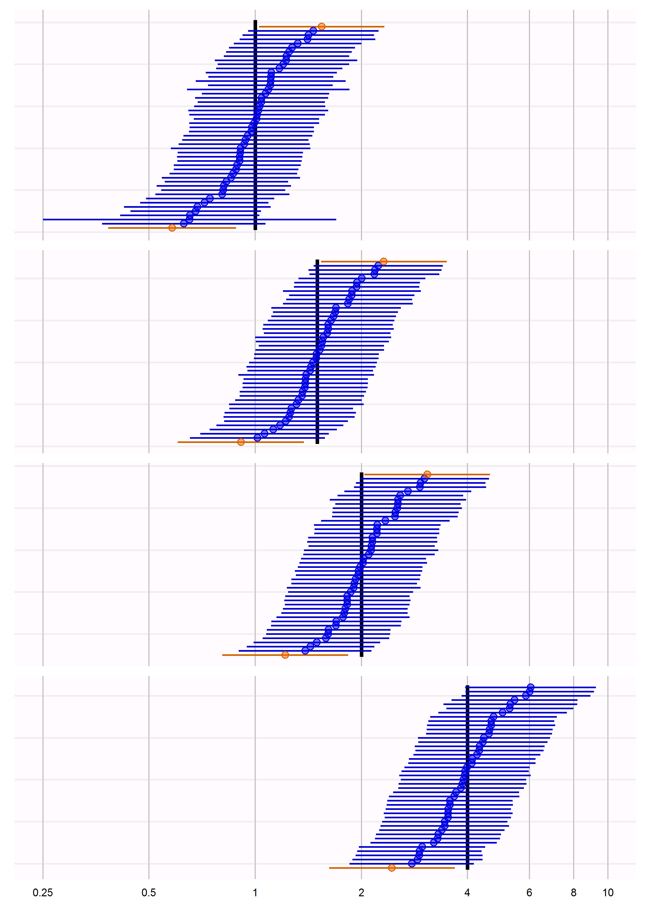
Confidence interval calibration
Uncalibrated
Calibrated

Slide 25
Confidence interval calibration
Coverage
Calibrated
96%
95%
95%
98%

Slide 26
Internal validity: Southworth

Slide 27
Internal validity: Graham

Slide 28
External validity
We could explain some but not all of the difference with study bias
Had Mini-Sentinel used CI calibration they could have come to a different conclusion

Slide 29
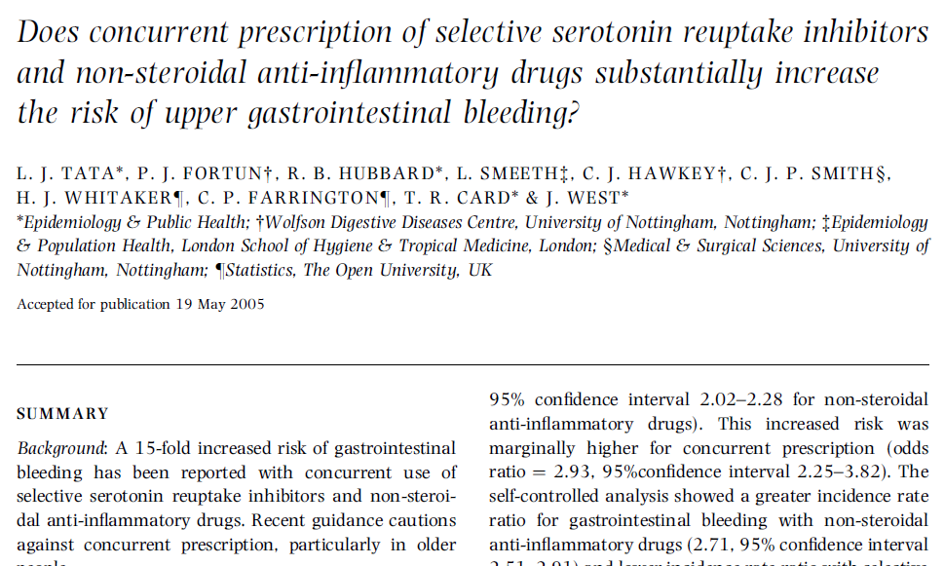
Additional example
Tata et al. studied relationship between SSRIs and upper GI bleeding
Case-control: OR = 2.38 (2.08–2.72)
SCCS: IRR = 1.71 (1.48–1.98)
Reproduce in CPRD (need ISAC approval)

Slide 30
Conclusion
Confidence interval calibration accounts for systematic error (in addition to random error)
Confidence interval calibration restores coverage of 95% CI to approximately 95%
Account for systematic error reduces between-study heterogeneity (but doesn’t eliminate it)

Slide 31
Questions?

Slide 32
Next workgroup meeting
Eastern hemisphere: January 25
3pm Hong Kong / Taiwan
4pm South Korea
5:30pm Adelaide
8am Central European time
7am UK time
Western hemisphere: Februari 2
6pm Central European time
12pm New York
9am Los Angeles / Stanford
http://www.ohdsi.org/web/wiki/doku.php?id=projects:workgroups:est-methods

