Slide 1
Future research topics
Martijn Schuemie, PhD
Janssen Research and Development

Slide 2
Previous Eastern Hemisphere meeting
Martijn Schuemie: Study reproducibility

Slide 3
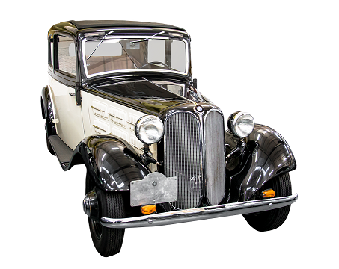
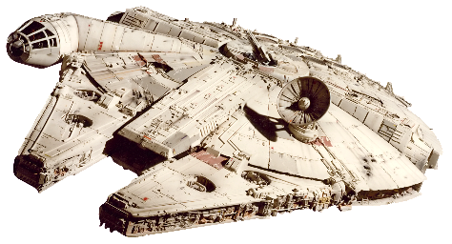
Future research topics?
Obvious next developments
Sci-fi
Brainstorm: figure out feasibility later

Slide 4
Methods research
$$y_{i}=f(x_{i},θ)$$
$x_{i}$= hypothesis of interest $i$ (e.g. dabi vs warfarin for bleeding)
$y_{i}$= effect size estimate for $i$
$θ$ = set of design choices:
Overall design (Cohort or case-control?)
Analysis choices within design (matching or stratification?)
Choice of database (CPRD or Truven CCAE?)

Slide 5
Evaluation
$$y_{i}=f(x_{i},θ)$$
${Error}_{i}= {\hat{y}}_{i}−$ $y_{i}$
${\hat{y}}_{i}$= True effect size for $i$
Can the error distribution be explained by random error?
Often not: there is also systematic error

Slide 6
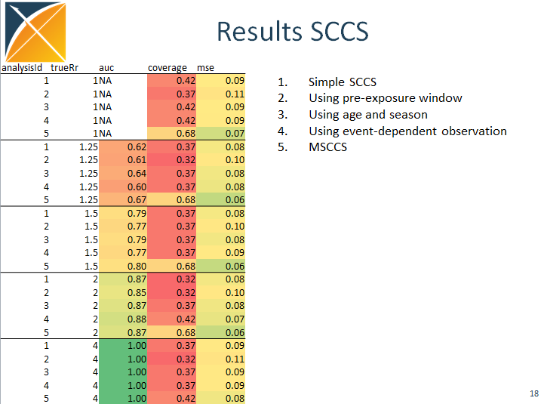
Candidate research topic 1: Systematic Evaluation of methods
Things to evaluate:
Existing methods
New-user cohort design (inc. HDPS)
Self-Controlled Case Series (SCCS)
Case-Control
…
Novel methods
New PS approaches (Alejandro, Yuxi)
Comparative SCCS (Jamie)
What to evaluate on:
Real negative controls + synthetic positive controls
Replication of RCTs

Slide 7
Calibration
$Error\sim N_{random}$+ $N_{systematic}$
$${y_{i}}_{}^{cal}=c\left(f\left(x_{i},θ\right)\right)$$
Purpose: to restore nominal characteristics
95% CI should contain truth 95% of times

Slide 8
Candidate research topic 2: Combining calibrated estimates
If I run a study on n databases, calibrating each estimate, how do I combine these estimates?
Random error will be independent across databases: inverse variance weighting?
Systematic error will not be independent!
Each database will have different population, so true effect size itself will be different: random effects model?

Slide 9
Candidate research topic 3: Smooshed comparators
Compare new treatment to all old treatments for same indication?
$${treatment}_{new} vs. \bigcup_{t=1}^{m}{{treatment}_{t}}$$
Problem: propensity score may not be able to adjust for heterogeneous comparator group.
Alternative:
$${treatment}_{new} vs. {treatment}_{1}$$
$${treatment}_{new} vs. {treatment}_{…}$$
$${treatment}_{new} vs. {treatment}_{m}$$
Combine across comparisons, taking correlation into account

Slide 10
Candidate research topic 4: Bayesian sensitivity analysis
$$y_{i}=f(x_{i},θ)$$
To what extend does $y_{i}$ depend on $θ$?

Slide 11
Distribution of possible results for one hypothesis
Stat signif > 1
OR
Databases
Methods
Stolen from George Hripcsak

Slide 12
Distribution of possible results for one hypothesis
Stat signif > 1
OR
Databases
Methods
Stolen from George Hripcsak

Slide 13
Distribution of possible results for one hypothesis
Stat signif > 1
Stat signif < 1
Databases
Methods
Stolen from George Hripcsak

Slide 14
Distribution of possible results for one hypothesis
JAMA
BMJ
Databases
Methods
Study #3
Stolen from George Hripcsak

Slide 15
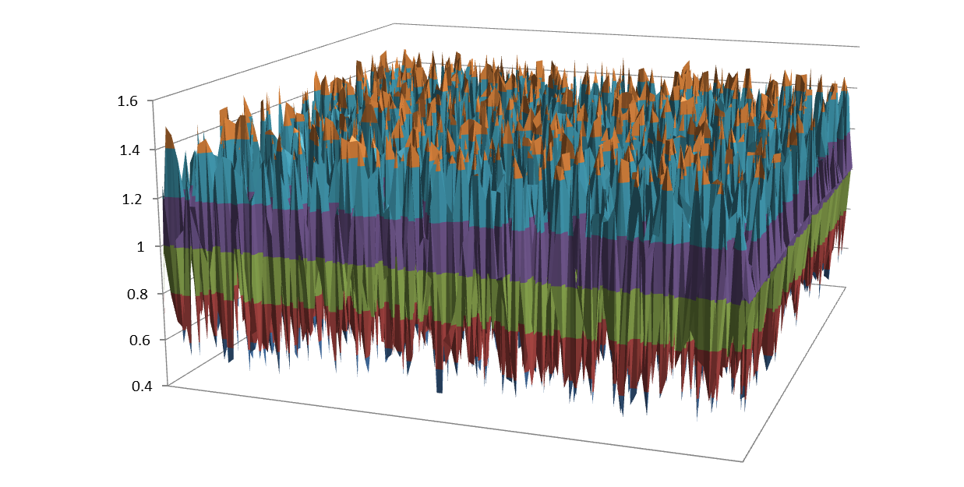
Distribution of possible results for one hypothesis
OR
Databases
Methods
Stolen from George Hripcsak

Slide 16
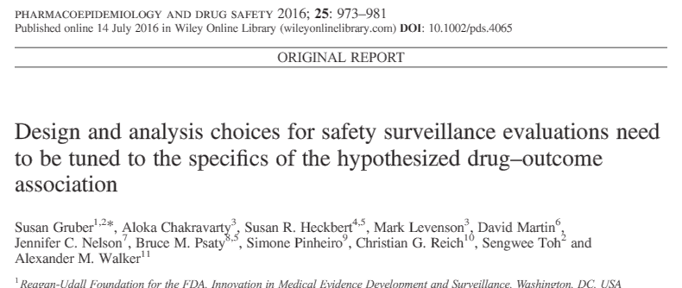
Design and analysis choices
Epi community:
expert knows best (through unformalizable knowledge)
use some predefined sensitivity analyses.
If pretty stable: mention in discussion
if not stable: mention in discussion
OMOP:
let the data decide (pick $θ$ that optimizes AUC)
design choices matter (a lot)

Slide 17
Bayesian sensitivity analysis
$$y_{i}\sim f\left(x_{i},θ\right)p(θ)$$
$p(θ)$ = prior of design and analysis choices being ‘correct’.
Advantage: if uncertain choices (both could be ‘correct’) lead to large differences, posterior will be wide to reflect that uncertainty.
How to get priors?
Expert informed
Based on our systematic evaluation

Slide 18
Candidate research topic 5: Mechanistic modeling (effect modification)
$$p\left(Outcome|t\right)=yt+intercept$$
$y$ = effect size
$t$ = treatment choice
Causal model: will tell you effect of changing $t$
Could we estimate:
$$p\left(Outcome|t\right)=yt+yμt+intercept$$
$μ$ = effect modifiers
without pre-specifying specific effect modifiers?

Slide 19
Candidate research topic 6: Systematic informed priors
$$p\left(Outcome|t\right)=yt+βz+intercept$$
$z$= Baseline characteristics
$β$= Coefficients for baseline characteristics
Current state-of-the-art:
Uninformed prior for $y$
Homogeneous prior for $β$
Prior for diabetes and MI = Prior for otitis media and MI?
Mining of prior knowledge (e.g. MEDLINE and Wikipedia) to inform priors

Slide 20
Candidate research topics
Systematic Evaluation of methods
Combining calibrated estimates
Smooshed comparators
Bayesian sensitivity analysis
Mechanistic modeling (effect modification)
Systematic informed priors

Slide 21
Next workgroup meeting
Eastern hemisphere: Februari 22
3pm Hong Kong / Taiwan
4pm South Korea
5:30pm Adelaide
8am Central European time
7am UK time
Western hemisphere: Februari 16
6pm Central European time
12pm New York
9am Los Angeles / Stanford
http://www.ohdsi.org/web/wiki/doku.php?id=projects:workgroups:est-methods

