Slide 1
Method benchmark update
Martijn Schuemie

Slide 2
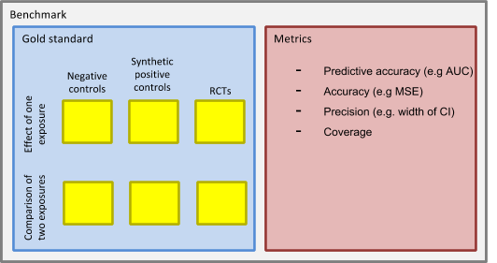
OHDSI Methods Benchmark

Slide 3
OHDSI Methods Benchmark
Two types of tasks:
Estimate effect of one exposure
Case-control
SCCS
Case-crossover
Cohort study when comparator is non-active
Comparison of two exposures
Cohort study
Comparative SCCS

Slide 4
OHDSI Methods Benchmark
Three types of data sets:
Real negative controls
Synthetic positive controls
RCTs

Slide 5
Negative controls
Advantages
Real exposures and outcomes, so real confounding (measured and unmeasured)
Effect size is known (RR = 1)
Disadvantage
Only null effects

Slide 6
Negative controls: where to start?
Selected four exposures of interest
Diclofenac
Ciprofloxacin
Metformin
Sertraline
Selected four outcomes of interest
Acute pancreatitis
Gastrointestinal (GI) bleeding
Stroke
Inflammatory Bowel Disease (IBD)

Slide 7
LAERTES to find controls
For each exposure (outcome) of interest, list controls where there was
No evidence in literature
No evidence in labels
No evidence in spontaneous reports
Prevalent in an observational database
Evidence for both exposure and outcome, just not both combined
Manually review evidence (Google search), select 25 most prevalent controls per exposure (outcome).
Refinement: there should be a lack of evidence of causality. So individual reports in FAERS or eHealthMe.com do not count, as long as PRR not statistically significant greater than 1.

Slide 8
Including comparators
For every exposure-outcome pair, find a comparator exposure that is also a negative control.
Heuristics for finding valid comparators:
A 2-armed trial in clinicaltrials.gov comparing the two drugs, or
First four digits of the ATC code match (same indication) but the 5th doesn't (different class).
Implemented in The Amazing Comparator Finder:
https://schuemie.shinyapps.io/ComparatorFinder/

Slide 9
Including comparators
Selected four exposures of interest
Diclofenac vs Celecoxib
Ciprofloxacin vs Azithromycin
Metformin vs Glipizide
Sertraline vs Venlafaxine
Selected four outcomes of interest
Acute pancreatitis
Gastrointestinal (GI) bleeding
Stroke
Inflammatory Bowel Disease (IBD)
Select a comparator for each exposure control

Slide 10
Including nesting cohorts
Some methods such as the nested case-control design require a nesting cohort to be defined.
For example: a case-control study for metformin may well be nested in T2DM, meaning both cases and controls should have prior diagnose of T2DM.
Heuristic for picking nesting cohorts: condition or procedure codes that appear more often on date of treatment initiation than expected.
(also implemented in The Amazing Comparator Finder)

Slide 11
Including nesting cohorts
Selected four exposures of interest
Diclofenac vs Celecoxib nested in arthralgia
Ciprofloxacin vs Azithromycin nested in otitis media
Metformin vs Glipizide nested in T2DM
Sertraline vs Venlafaxine nested in depression
Selected four outcomes of interest
Acute pancreatitis
Gastrointestinal (GI) bleeding
Stroke
Inflammatory Bowel Disease (IBD)
Select a nesting cohort for each exposure control.

Slide 12
First draft of negative control set
200 exposure-comparator-outcome-nesting-cohort combinations
Potentially stratified by 4 outcomes and 4 exposures of interest
Need help in reviewing!

Slide 13
Next step for method benchmark
Vetting of the negative control set
Signal injection
Selection of RCTs
Vojtech, Soledad, and Jill have volunteered to help
Will start with a single RCT

Slide 14
CaseCrossover package
Martijn Schuemie

Slide 15
Case-crossover design
For every case (person with the outcome) define n control windows prior to the outcome (usually n = 1)
Determine exposure status on index date and control windows
Outcome
Case 1
Exposure
Control window
At risk window
Fixed interval (e.g. 30 days)
Outcome
Case 2
Control window
At risk window
Outcome
Case 3
Exposure
Control window
At risk window

Slide 16
Case-time-control design
Adjust for trend in prescribing by picking matched controls
Matching typically on age, gender, and calendar time
Outcome
Case
Exposure
Control window
At risk window
Control
Exposure
Control window
At risk window
2001-02-03

Slide 17
OHDSI Methods Library
Cohort Method
Self-Controlled Case Series
Self-Controlled Cohort
IC Temporal Pattern Disc.
s
s
s
s
New-user cohort studies using large-scale regression for propensity and outcome models
Self-Controlled Case Series analysis using few or many predictors, includes splines for age and seasonality.
A self-controlled cohort design, where time preceding exposure is used as control.
A self-controlled design, but using temporal patterns around other exposures and outcomes to correct for time-varying confounding.
Estimation methods
Case-control
s
Case-crossover
s
Case-control studies, matching controls on age, gender, provider, and visit date. Allows nesting of the study in another cohort.
Case-crossover design including the option to adjust for time-trends in exposures (so-called case-time-control).
Patient Level Prediction
Feature Extraction
s
s
Build and evaluate predictive models for user-specified outcomes, using a wide array of machine learning algorithms.
Automatically extract large sets of features for user-specified cohorts using data in the CDM.
Prediction methods
Empirical Calibration
Method Evaluation
s
s
Use negative control exposure-outcome pairs to profile and calibrate a particular analysis design.
Use real data and established reference sets as well as simulations injected in real data to evaluate the performance of methods.
Method characterization
Database Connector
Sql Render
Cyclops
Ohdsi R Tools
s
s
s
s
Connect directly to a wide range of database platforms, including SQL Server, Oracle, and PostgreSQL.
Generate SQL on the fly for the various SQL dialects.
Highly efficient implementation of regularized logistic, Poisson and Cox regression.
Support tools that didn’t fit other categories, including tools for maintaining R libraries.
Supporting packages
Under construction

Slide 18
A single CaseCrossover study
caseCrossoverData <- getDbCaseCrossoverData(connectionDetails = connectionDetails,
cdmDatabaseSchema = cdmDatabaseSchema,
oracleTempSchema = oracleTempSchema,
outcomeDatabaseSchema = cohortDatabaseSchema,
outcomeTable = cohortTable,
outcomeId = 1,
exposureDatabaseSchema = cdmDatabaseSchema,
exposureTable = "drug_era",
exposureIds = 1124300,
useNestingCohort = TRUE,
nestingCohortDatabaseSchema = cohortDatabaseSchema,
nestingCohortTable = cohortTable,
nestingCohortId = 2,
useObservationEndAsNestingEndDate = TRUE,
getTimeControlData = TRUE)
matchingCriteria <- createMatchingCriteria(controlsPerCase = 1,
matchOnAge = TRUE,
ageCaliper = 2,
matchOnGender = TRUE)
subjectsCtc <- selectSubjectsToInclude(caseCrossoverData = caseCrossoverData,
outcomeId = 1,
firstOutcomeOnly = TRUE,
washoutPeriod = 183,
matchingCriteria = matchingCriteria)
exposureStatus <- getExposureStatus(subjects = subjects,
caseCrossoverData = caseCrossoverData,
exposureId = 1124300,
firstExposureOnly = FALSE,
riskWindowStart = -30,
riskWindowEnd = 0,
controlWindowOffsets = c(-60))
fit <- fitCaseCrossoverModel(exposureStatus)

Slide 19
A single CaseCrossover study
caseCrossoverData <- getDbCaseCrossoverData(connectionDetails = connectionDetails,
cdmDatabaseSchema = cdmDatabaseSchema,
oracleTempSchema = oracleTempSchema,
outcomeDatabaseSchema = cohortDatabaseSchema,
outcomeTable = cohortTable,
outcomeId = 1,
exposureDatabaseSchema = cdmDatabaseSchema,
exposureTable = "drug_era",
exposureIds = 1124300,
useNestingCohort = TRUE,
nestingCohortDatabaseSchema = cohortDatabaseSchema,
nestingCohortTable = cohortTable,
nestingCohortId = 2,
useObservationEndAsNestingEndDate = TRUE,
getTimeControlData = TRUE)
matchingCriteria <- createMatchingCriteria(controlsPerCase = 1,
matchOnAge = TRUE,
ageCaliper = 2,
matchOnGender = TRUE)
subjectsCtc <- selectSubjectsToInclude(caseCrossoverData = caseCrossoverData,
outcomeId = 1,
firstOutcomeOnly = TRUE,
washoutPeriod = 183,
matchingCriteria = matchingCriteria)
exposureStatus <- getExposureStatus(subjects = subjects,
caseCrossoverData = caseCrossoverData,
exposureId = 1124300,
firstExposureOnly = FALSE,
riskWindowStart = -30,
riskWindowEnd = 0,
controlWindowOffsets = c(-60))
fit <- fitCaseCrossoverModel(exposureStatus)
Get the data from the CDM database:
Specified 1 outcome in the cohort table
Specified a nesting cohort in the cohort table
Nesting cohort ends on observation end
Get data for selecting controls

Slide 20
A single CaseCrossover study
caseCrossoverData <- getDbCaseCrossoverData(connectionDetails = connectionDetails,
cdmDatabaseSchema = cdmDatabaseSchema,
oracleTempSchema = oracleTempSchema,
outcomeDatabaseSchema = cohortDatabaseSchema,
outcomeTable = cohortTable,
outcomeId = 1,
exposureDatabaseSchema = cdmDatabaseSchema,
exposureTable = "drug_era",
exposureIds = 1124300,
useNestingCohort = TRUE,
nestingCohortDatabaseSchema = cohortDatabaseSchema,
nestingCohortTable = cohortTable,
nestingCohortId = 2,
useObservationEndAsNestingEndDate = TRUE,
getTimeControlData = TRUE)
matchingCriteria <- createMatchingCriteria(controlsPerCase = 1,
matchOnAge = TRUE,
ageCaliper = 2,
matchOnGender = TRUE)
subjectsCtc <- selectSubjectsToInclude(caseCrossoverData = caseCrossoverData,
outcomeId = 1,
firstOutcomeOnly = TRUE,
washoutPeriod = 183,
matchingCriteria = matchingCriteria)
exposureStatus <- getExposureStatus(subjects = subjects,
caseCrossoverData = caseCrossoverData,
exposureId = 1124300,
firstExposureOnly = FALSE,
riskWindowStart = -30,
riskWindowEnd = 0,
controlWindowOffsets = c(-60))
fit <- fitCaseCrossoverModel(exposureStatus)
Specify matching criteria for case-time-control
Select cases and controls

Slide 21
A single CaseCrossover study
caseCrossoverData <- getDbCaseCrossoverData(connectionDetails = connectionDetails,
cdmDatabaseSchema = cdmDatabaseSchema,
oracleTempSchema = oracleTempSchema,
outcomeDatabaseSchema = cohortDatabaseSchema,
outcomeTable = cohortTable,
outcomeId = 1,
exposureDatabaseSchema = cdmDatabaseSchema,
exposureTable = "drug_era",
exposureIds = 1124300,
useNestingCohort = TRUE,
nestingCohortDatabaseSchema = cohortDatabaseSchema,
nestingCohortTable = cohortTable,
nestingCohortId = 2,
useObservationEndAsNestingEndDate = TRUE,
getTimeControlData = TRUE)
matchingCriteria <- createMatchingCriteria(controlsPerCase = 1,
matchOnAge = TRUE,
ageCaliper = 2,
matchOnGender = TRUE)
subjectsCtc <- selectSubjectsToInclude(caseCrossoverData = caseCrossoverData,
outcomeId = 1,
firstOutcomeOnly = TRUE,
washoutPeriod = 183,
matchingCriteria = matchingCriteria)
exposureStatus <- getExposureStatus(subjects = subjects,
caseCrossoverData = caseCrossoverData,
exposureId = 1124300,
firstExposureOnly = FALSE,
riskWindowStart = -30,
riskWindowEnd = 0,
controlWindowOffsets = c(-60))
fit <- fitCaseCrossoverModel(exposureStatus)
Define at-risk and control windows
Determine exposure status in windows

Slide 22
A single CaseCrossover study
caseCrossoverData <- getDbCaseCrossoverData(connectionDetails = connectionDetails,
cdmDatabaseSchema = cdmDatabaseSchema,
oracleTempSchema = oracleTempSchema,
outcomeDatabaseSchema = cohortDatabaseSchema,
outcomeTable = cohortTable,
outcomeId = 1,
exposureDatabaseSchema = cdmDatabaseSchema,
exposureTable = "drug_era",
exposureIds = 1124300,
useNestingCohort = TRUE,
nestingCohortDatabaseSchema = cohortDatabaseSchema,
nestingCohortTable = cohortTable,
nestingCohortId = 2,
useObservationEndAsNestingEndDate = TRUE,
getTimeControlData = TRUE)
matchingCriteria <- createMatchingCriteria(controlsPerCase = 1,
matchOnAge = TRUE,
ageCaliper = 2,
matchOnGender = TRUE)
subjectsCtc <- selectSubjectsToInclude(caseCrossoverData = caseCrossoverData,
outcomeId = 1,
firstOutcomeOnly = TRUE,
washoutPeriod = 183,
matchingCriteria = matchingCriteria)
exposureStatus <- getExposureStatus(subjects = subjects,
caseCrossoverData = caseCrossoverData,
exposureId = 1124300,
firstExposureOnly = FALSE,
riskWindowStart = -30,
riskWindowEnd = 0,
controlWindowOffsets = c(-60))
fit <- fitCaseCrossoverModel(exposureStatus)
Fit model

Slide 23
Evaluation of case-crossover
Three analyses variants:
Simple case-crossover (1-day windows, control window 30 days prior)
Nested case-crossover
Nested case-time-control
Executed against OHDSI benchmark negative controls

Slide 24
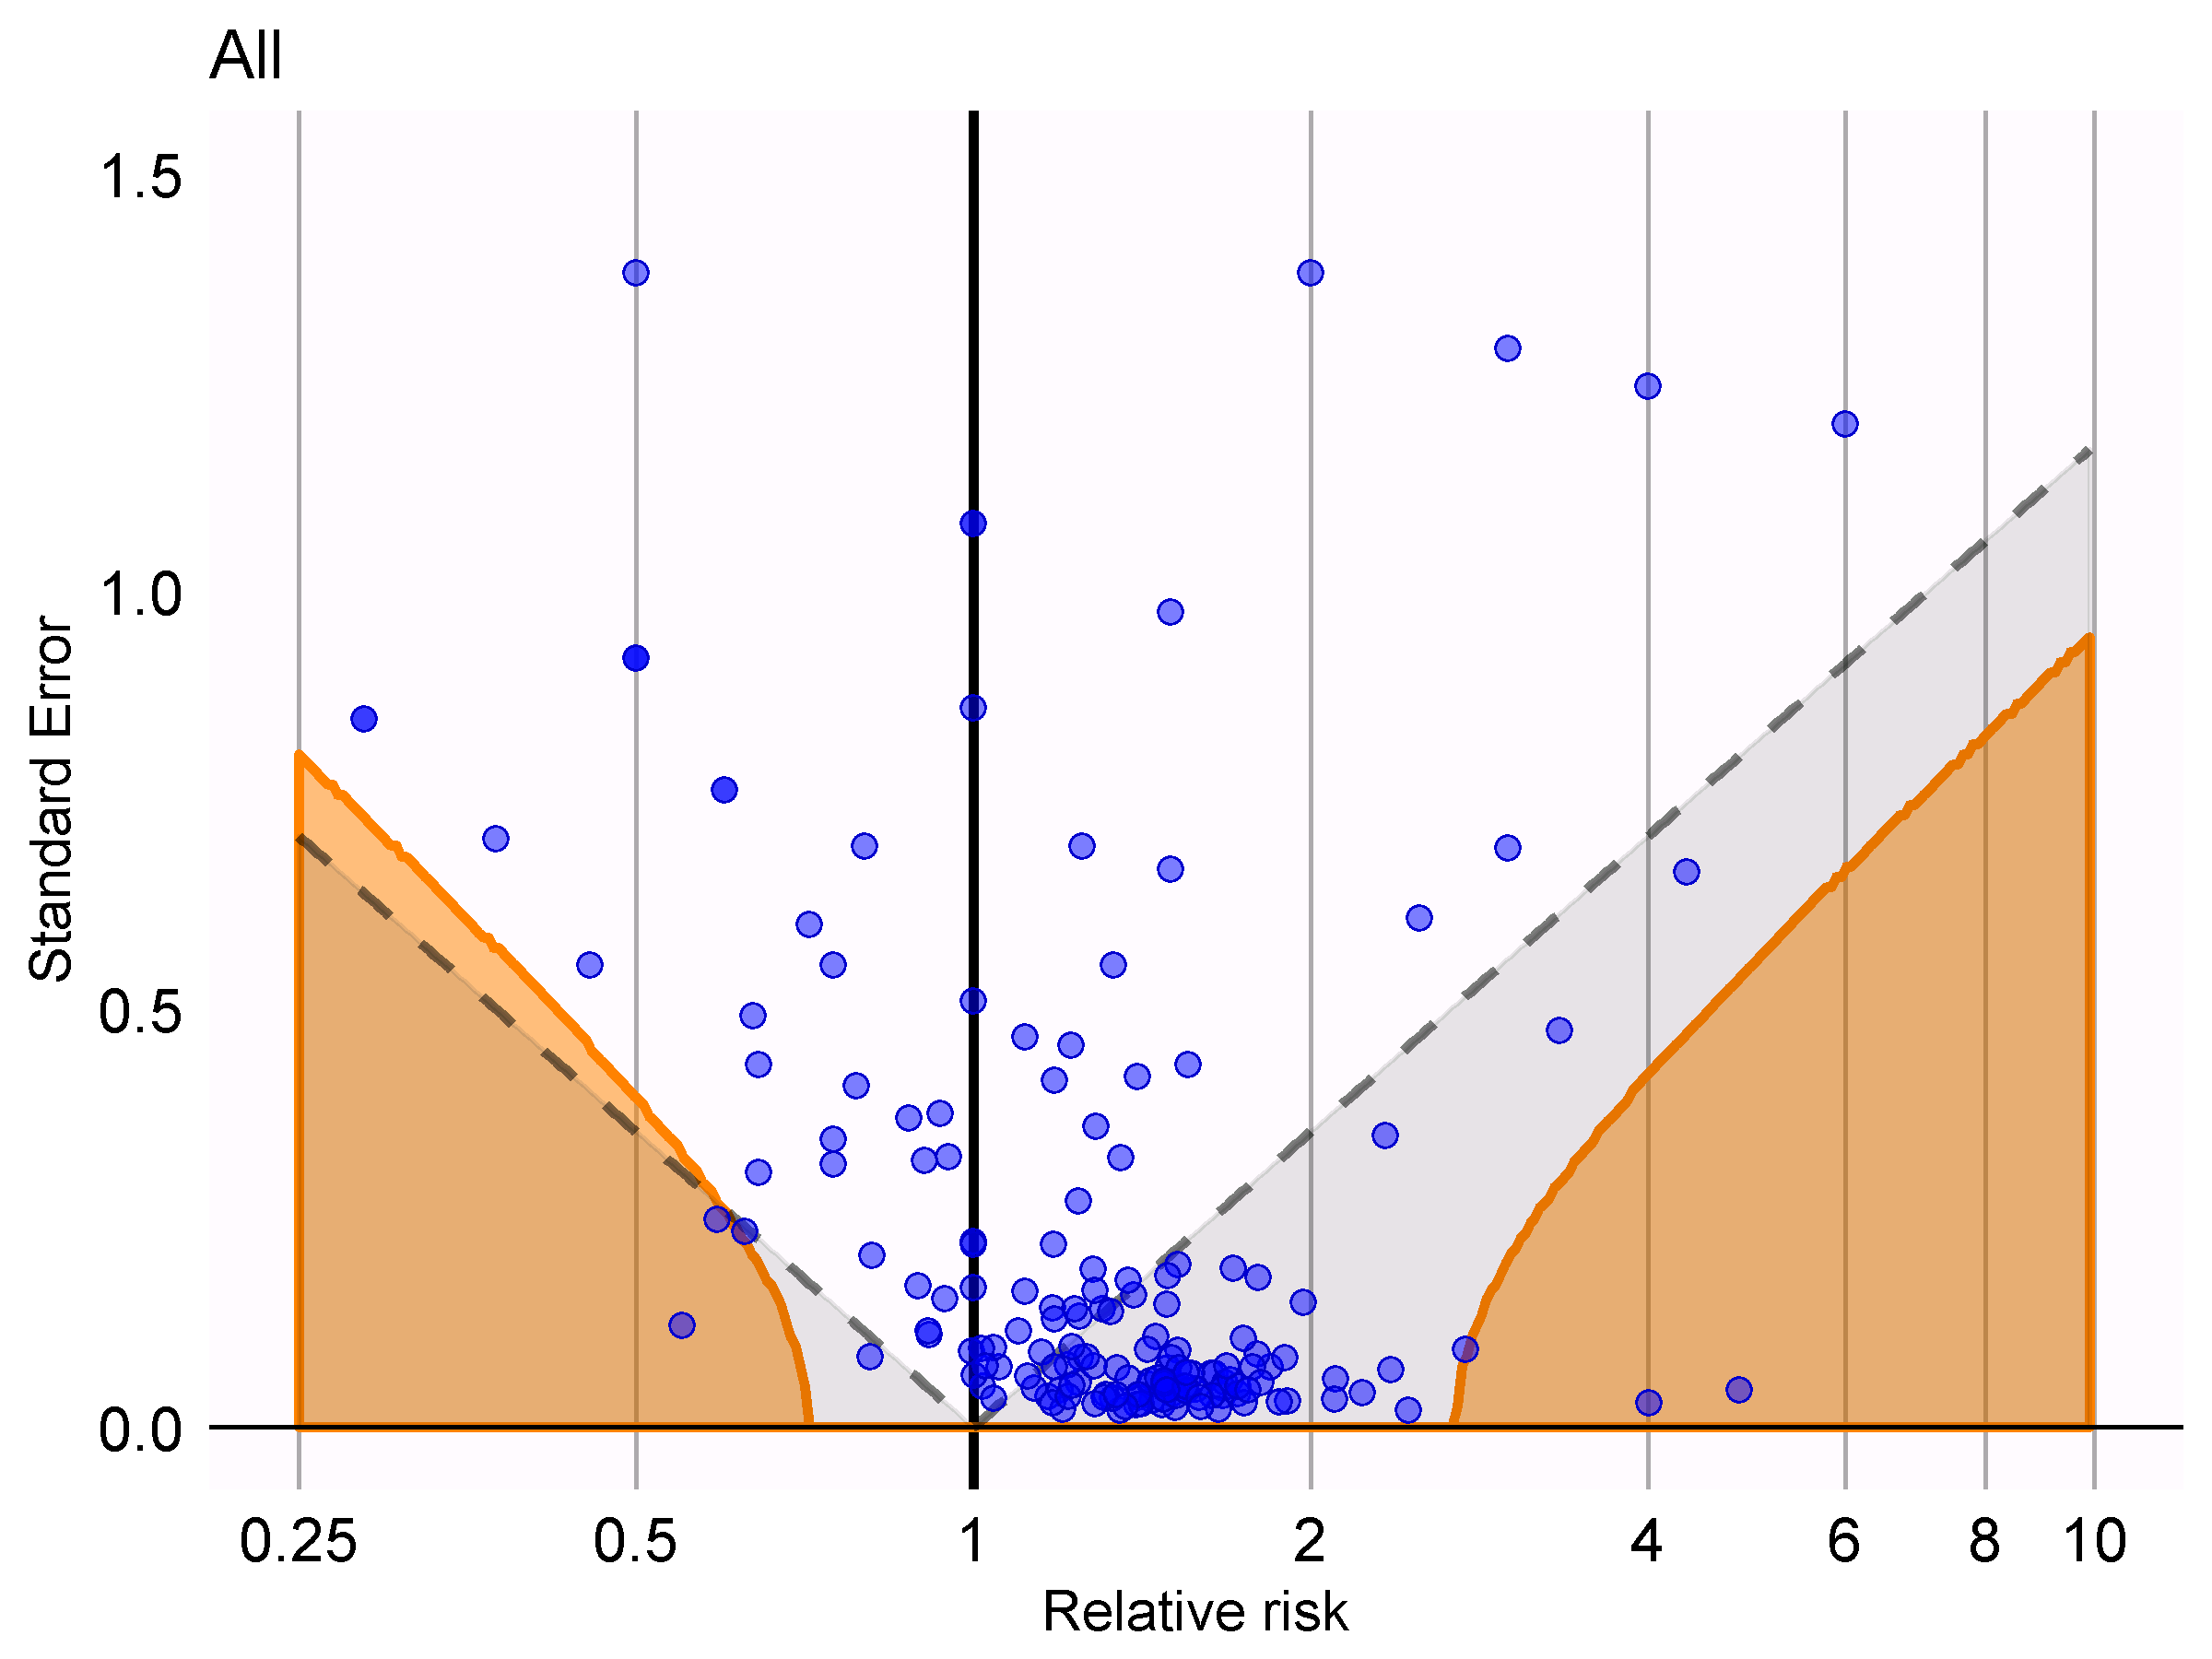
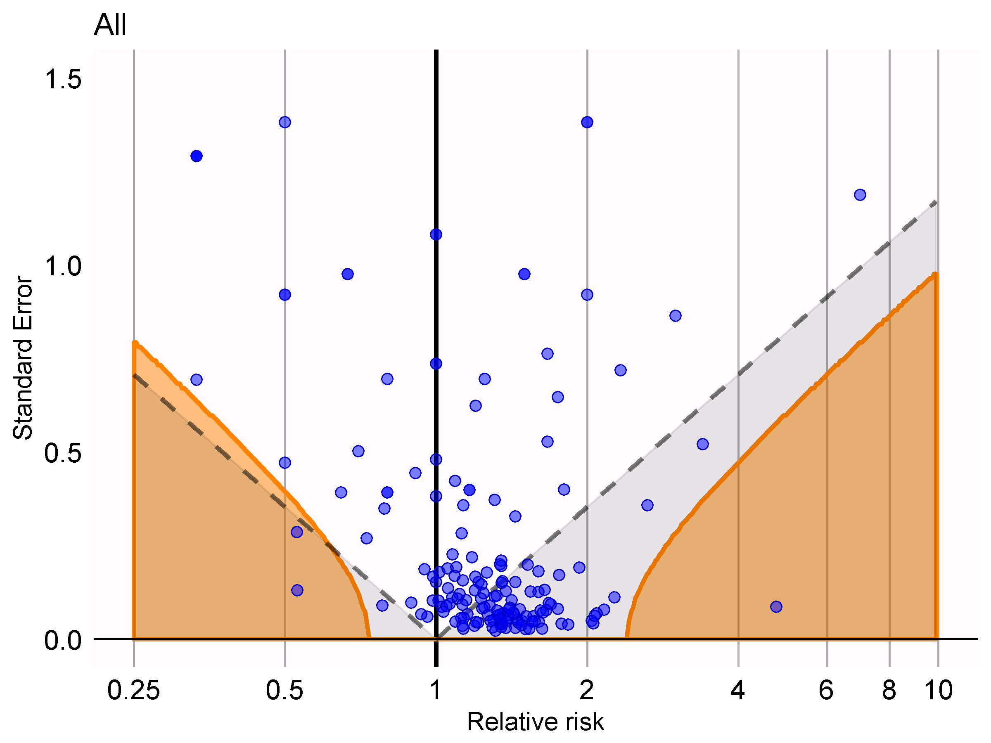
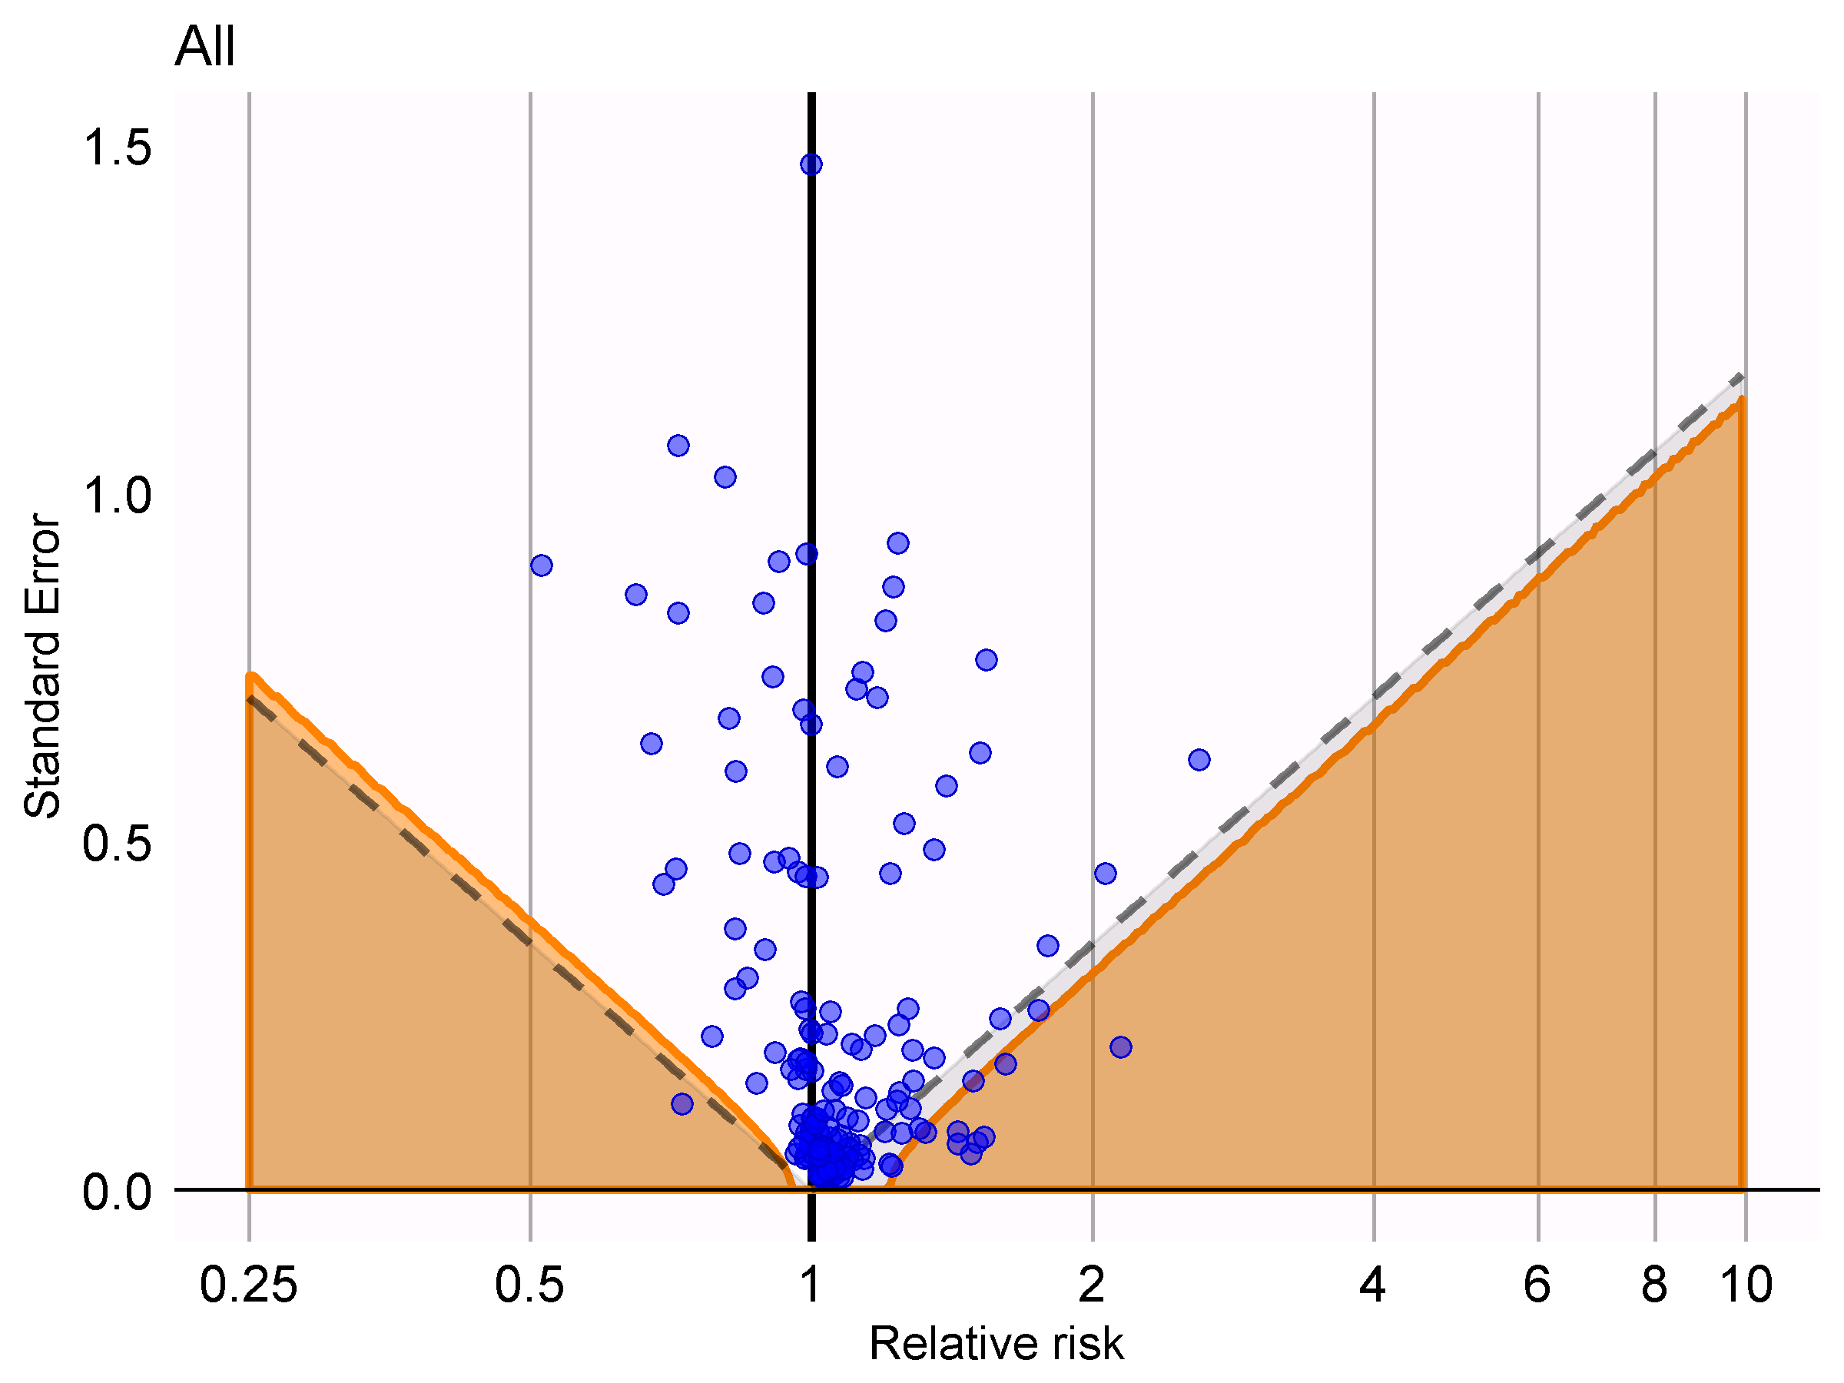
Using all negative controls
Simple case-crossover
Nested case-crossover
Nested case-time-control

Slide 25
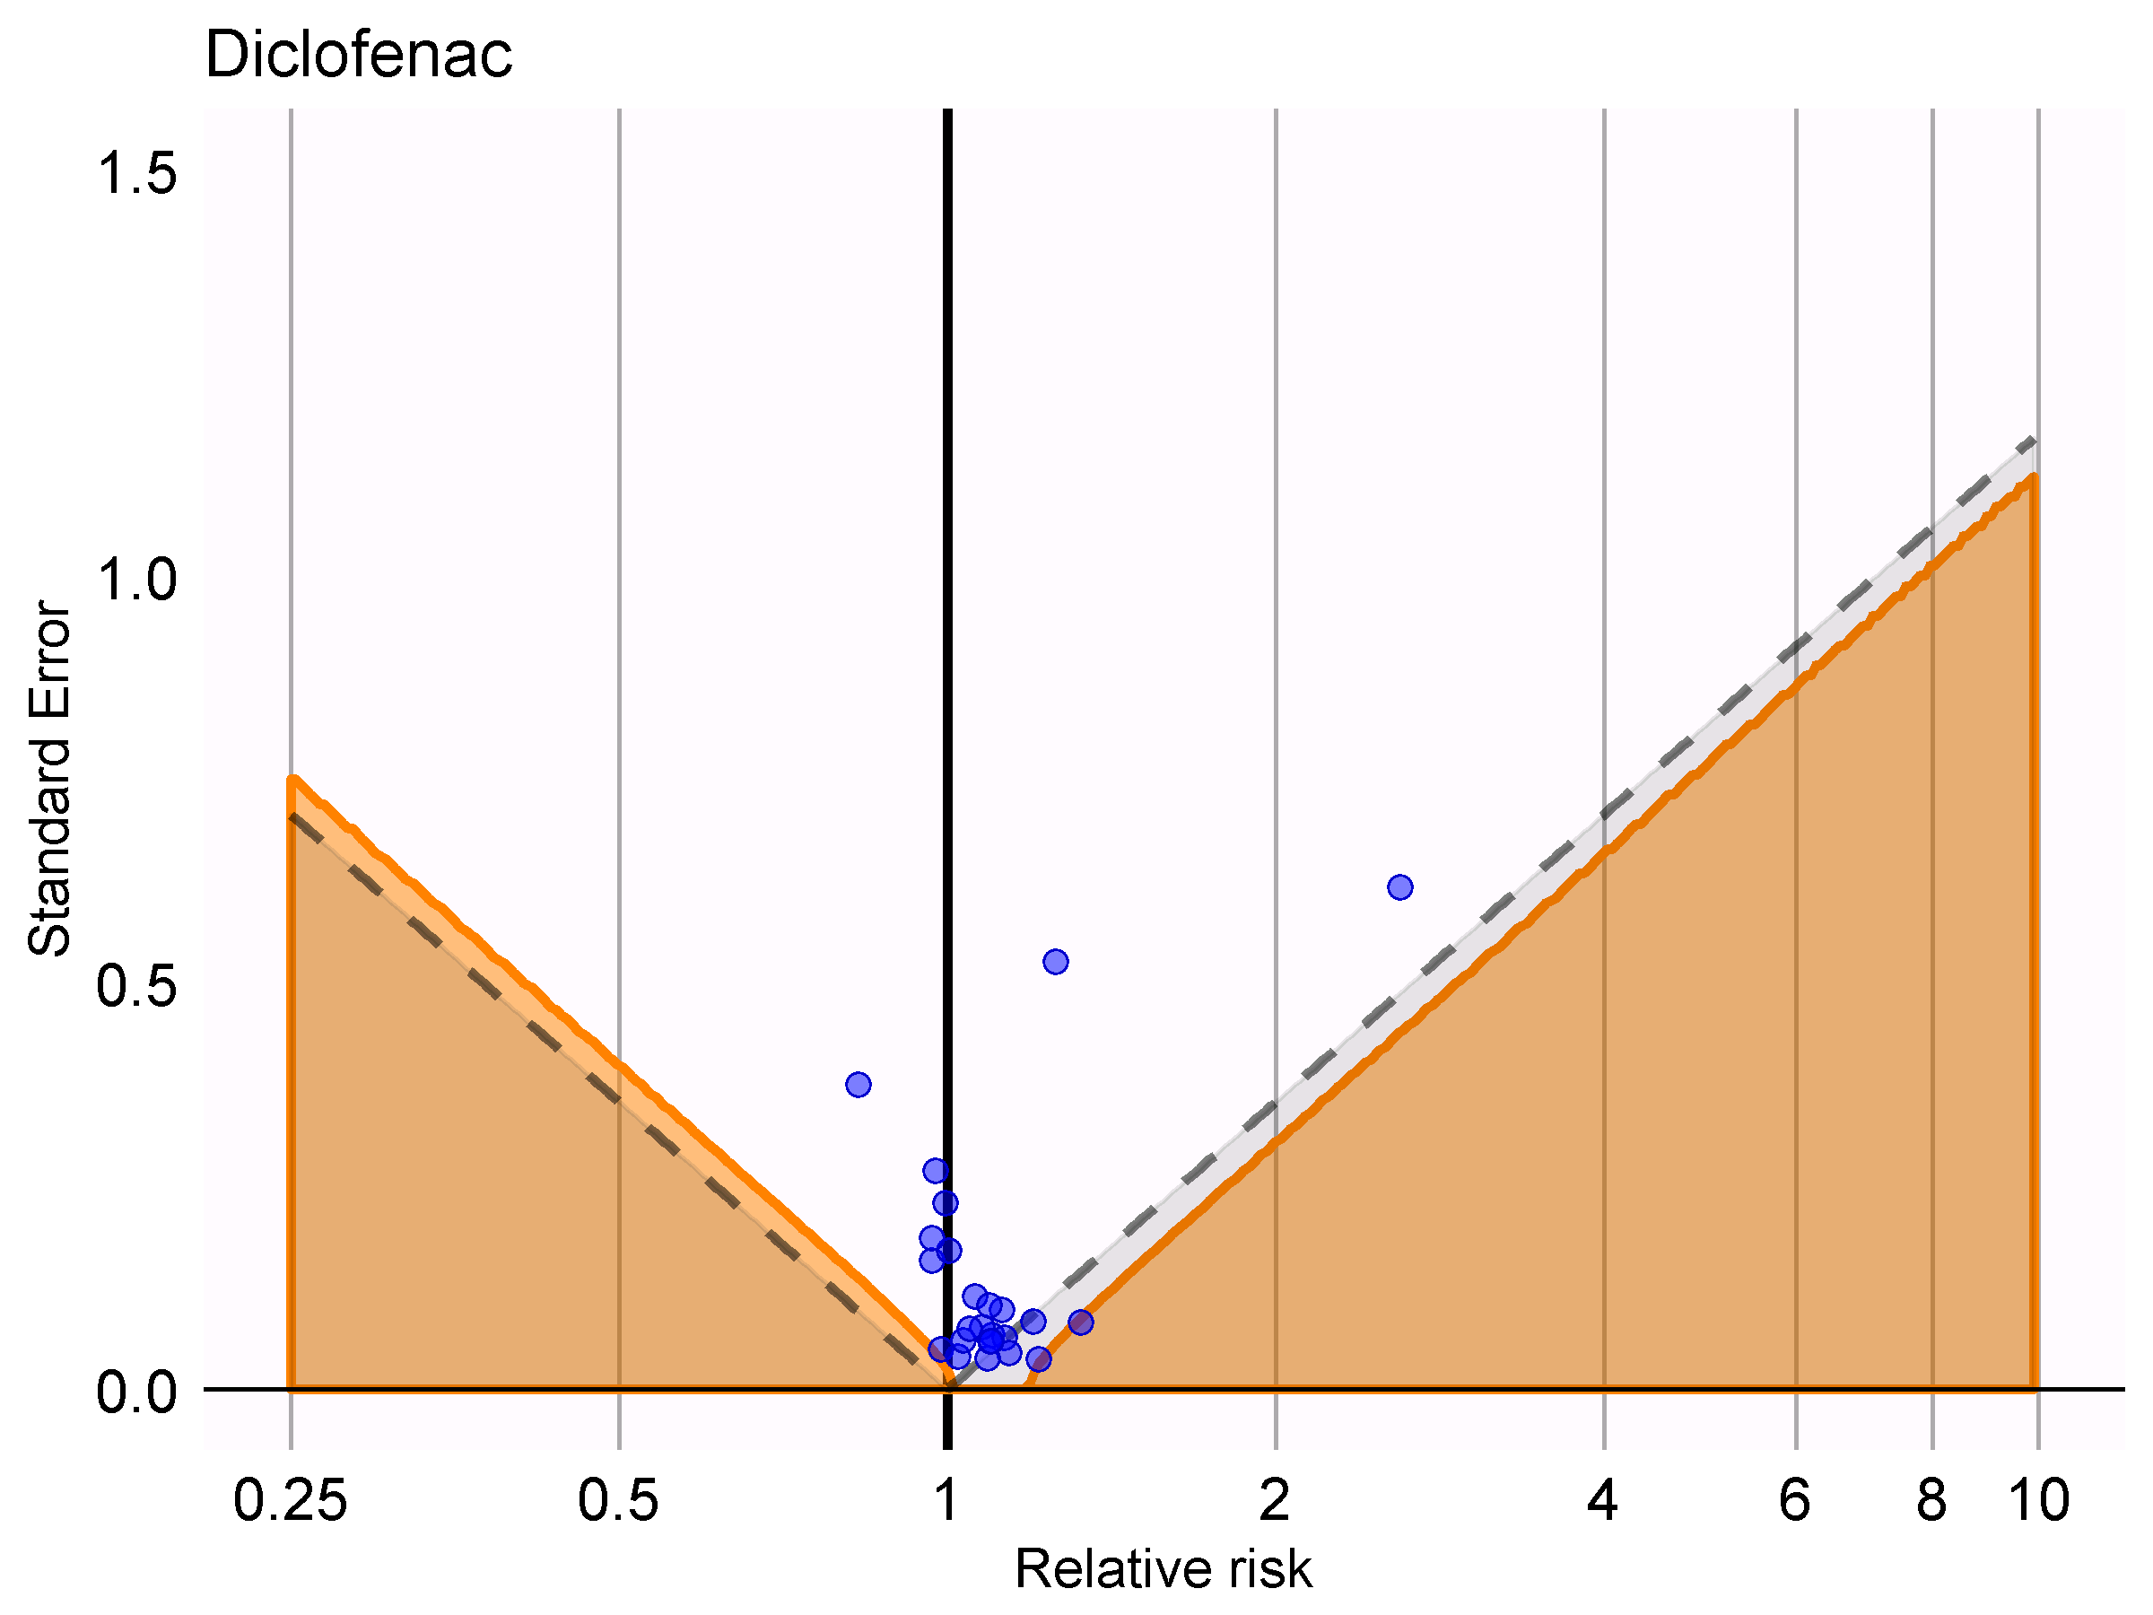
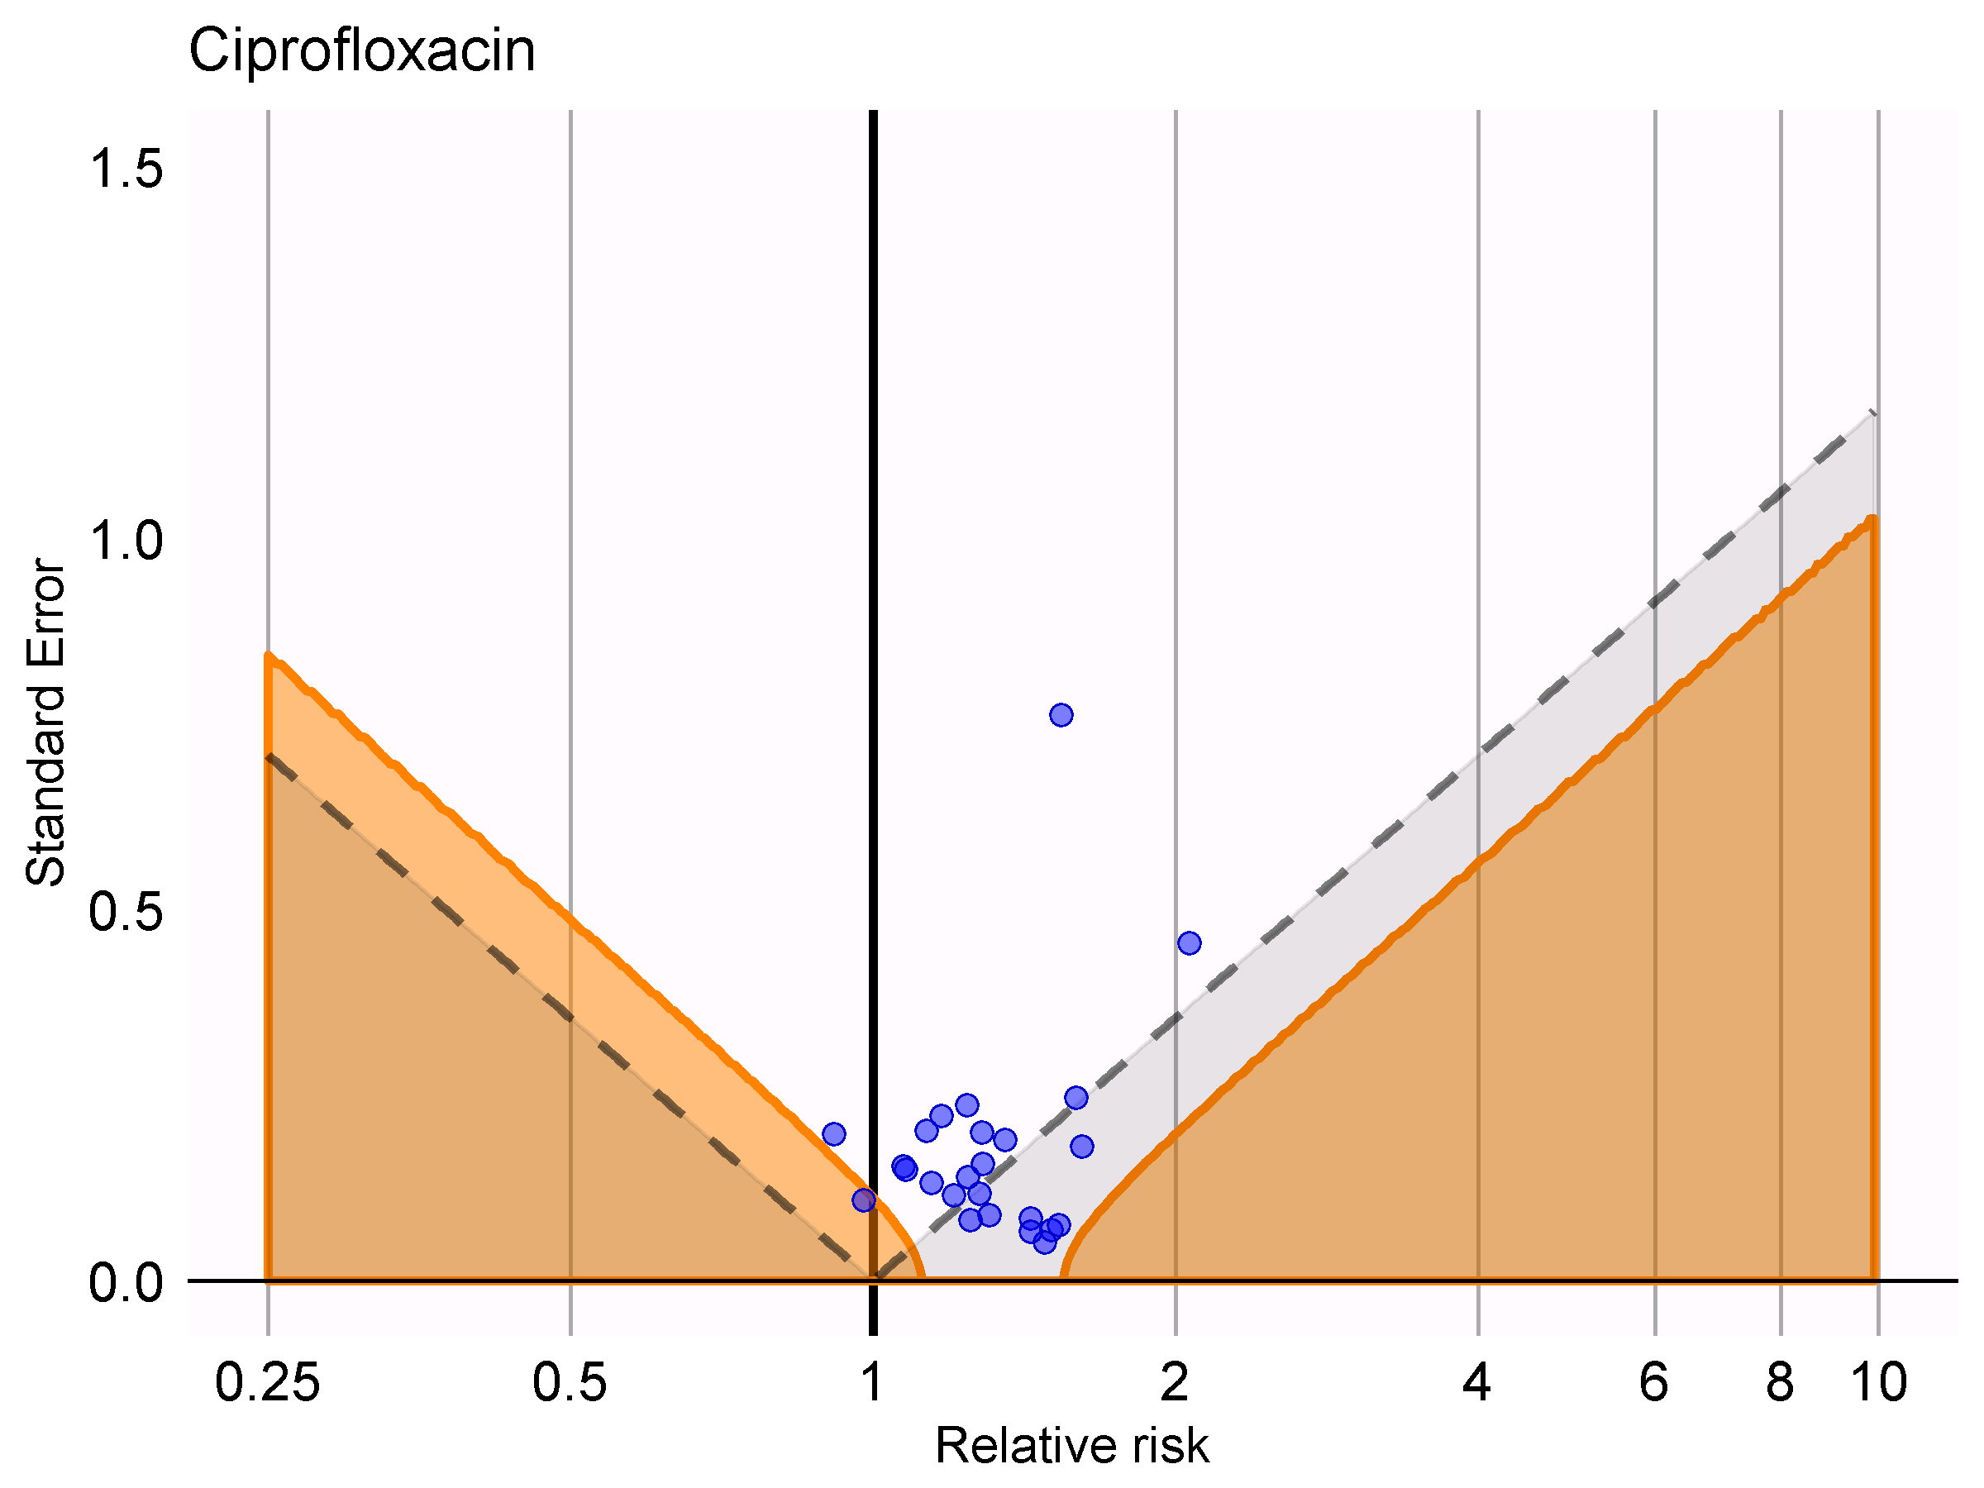
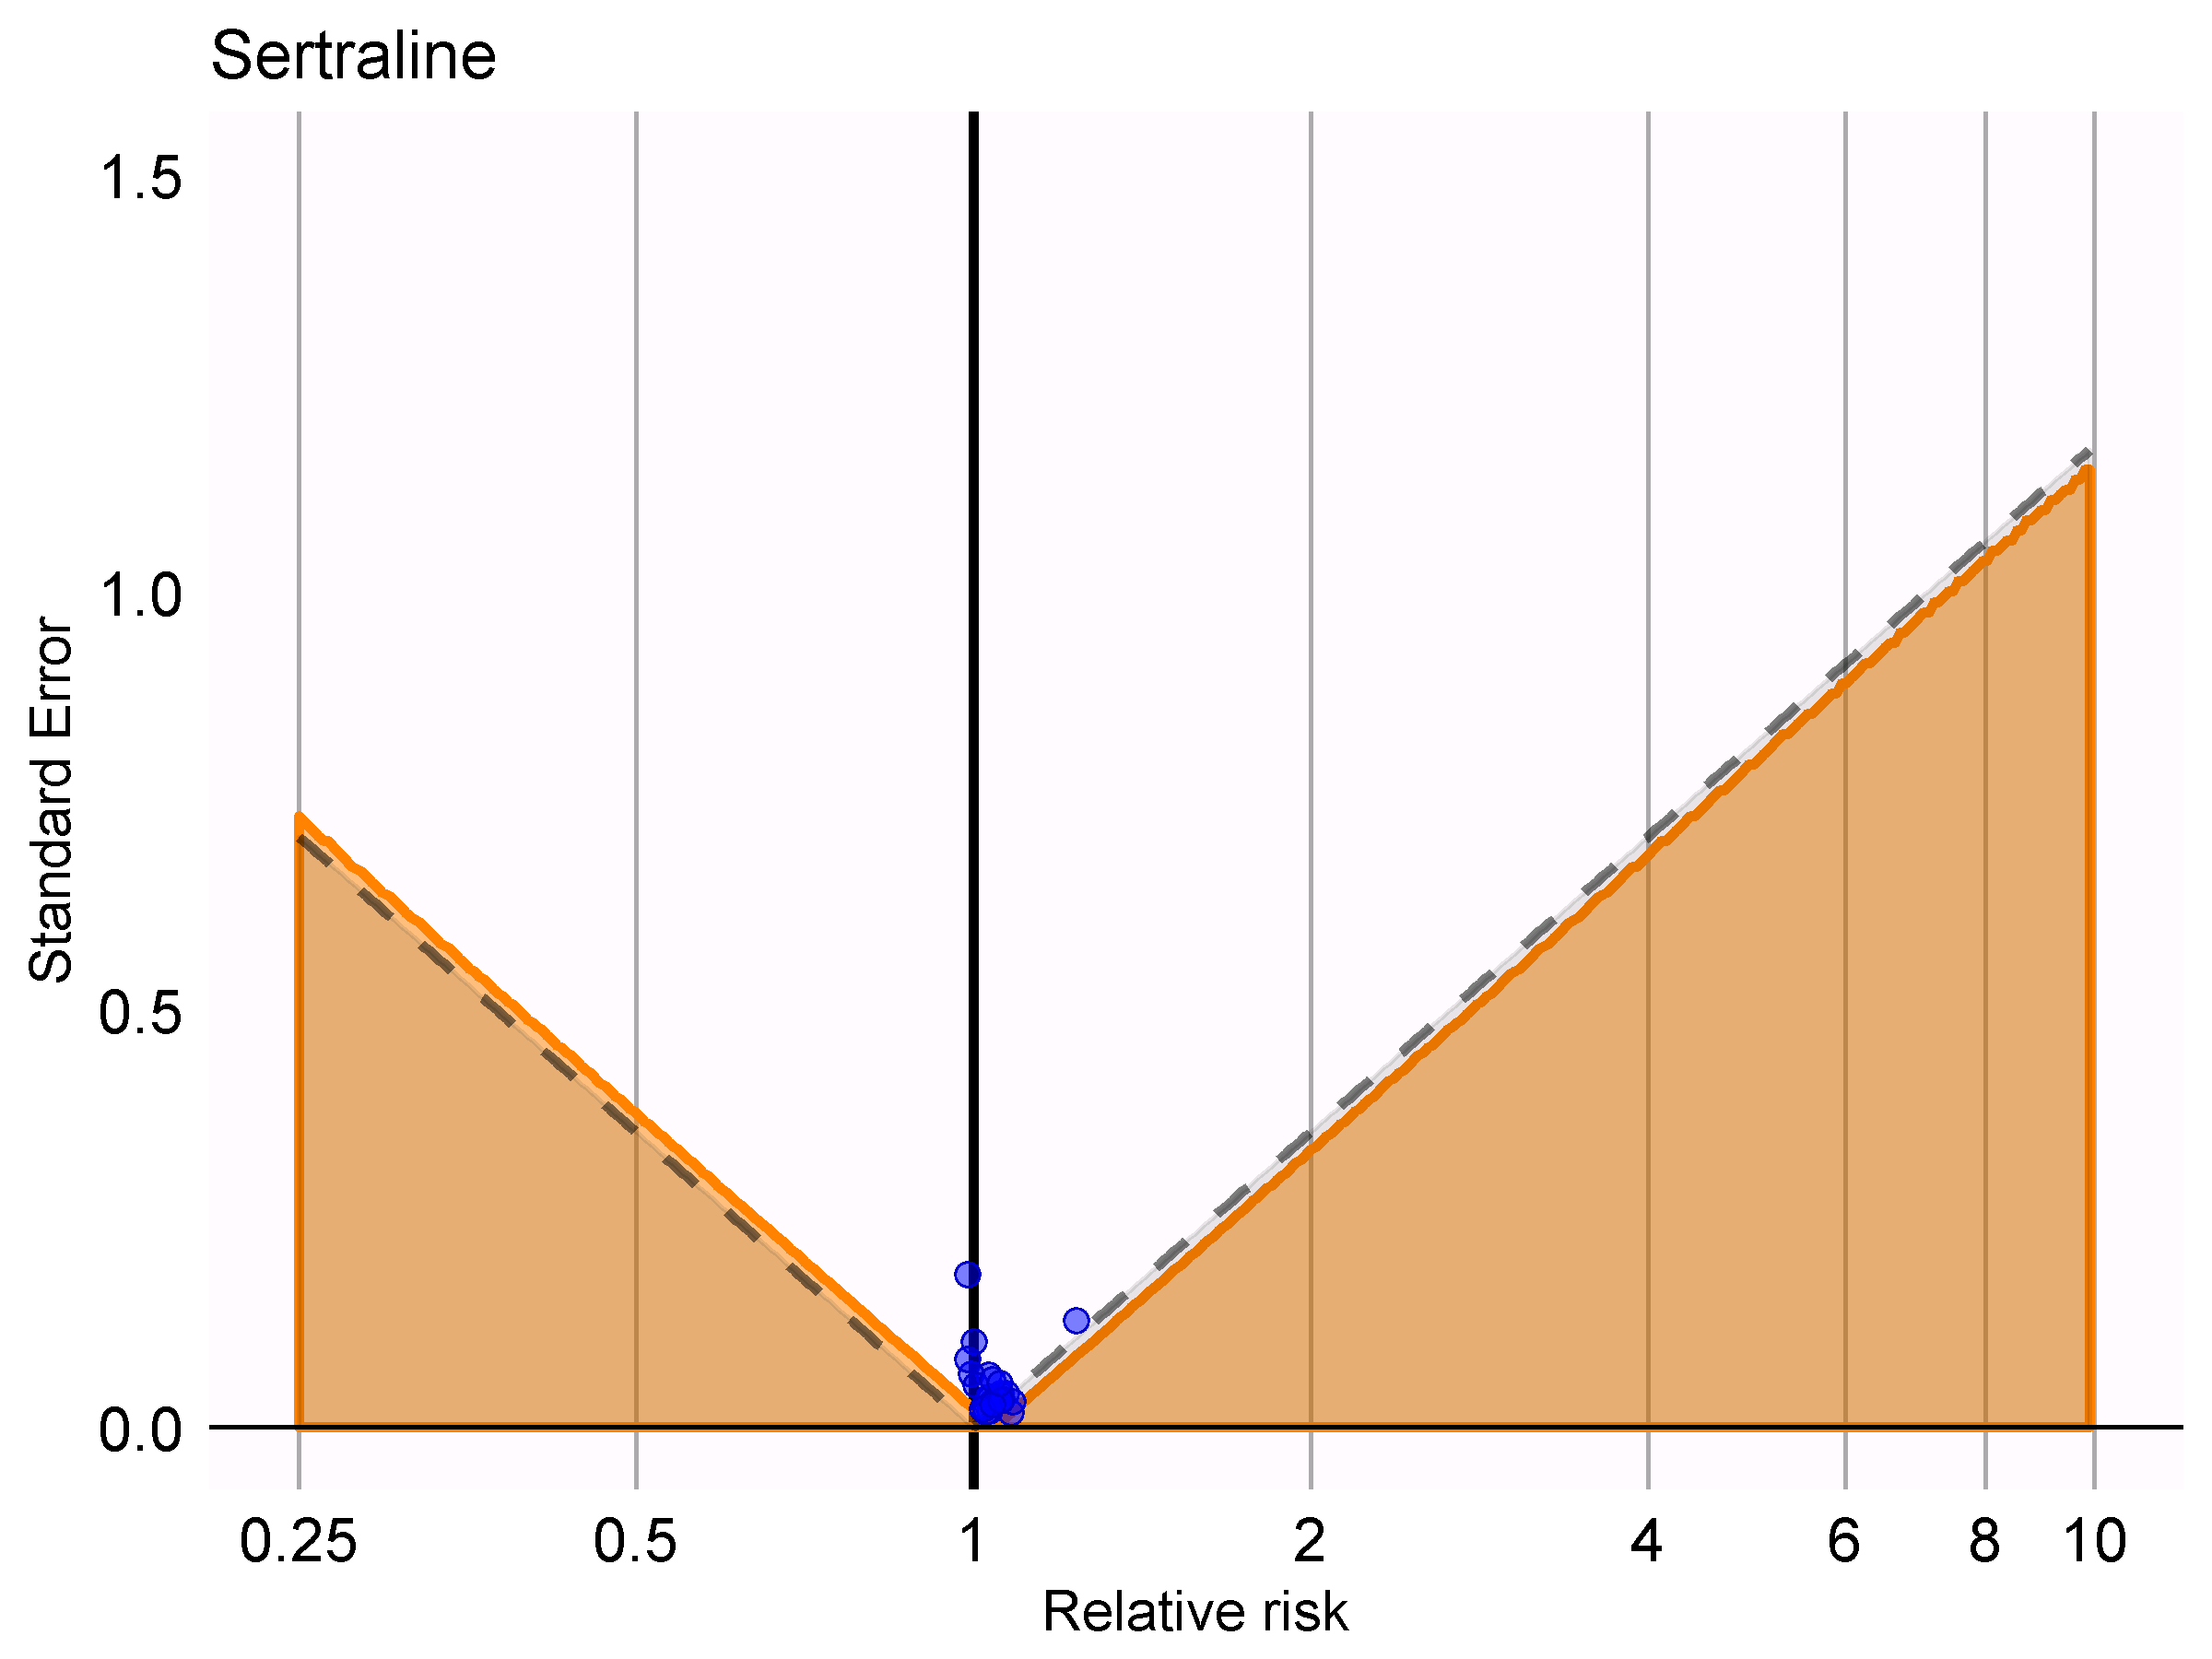
Stratified by exposure
Nested case-time-control

Slide 26
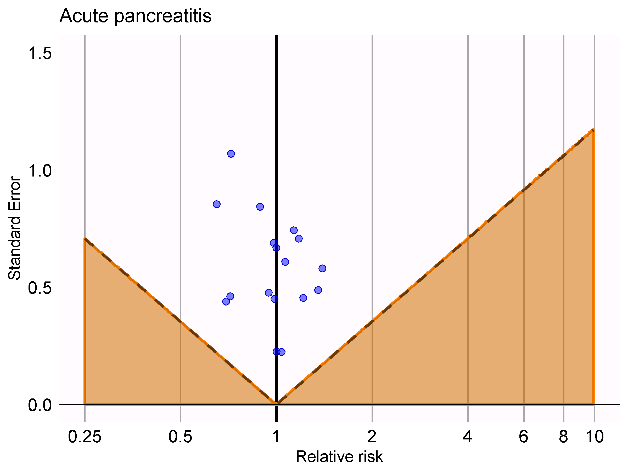
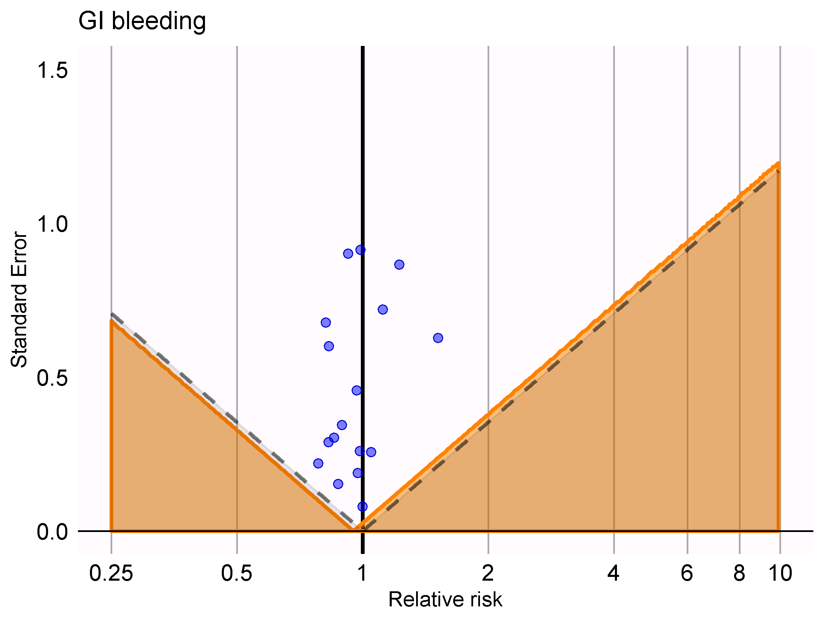
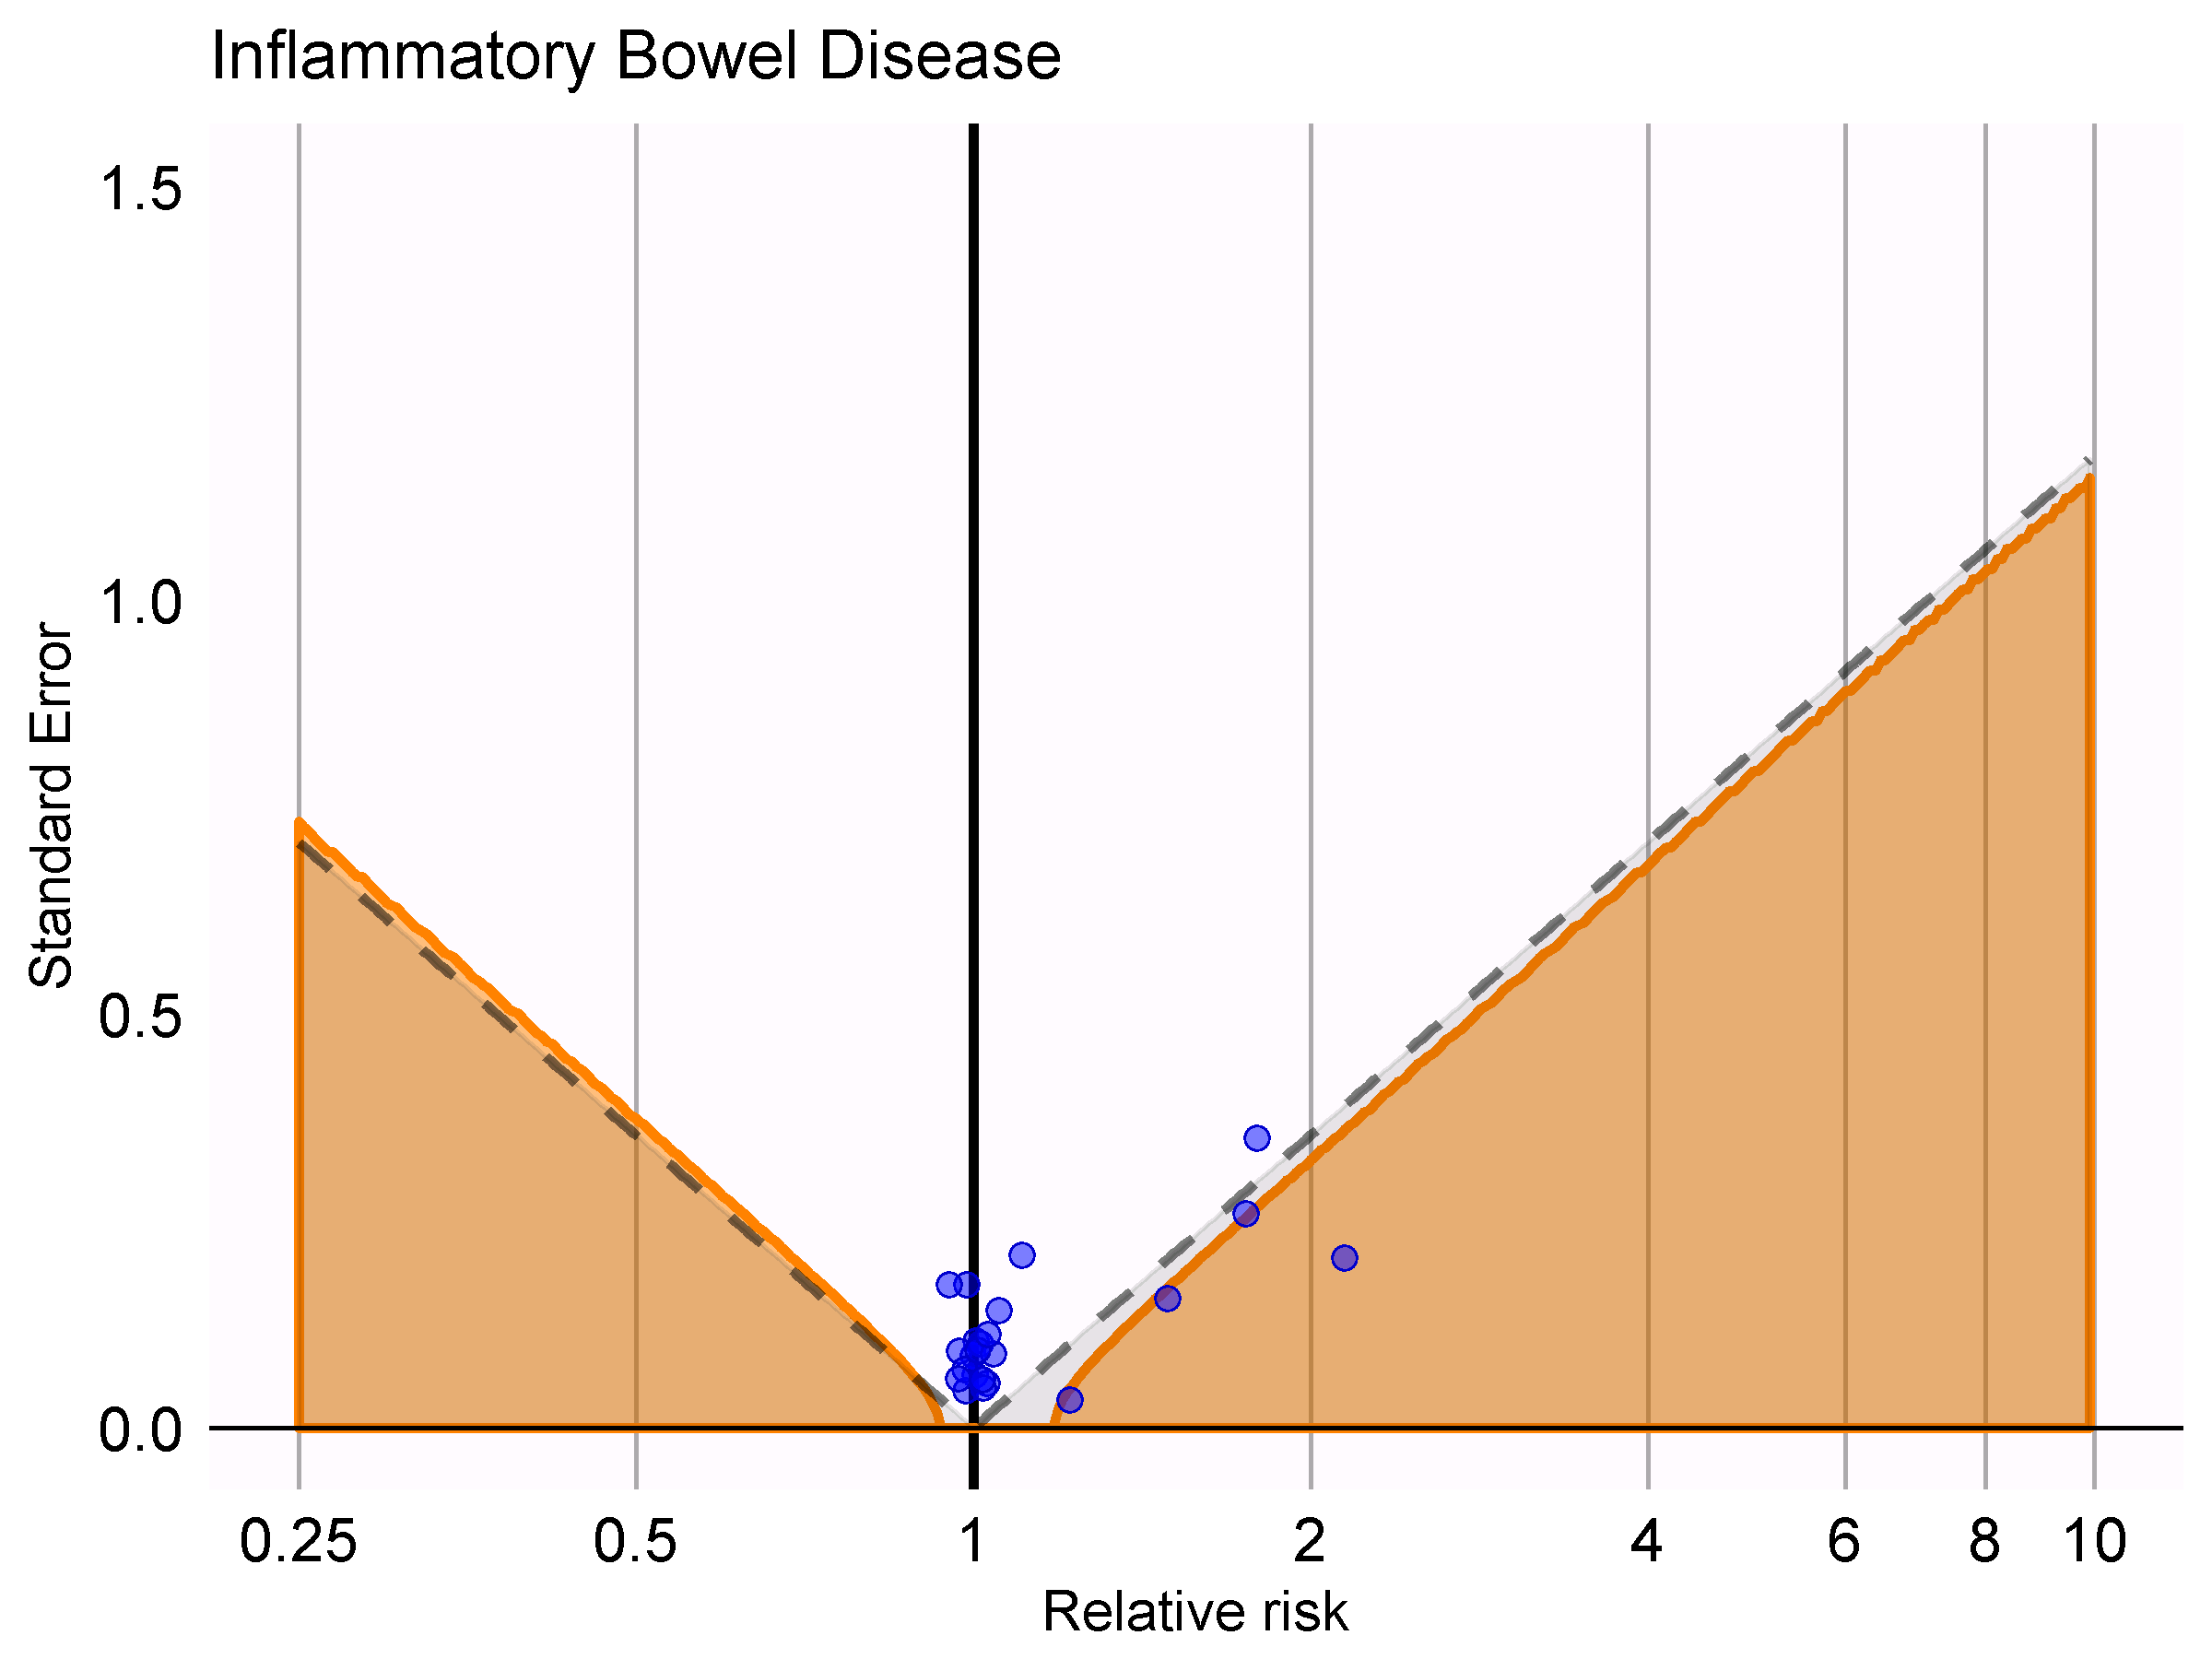
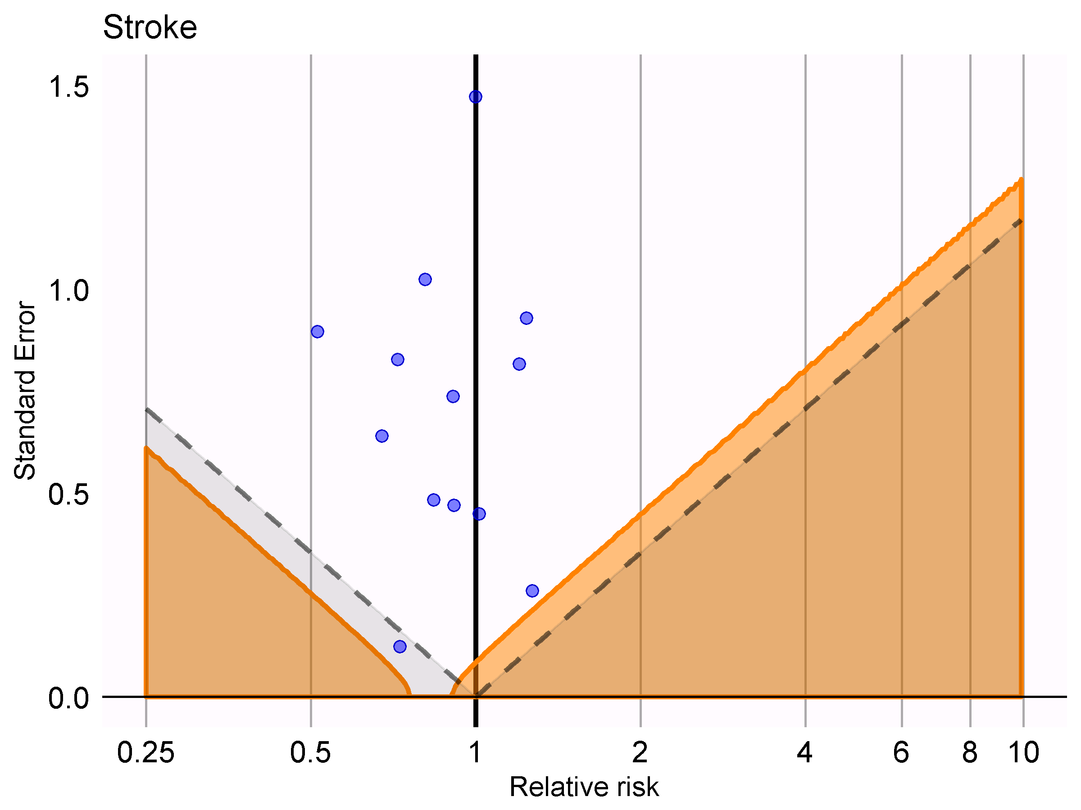
Stratified by outcome
Nested case-time-control

Slide 27
The importance of calendar time

Slide 28
OHDSI Symposium is coming! (October 18)
Posters?
OHDSI methods benchmark
Results of large set of methods on benchmark
…

Slide 29
Topic of next meeting(s)?
?

Slide 30
Next workgroup meeting
Eastern hemisphere: June 14
3pm Hong Kong / Taiwan
4pm South Korea
4:30pm Adelaide
9am Central European time
8am UK time
Western hemisphere: June 8
6pm Central European time
12pm New York
9am Los Angeles / Stanford
http://www.ohdsi.org/web/wiki/doku.php?id=projects:workgroups:est-methods

