Slide 1
The comparative self-controlled case series (CSCCS)
Jamie Weaver
Janssen R&D

Slide 2
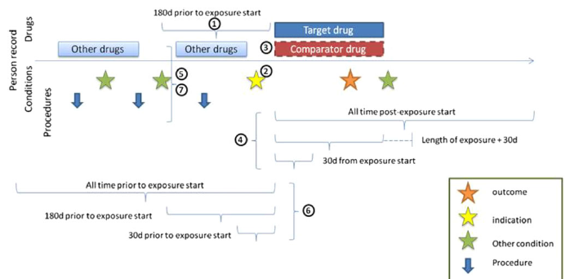
Background
Comparative cohort study
Evaluates risk of outcome in treatment group vs. comparator group after exposure during defined time-at-risk period
Selection effects drive treatment assignment; mitigated by propensity score methods that balance observed covariates between persons

Slide 3
Background
Self-controlled case series (SCCS)
Evaluates risk of outcomes in cases only by comparing event rate in unexposed vs. exposed periods within defined observation period
Implicitly controls for fixed and unobserved covariates within persons

Slide 4
Background
Comparative self-controlled case series (CSSCS)
Combines advantages of comparative cohort and SCCS designs
Treatment and comparator groups balanced on observed covariates, estimate treatment and comparator effects in balanced groups while controlling for unobserved covariates
Treatment
Between person balance
Comparator
Within person balance

Slide 5
Objectives
Evaluate CSCCS vs. comparative cohort method performance
Discriminative performance (AUC); predictive accuracy distinguishing between positive and negative control outcomes
Mean square error (MSE); average squared difference between log RR and true RR
Confidence interval coverage; proportion of 95% CIs that include 0
Systematic evaluation of methods discussion
CSCCS specifications for evaluation
Comparative cohort study settings for evaluation
Methods evaluation framework

Slide 6
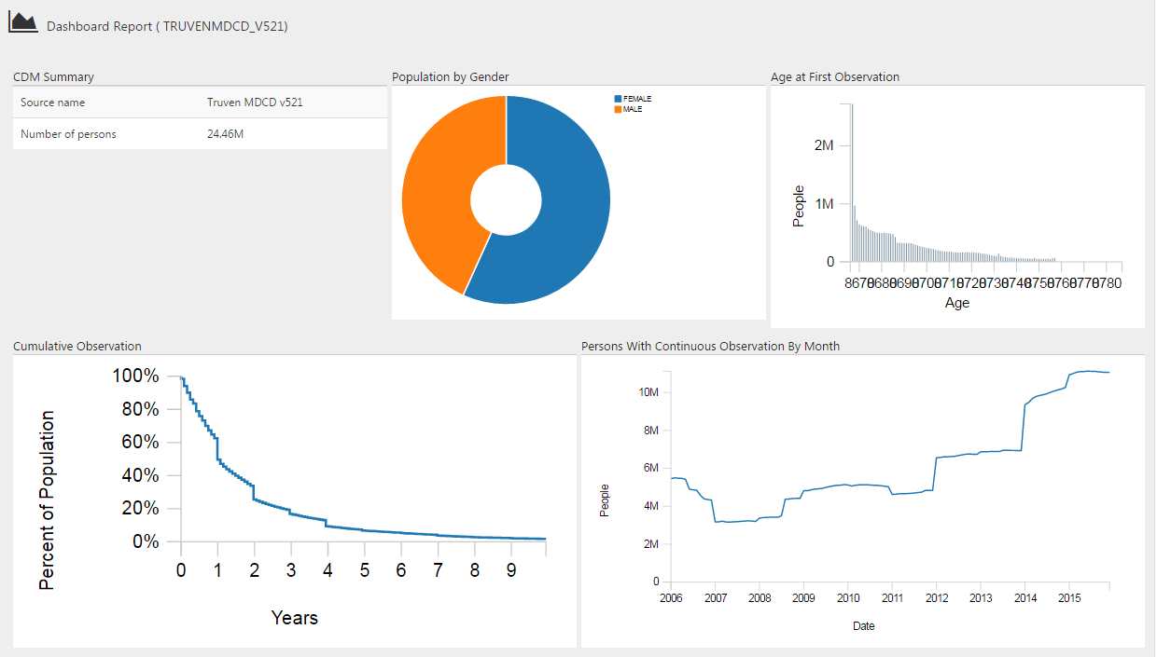
Data

Slide 7
Data
Created exposure-outcome pairs using diclofenac exposure
Negative controls, RR = 1
20 negative controls with >= 100 events during diclofenac exposure
Positive controls, RR = (1.25, 1.5, 2, 4)
Fit Poisson outcome model during diclofenac exposure
Use model predictions to inject outcomes to high-risk patients (i.e. similar to patients who experienced the outcome)
20 negative controls + 20*4 positive controls = 120 outcomes
Celecoxib as comparator exposure, RR = 1 for all outcomes

Slide 8
Analysis settings
Comparative cohort study reference
Diclofenac vs. celecoxib (β = RR)
Matching plus stratified Poisson outcome model
CSCCS
Non-stratified diclofenac or celecoxib exposure covariate
Diclofenac exposure covariate (β = RRR)
All cases, unadjusted model
Exposure matched cases, unadjusted model
All cases, adjusted model (results pending)
Exposure matched cases, adjusted model (results pending)

Slide 9
Evaluation metrics
Discriminative performance
Area Under receiver operator characteristic Curve (AUC)
Predictive accuracy distinguishing between positive and negative control outcomes
Bias
Negative control outcomes and the empirical null distribution
Mean square error (MSE)
Average squared difference between log RR and true RR
Confidence interval coverage
Proportion of 95% CIs that include 1

Slide 10
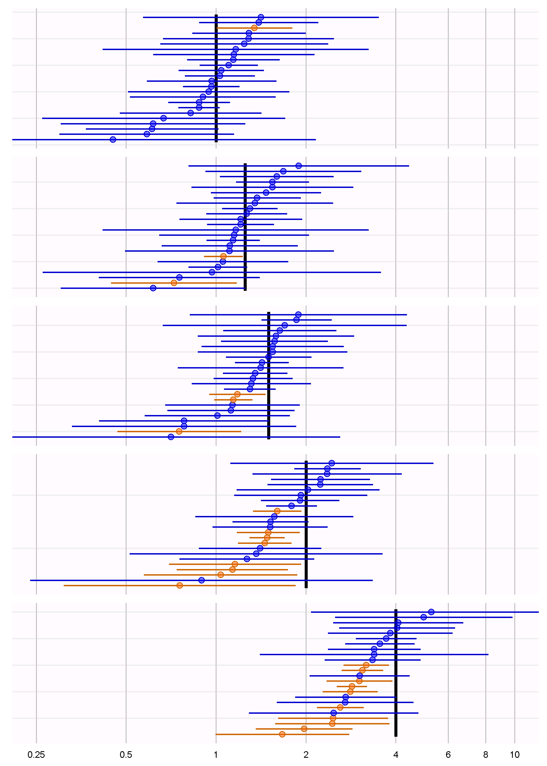
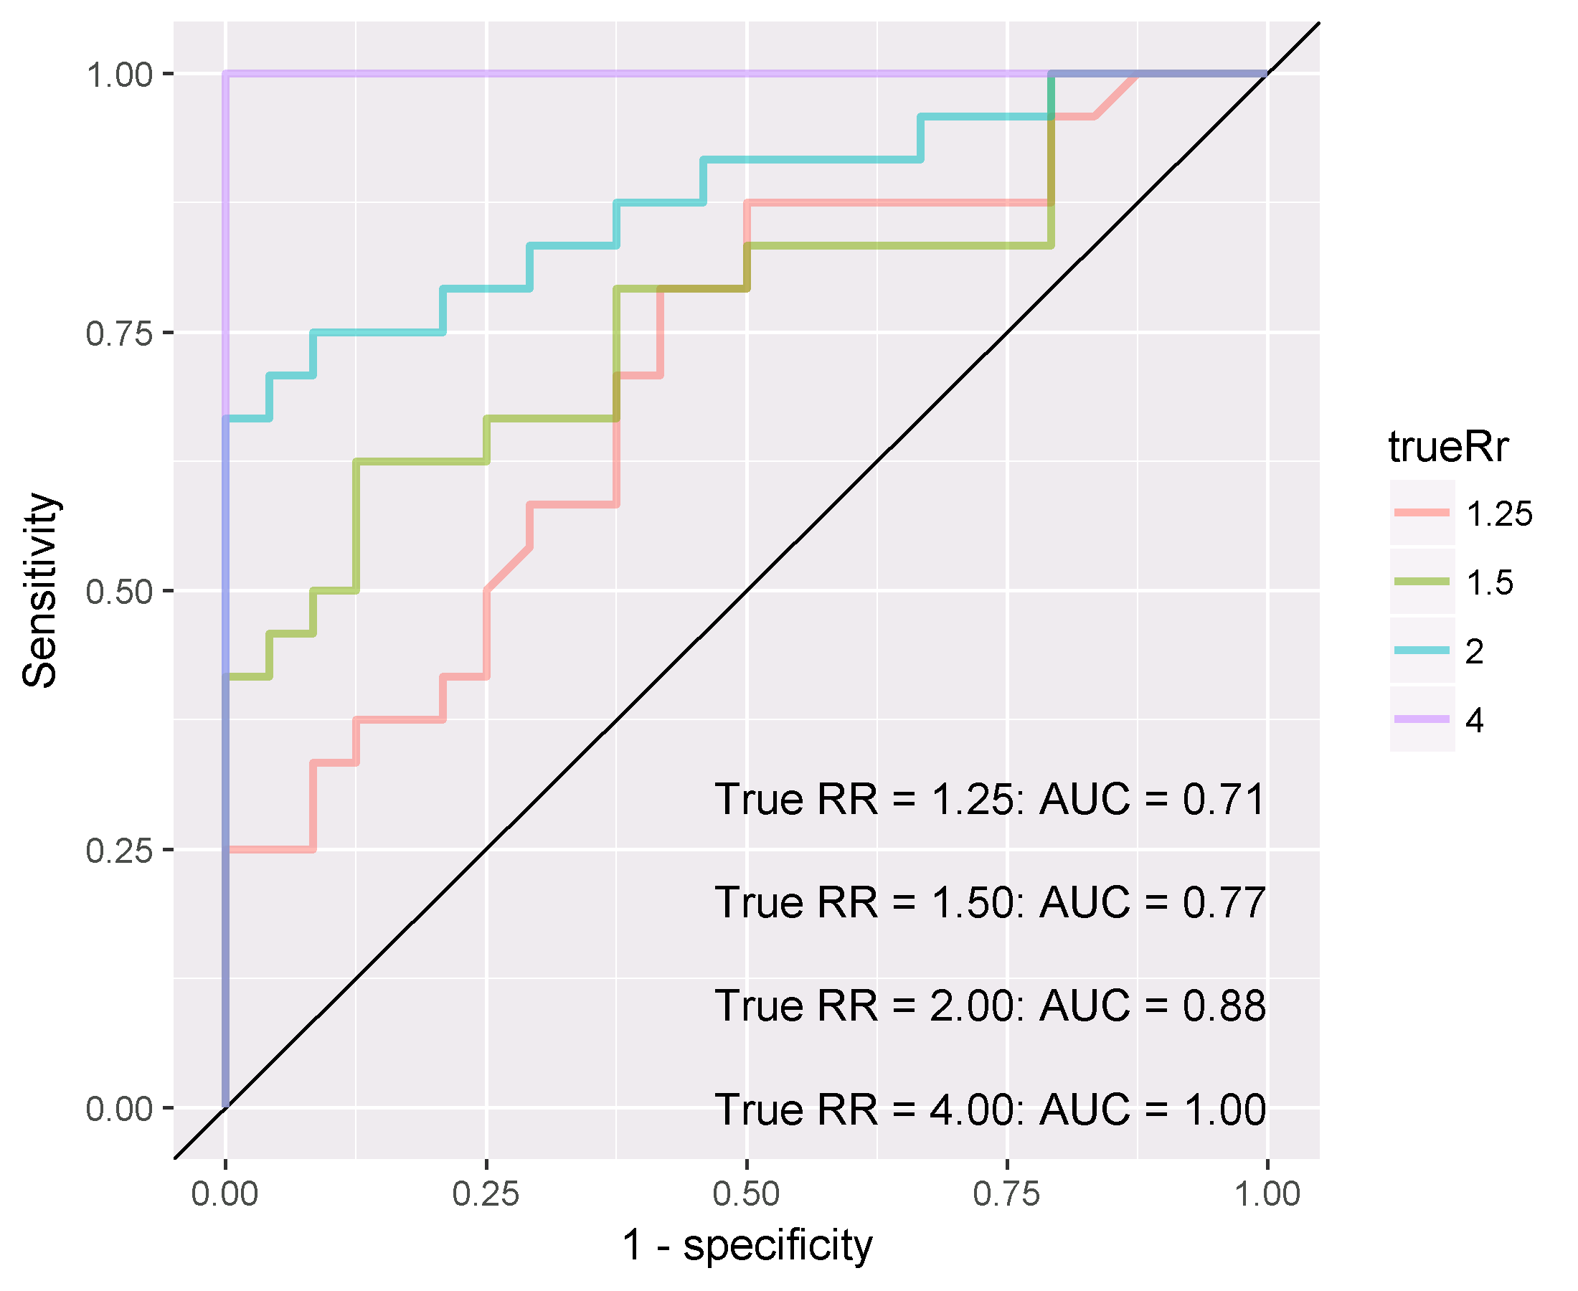
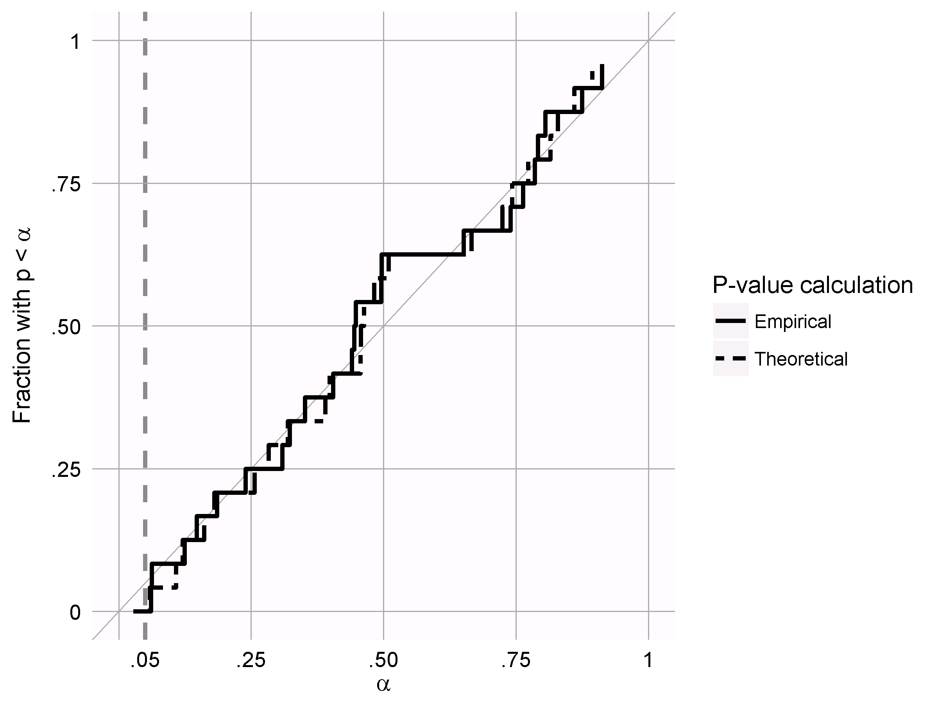
Results
Comparative cohort study
Matching plus stratified Poisson outcome model
True RR | AUC | Coverage
1 |  | 0.96
1.25 | 0.71 | 0.92
1.5 | 0.77 | 0.88
2 | 0.88 | 0.67
4 | 1 | 0.58

Slide 11
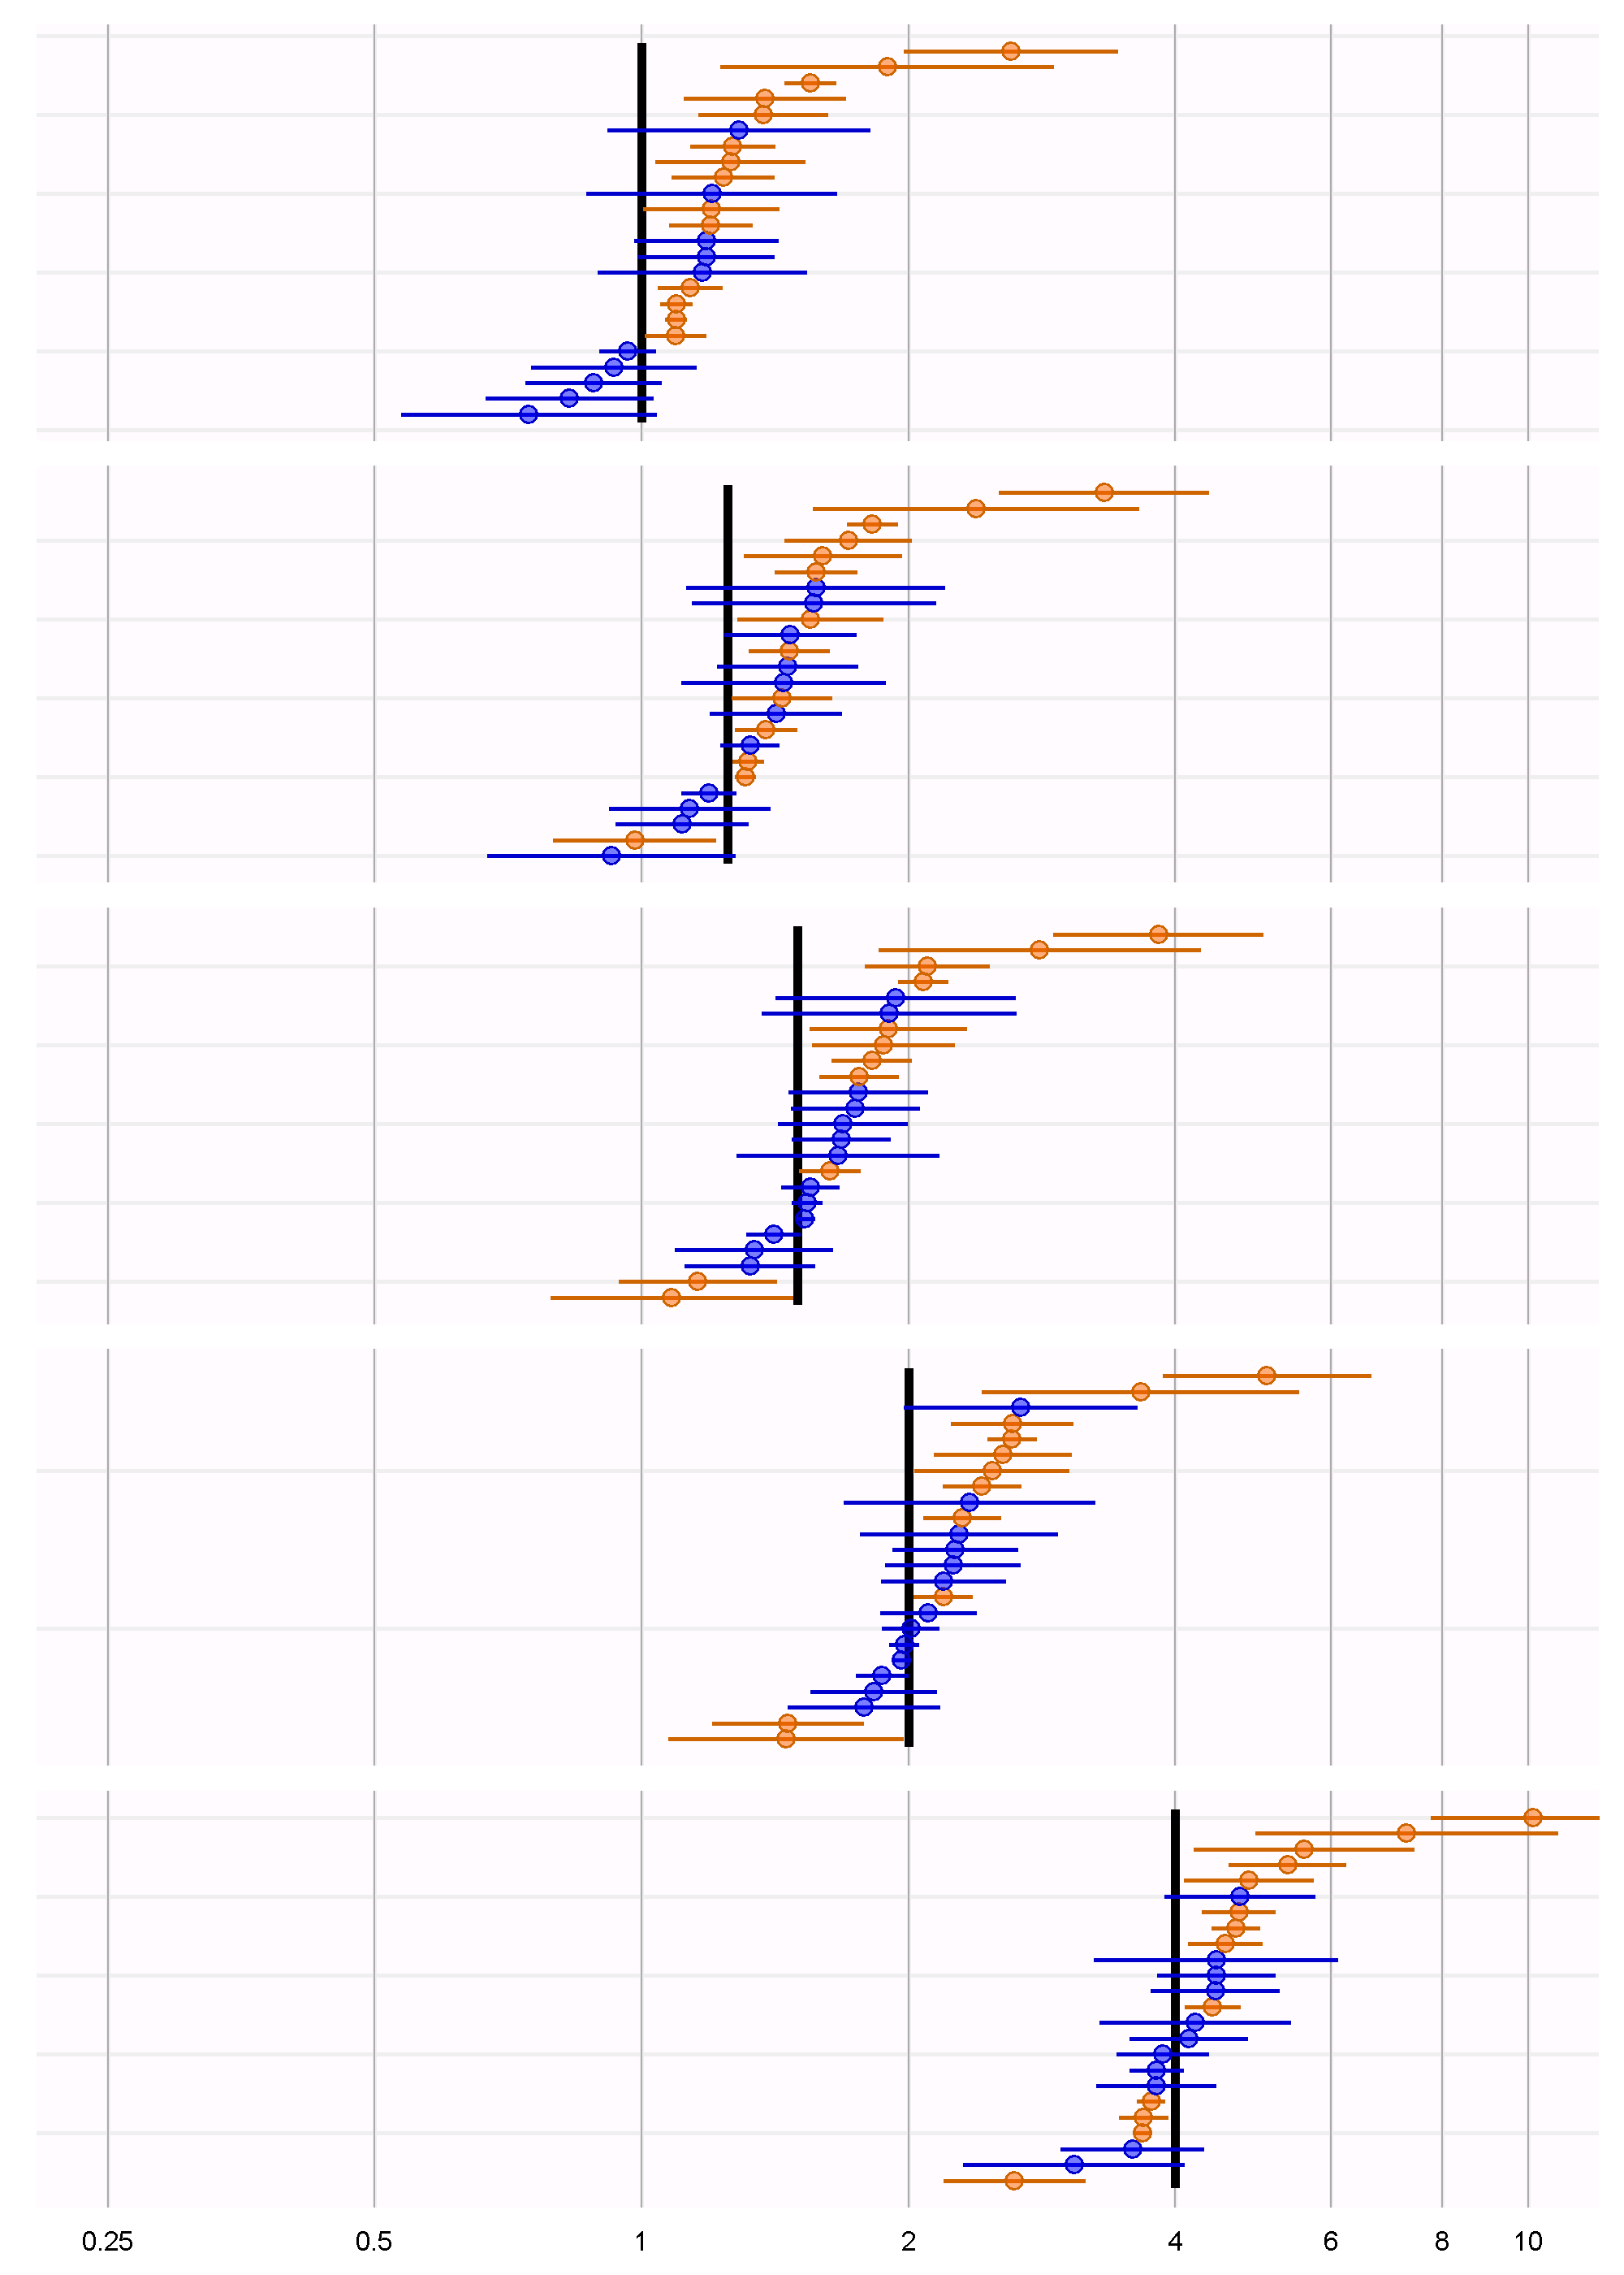
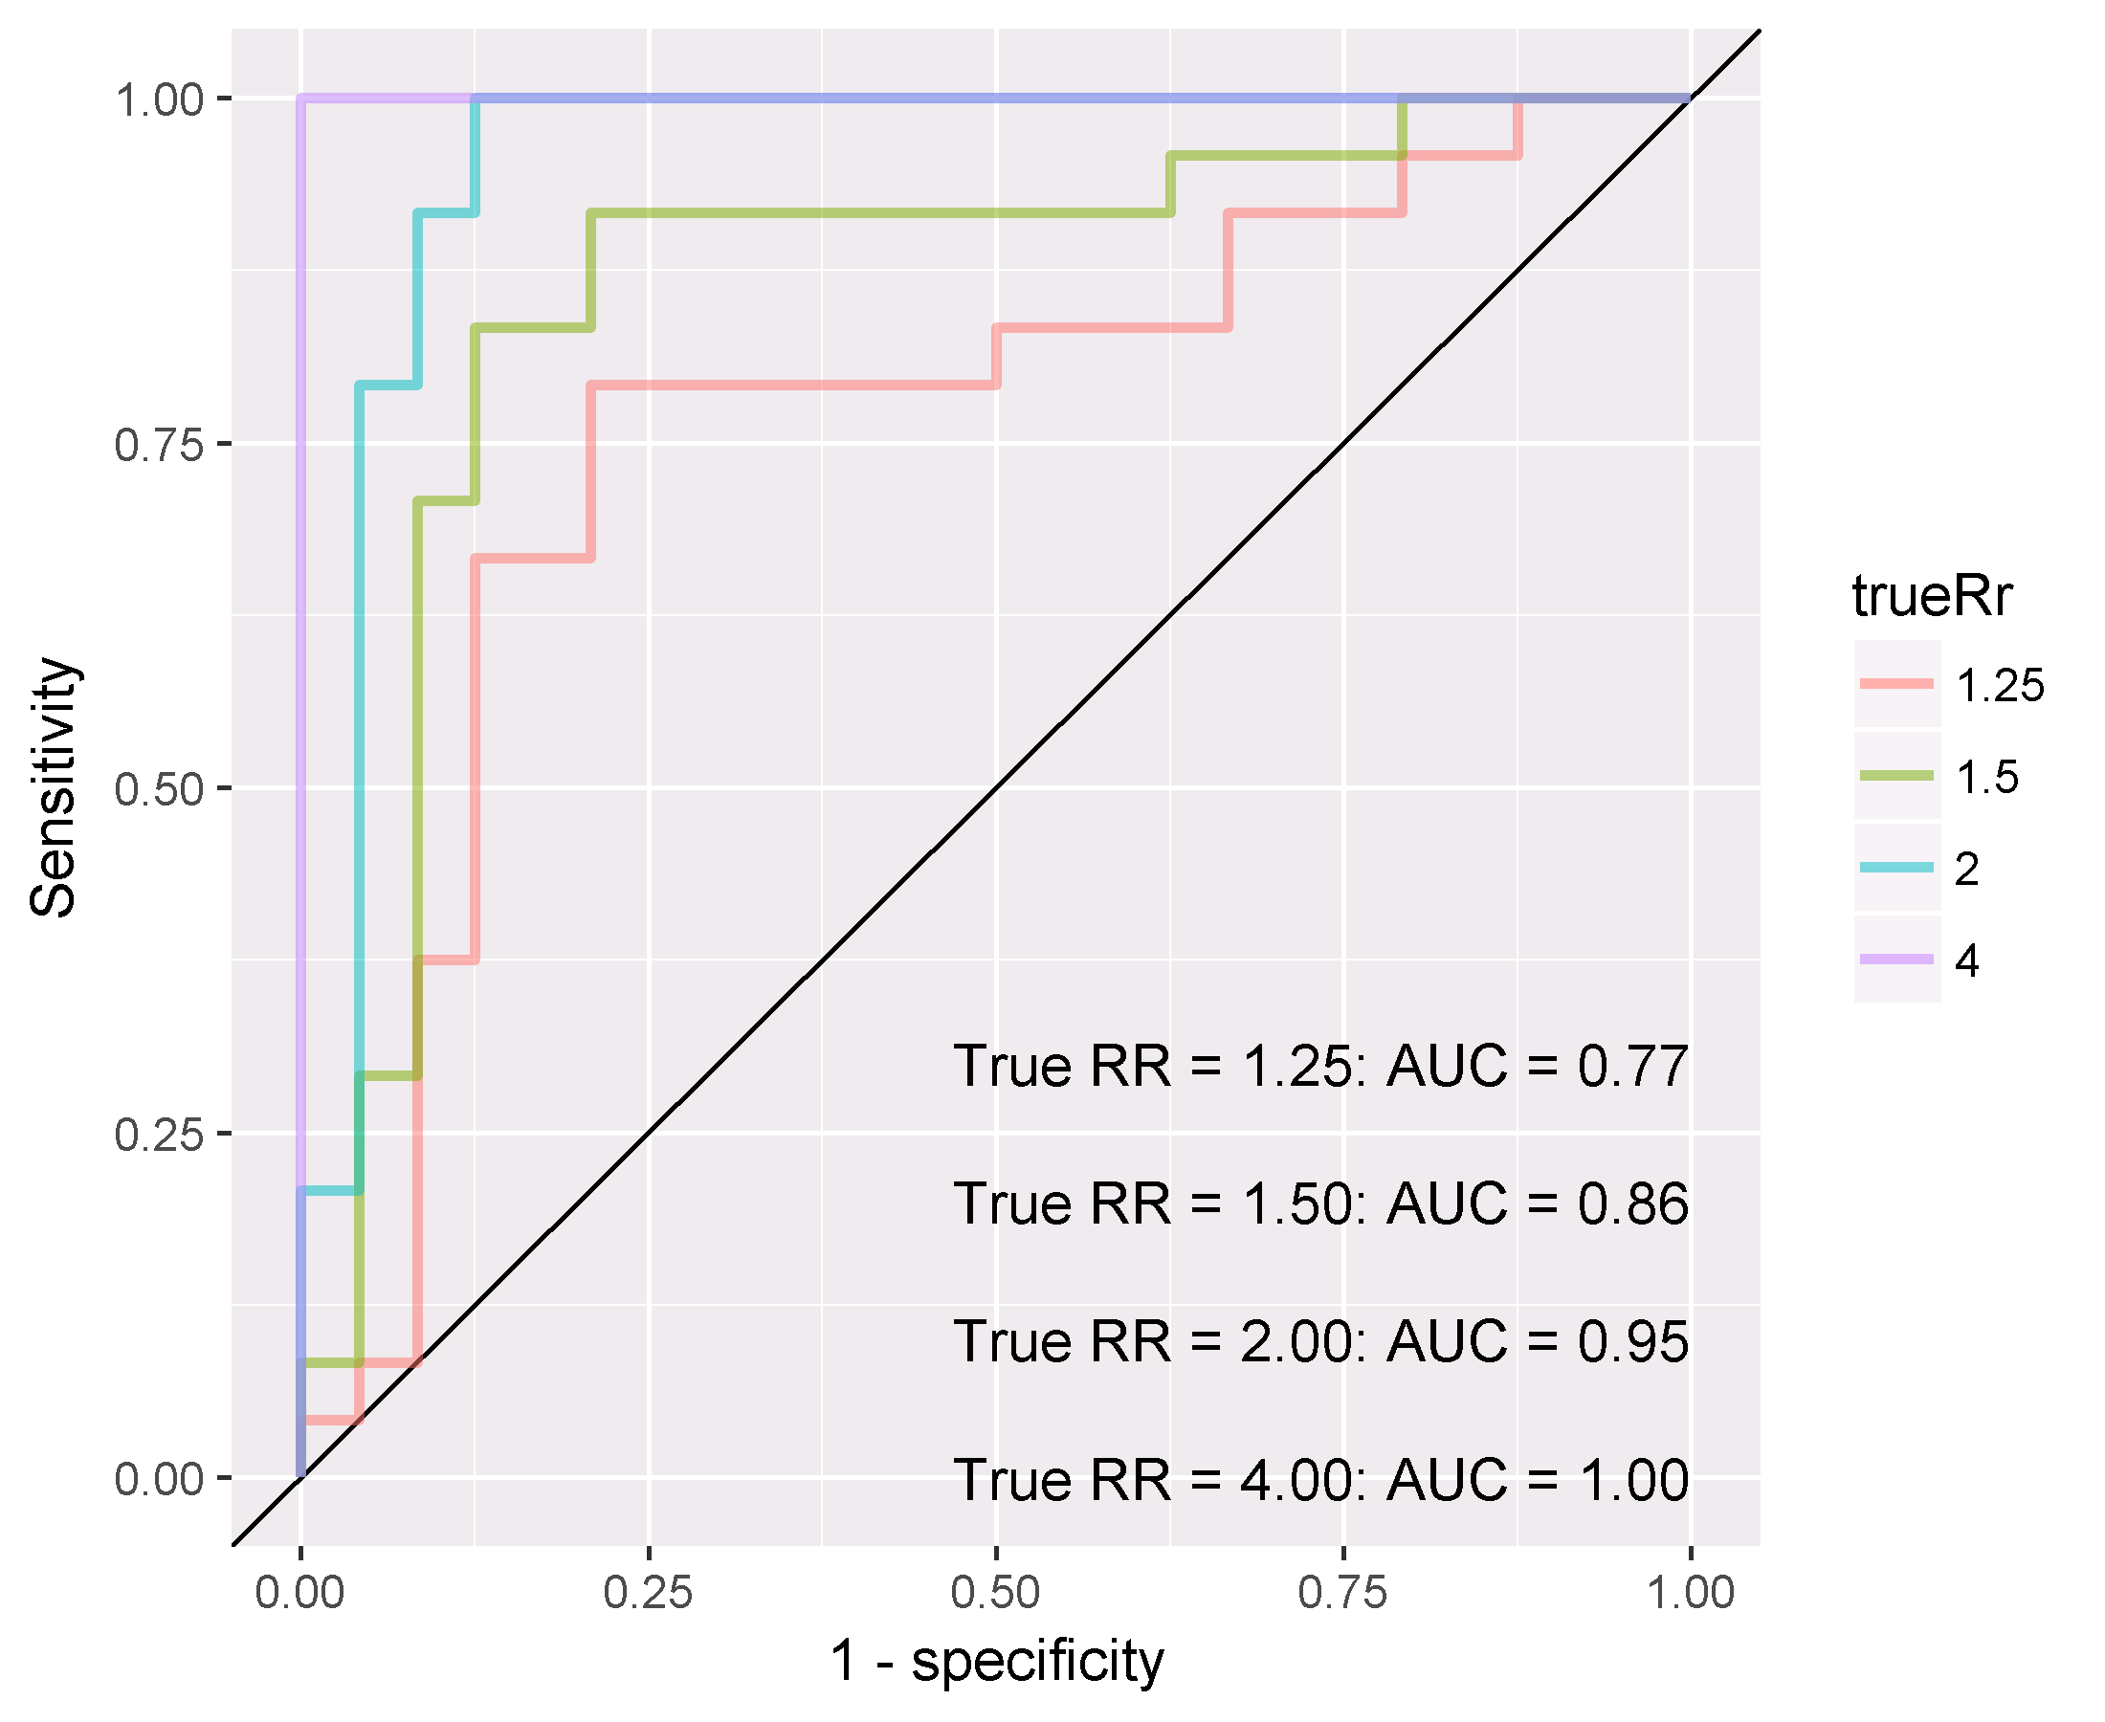
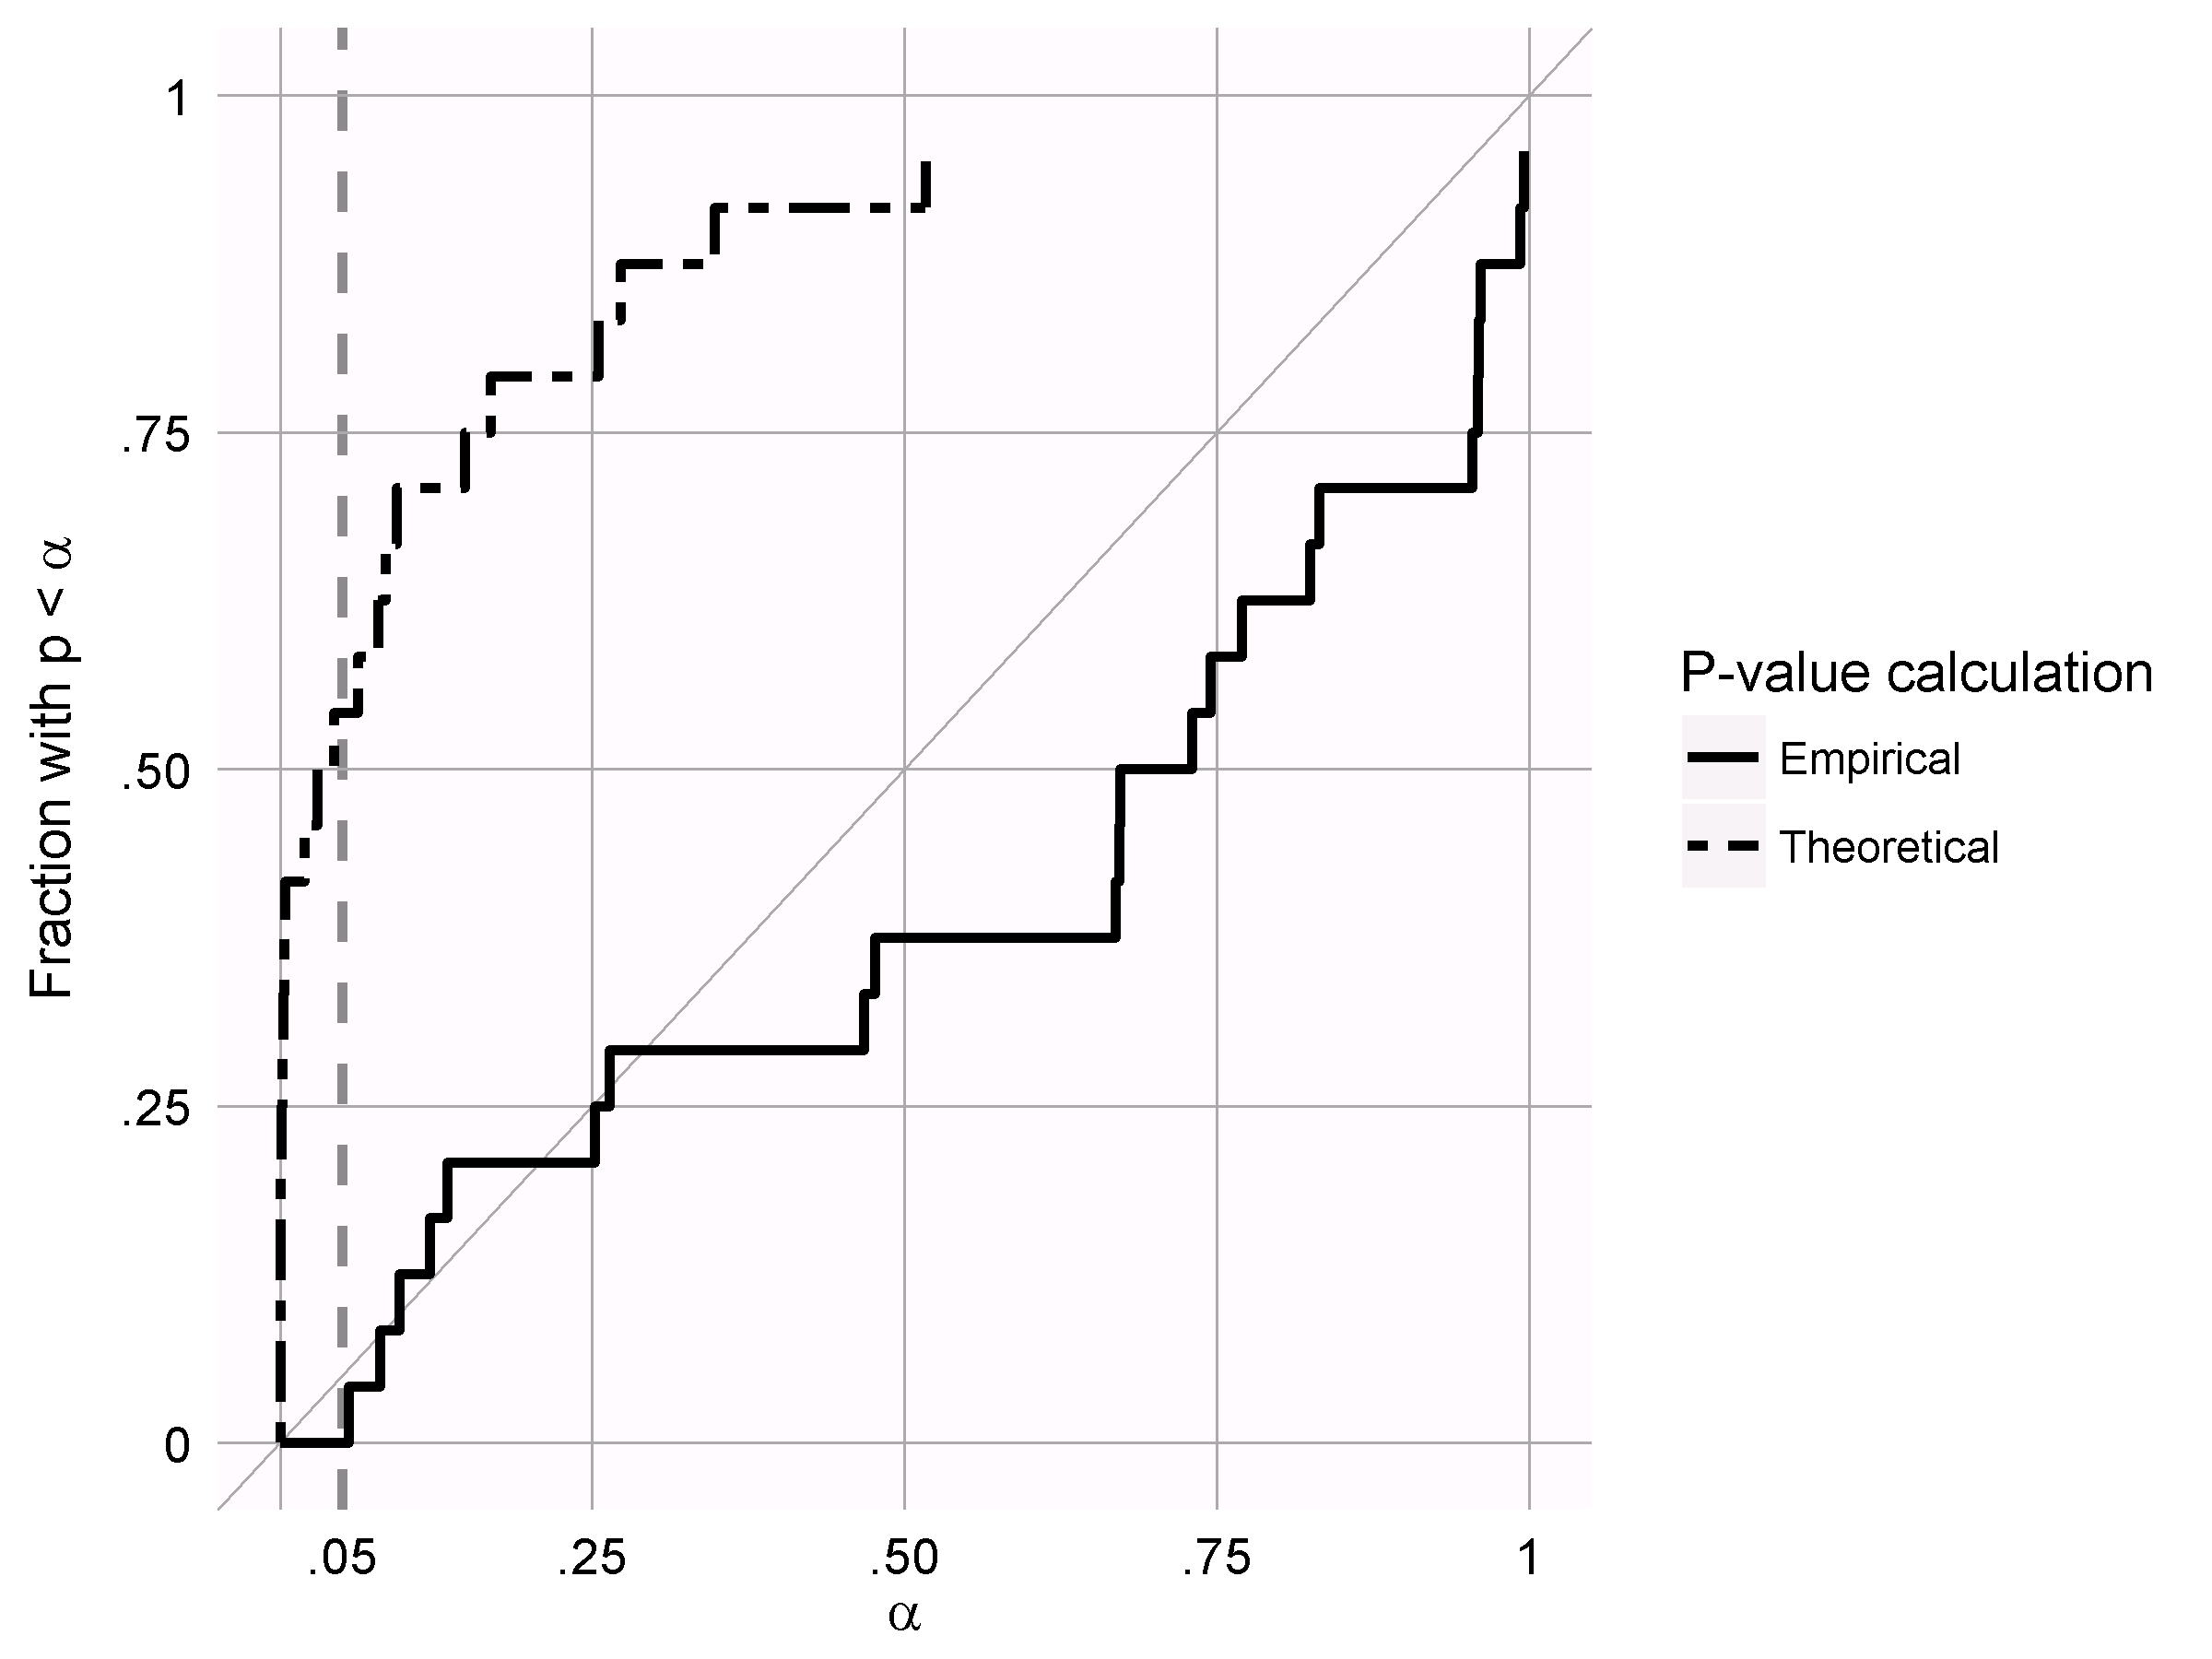
Results
CSCCS
All cases, unadjusted model
True RR | AUC | Coverage
1 |  | 0.42
1.25 | 0.77 | 0.46
1.5 | 0.86 | 0.54
2 | 0.95 | 0.54
4 | 1 | 0.46

Slide 12
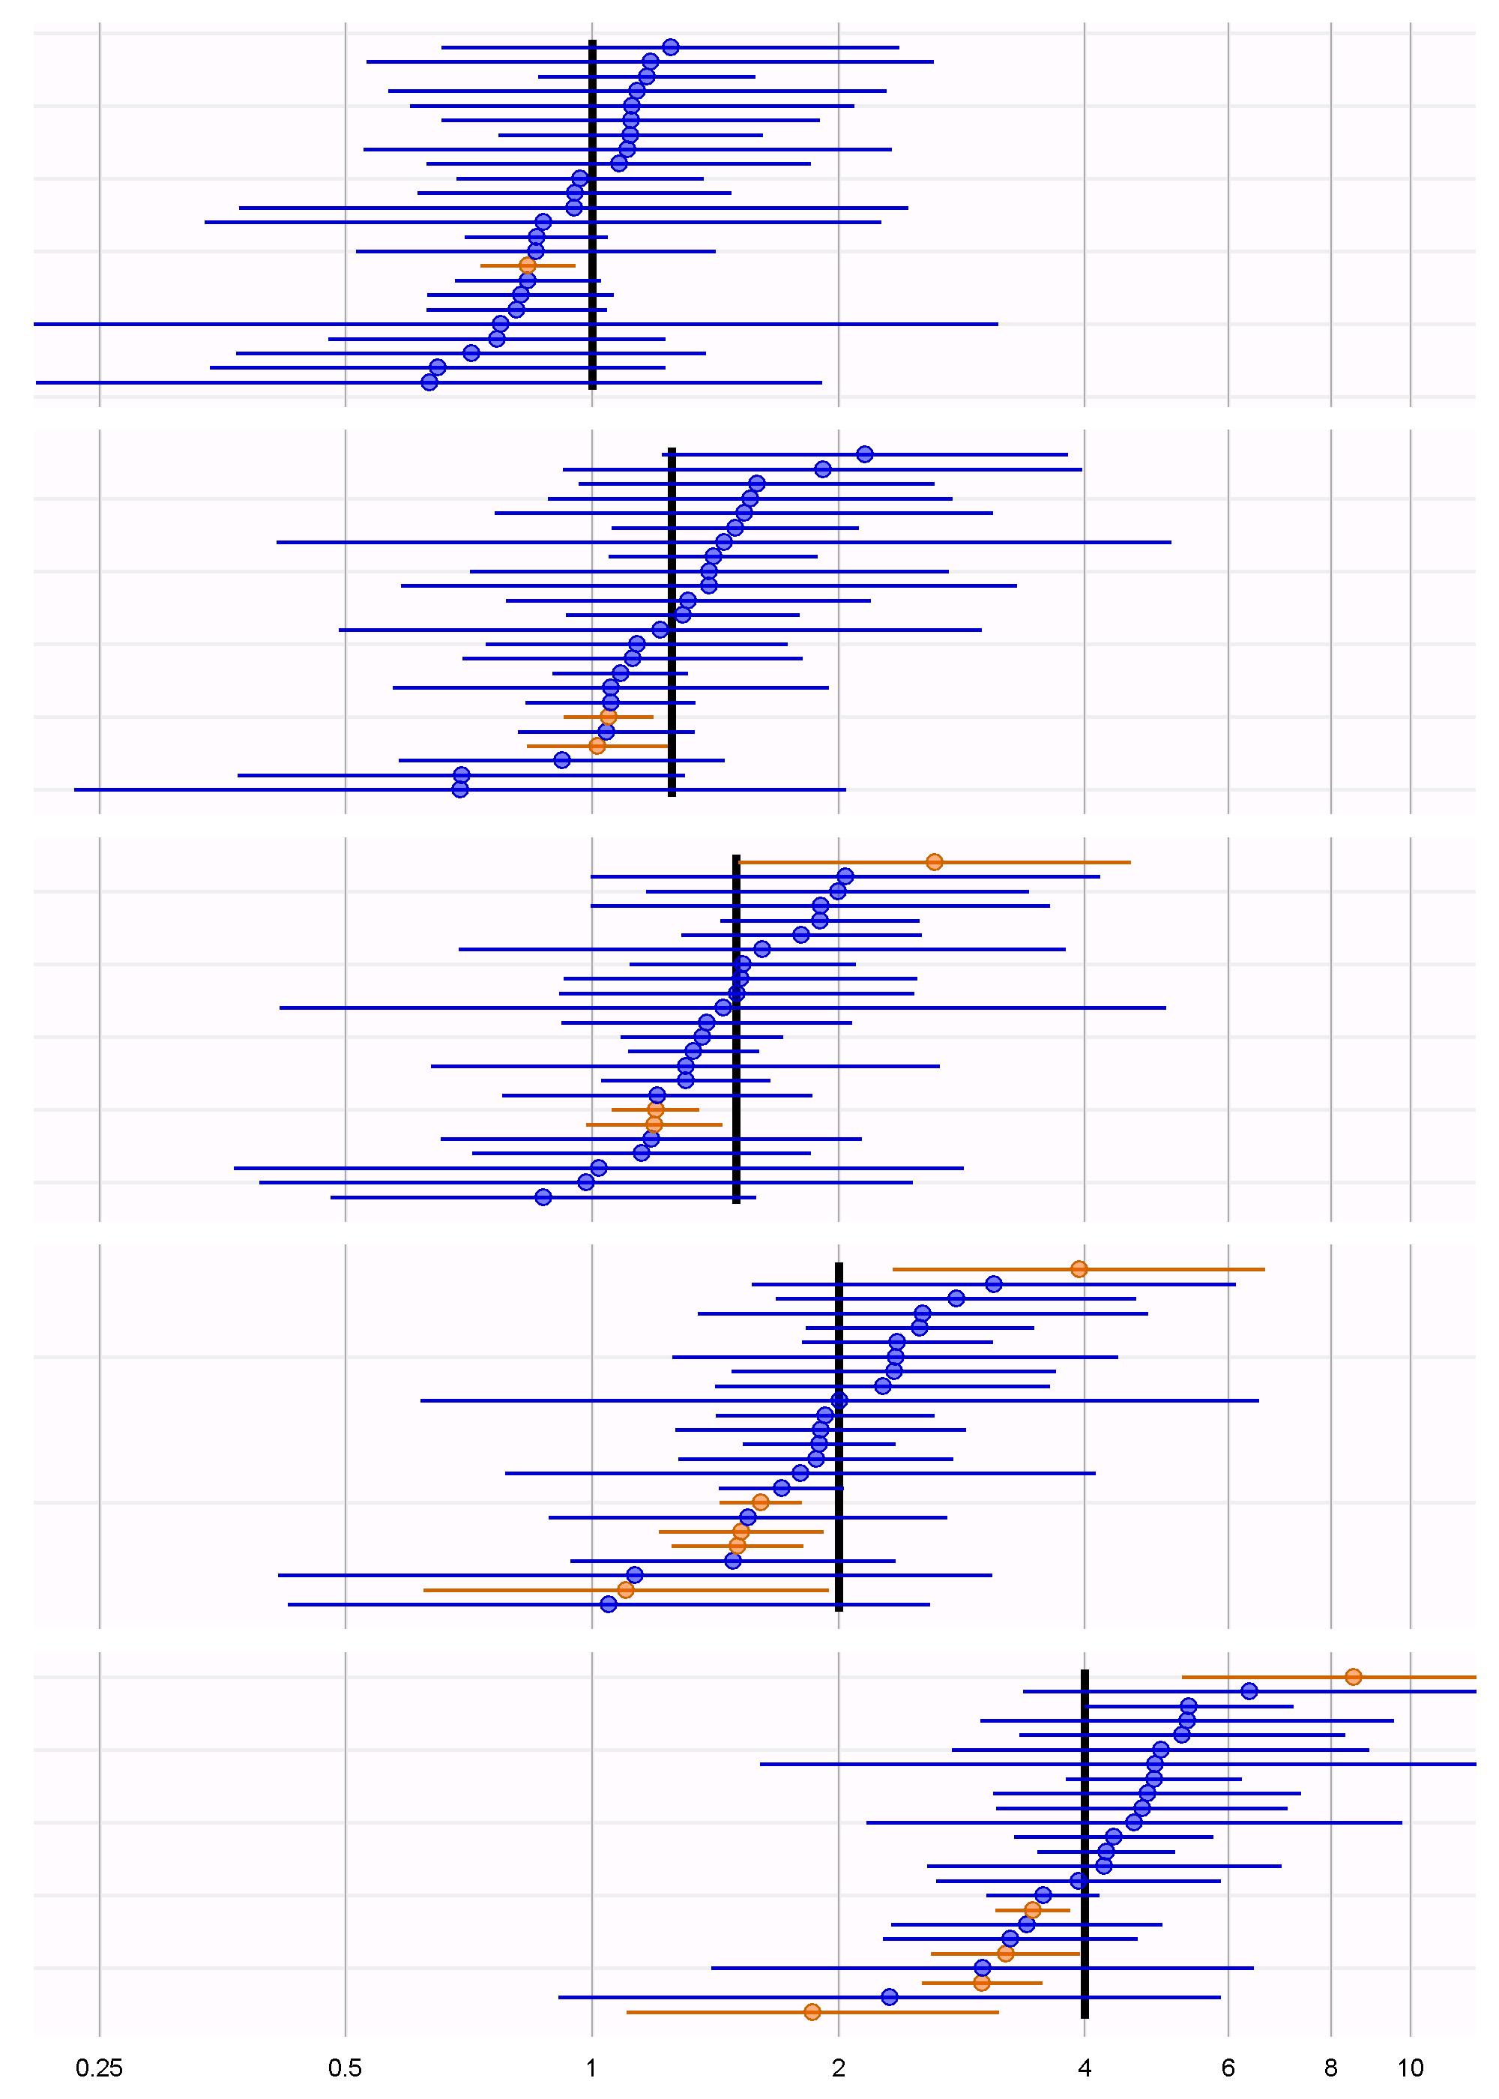
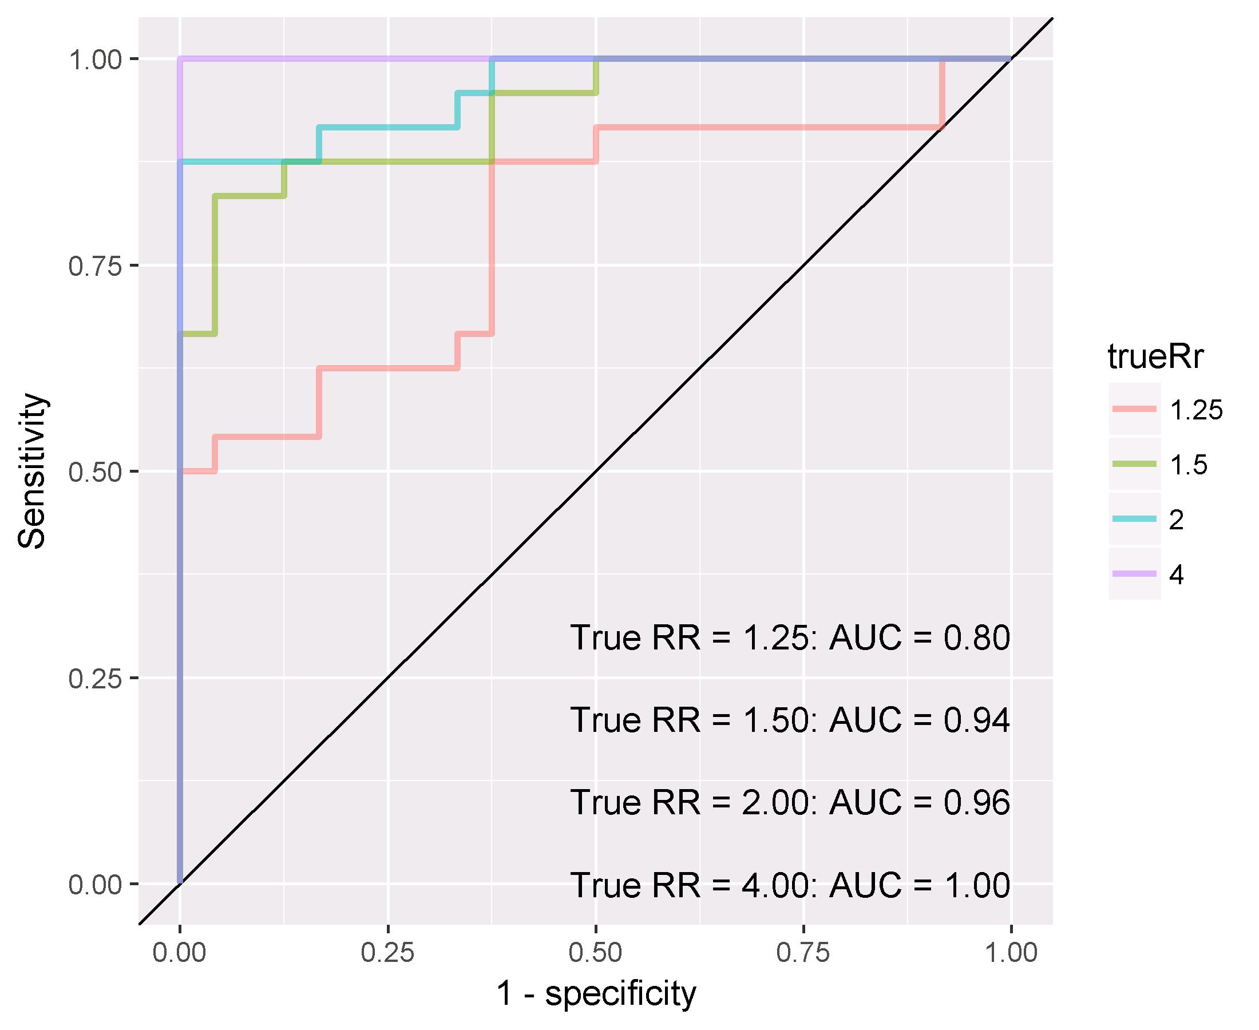
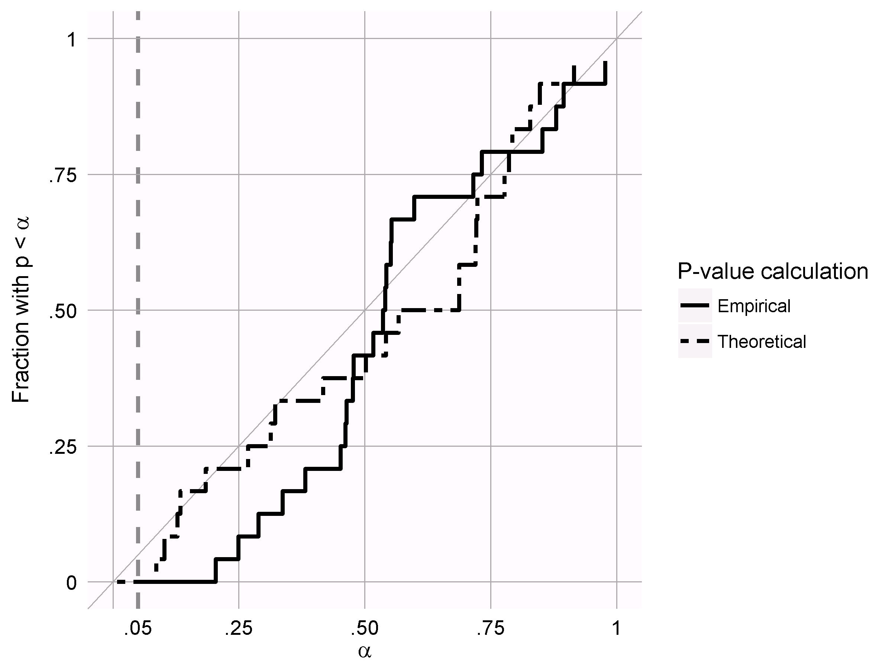
Results
CSCCS
Exposure matched cases, unadjusted model
True RR | AUC | Coverage
1 |  | 0.96
1.25 | 0.80 | 0.92
1.5 | 0.94 | 0.88
2 | 0.96 | 0.79
4 | 1.00 | 0.79

Slide 13
Discussion
Additonal CSCCS specification variants for evaluation
Pre-exposure window for contra-indications
Age and seasonality for time-varying confounding
Event dependent exposure distribution and/or observation period censoring
Comparative cohort study settings for evaluation
Other variants for comparison?
Compare CSCCS and comparative cohort study time-at-risk
Methods evaluation framework
Other evaluation metrics?
Test new methods vs. existing methods that are considered “good”?
Alternative frameworks?

Slide 14
Discussion
Questions?

